Slide 1


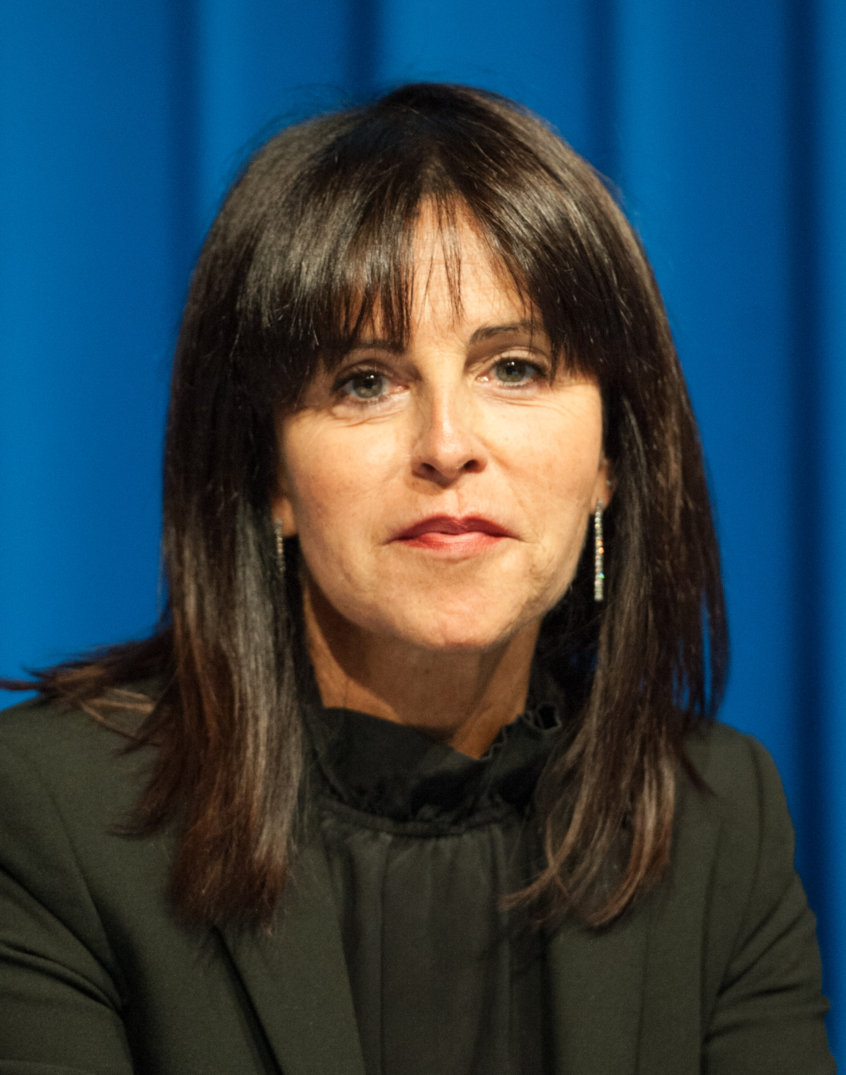
Welcome & Introduction
Silvia Novello, MD, PhD
San Luigi Hospital (part of University of Turin), Orbassano, Italy
0724-BGB-A317-MRC-022
Approved: 30 August 2024

Slide 2
Disclosures
COI | Sponsor
Speaker’s Bureau, Advisory Board, Consultant | Amgen, AstraZeneca, Boehringer Ingelheim, BeiGene, Eli Lilly, Pfizer, Roche, MSD, Janssen, Thermo Fisher, Novartis, Pierre Fabre, Takeda
Advisory Board, Consultant | Sanofi
COI, conflict of interest.

Slide 3




Chairs and Speakers
Prof. Silvia Novello (Co-chair)
San Luigi Hospital (part of University of Turin), Orbassano, Italy
Prof. Tony Mok (Co-chair)
Li Shu Fan Medical Foundation
Professor of Clinical Oncology
The Chinese University of Hong Kong
Dr. Mariano Provencio
Hospital Universitario Puerta de Hierro Majadahonda,
Autonomous University Madrid, Spain
Dr. Luis Paz-Ares
Hospital Universitario “12 de Octubre”
Universidad Complutense de Madrid
Lung Cancer Unit at National Oncology Research Center
Prof. Martin Reck
Lung Clinic Grosshansdorf,
Grosshansdorf, Germany

Slide 4


A new comprehensive approach to lung cancer treatment
Agenda
Co-Chairs & Speakers
Welcome and introduction
13.00
Silvia Novello (Co-chair)
Resectable NSCLC – neo-adjuvant / adjuvant
13.05
Mariano Provencio
Debate: Single agent IO is the only treatment option for NSCLC
with PD-L1 high expression
13.20
PRO – Martin Reck
CON – Tony Mok
What to do in NSCLC with low PD-1 expression?
13.50
Luis Paz-Ares
1L SCLC
14.05
Silvia Novello
General panel discussion / audience Q&A
14.20
All
Take-home message and farewell
14.29
Tony Mok (Co-chair)
Notes:
00:10 – 00:19 = 9s
Text ist aktuell Platzhalter, korrekter Text folgt von BeiGene

Slide 5

SCAN QR CODE NOW!
Allows you to:
Ask your questions to the faculty.
Provide your feedback and help BeiGene to better meet your educational needs in the future.

Slide 6
Disclaimers
The views expressed are those of the speakers and may not necessarily reflect the opinion of BeiGene.
The material may contain information about products or indications that have not yet been approved in your country; for prescriptions, always refer to the product information approved in your country, as well as, where applicable, the reimbursement conditions.
This material is intended for Healthcare Professionals for scientific information exchange purposes only, not for advertising purposes, and does not constitute commercial promotion of any product or recommendation on diagnosis and treatments. The speakers’ opinions are those of experts and do not necessarily reflect those of BeiGene.
As part of scientific exchange patient cases prepared by healthcare professionals will be presented. The presentation includes patient cases that may include information about products or indications that have not yet been approved in your country; for prescriptions, always refer to the product information approved in your country, as well as, where applicable, the reimbursement conditions. Generalized conclusions should never be drawn from individual patient cases.

Slide 7
Resectable NSCLC – neo-adjuvant/adjuvant
(RATIONALE-315)
Mariano Provencio, MD, PhD
Hospital Universitario Puerta de Hierro Majadahonda,
Autonomous University Madrid, Spain
0724-BGB-A317-MRC-019
Approved: 30 August 2024

Slide 8
Disclosures
COI | Sponsor
Honoraria | BMS, AstraZeneca, MSD, Roche, Takeda, Eli Lilly, F. Hoffmann-La Roche, Janssen, Pfizer, Amgen
Research funding | MSD, AstraZeneca, Roche, BMS, Takeda, Boehringer Ingelheim, Amgen, Pfizer
Advisory boards | BMS, Roche, MSD, AstraZeneca, Takeda, Eli Lilly, Janssen, F. Hoffmann-La Roche, Pfizer
Speakers’ bureau | BeiGene, BMS, Roche, MSD, AstraZeneca, Takeda, Eli Lilly, Janssen, F. Hoffmann-La Roche, Pfizer
Other | Support for attending meetings and/or travel: BMS, AstraZeneca, MSD, Roche, Takeda, Eli Lilly, F. Hoffmann-La Roche, Janssen, Pfizer, Amgen, Boehringer Ingelheim, Pierre Fabre Pharmaceuticals, Janssen
COI, conflict of interest.

Slide 9
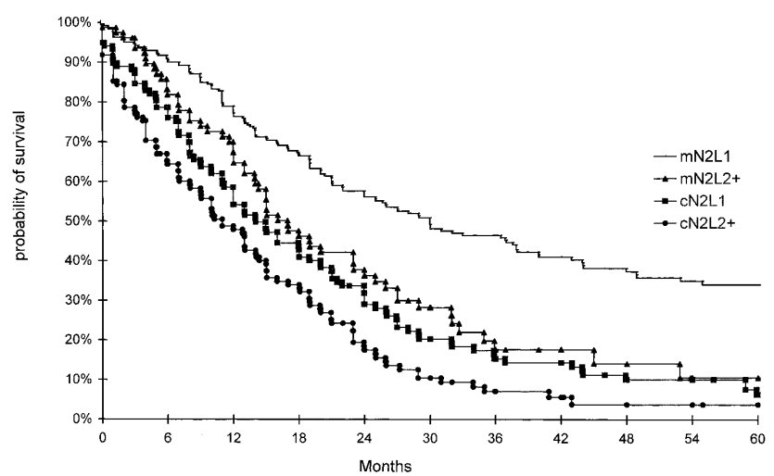
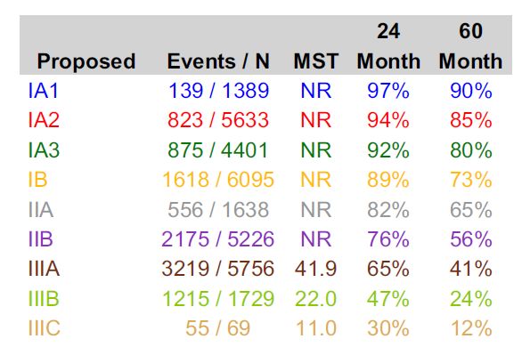

Surgery gives the best chance to cure early-stage NSCLC but recurrence is common
5-year tumor recurrence rate up to 67% (depending on disease stage)¹⁻⁷
Survival of patients with N2 disease treated with primary surgery
according to N2 status and number of levels involved⁷
Overall survival by clinical stage⁶
24
Month
60
Month
Stage
Events / N
MST
cN2, clinical ipsilateral mediastinal lymph node involvement; mN2, minimal N2; MST, median survival time; NR, not reached; NSCLC, non-small cell lung cancer.
Extracted from 1) Uramoto H and Tanaka F. Transl Lung Cancer Res. 2014;3(4):242-249; 2) Kelsey CR et al. Cancer 2009;115(22):5218-5227; 3) Gourcerol D et al. Eur Respir J. 2013;42(5):1357-1364;
4) NCCN Clinical Practice Guidelines in Oncology (NCCN Guidelines®) Non-Small Cell Lung Cancer: Version 5 2023. nscl.pdf (nccn.org); 5) West H et al. Clin Lung Cancer. 2023;24(3):260-268;
6) Goldstraw P et al. J Thorac Oncol. 2016;11(1):39-51; 7) André F et al. J Clin Oncol. 2000;18(16):2981-9.

Slide 10
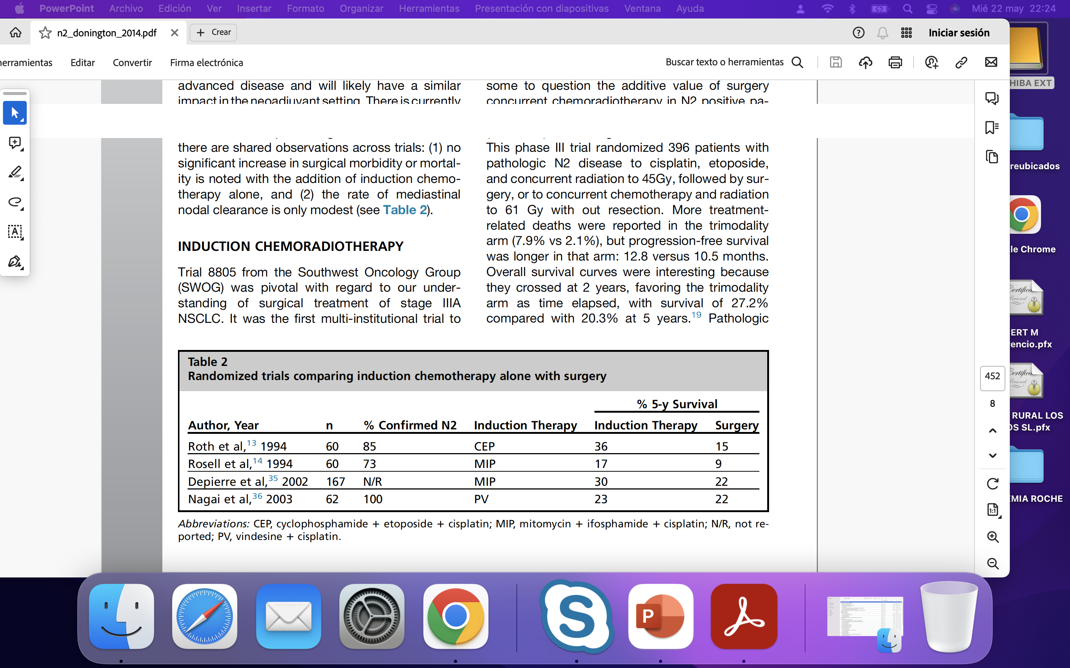

Induction treatment in the pre-IO era
Quite small trials
Many patients not considered Stage IIIA now
Survival differences were significant
Ideal approach: induction Chemo vs concurrent Chemo-RT?
CEP, cyclophosphamide + etoposide + cisplatin; Chemo, chemotherapy; IO, immuno-oncology; MIP, mitomycin + ifosphamide + cisplatin; N/R, not reported; PV, vindesine + cisplatin; RT, radiotherapy.
Extracted from Donington JS, Pass HI. Thorac Surg Clin. 2014; 24(4):449-456.

Slide 11
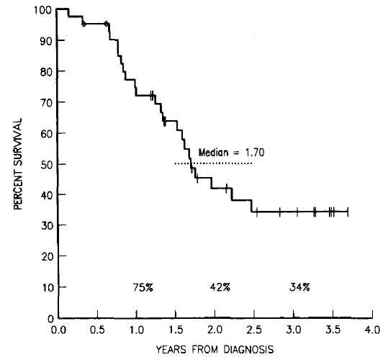
Little progress in outcomes in 30 years pre-IO
Survival from diagnosis for 41 patients treated with chemotherapy¹
OS probability for patients with stage III NSCLC²
3-year OS: 34%
R0 surgery: 75%
1988
OS: 36.8%
EFS:12.4 m
R0 Surgery: 80%
2022
EFS, event-free survival; IO, immuno-oncology; OS, overall survival.
Extracted from 1) Martini N et al. Ann Thorac Surg. 1988;45(4):370-9; 2) König D et al. ESMO Open. 2022;7(2):100455 (supplementary appendix).

Slide 12
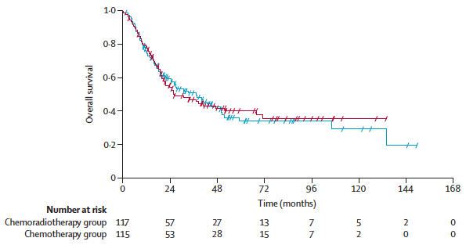
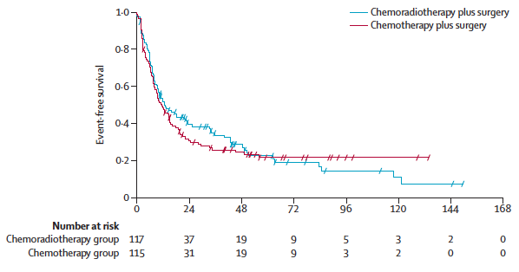
Radiotherapy did not add benefit to induction chemotherapy and surgery
Interpretation: Radiotherapy did not add any benefit to induction chemotherapy followed by surgery. We suggest that one definitive local treatment modality combined with neoadjuvant chemotherapy is adequate to treat resectable stage IIIA/N2 non-small-cell lung cancer
OS
EFS
Ch-RT, chemoradiotherapy; EFS, event-free survival; NSCLC, non-small cell lung cancer; OS, overall survival.
Extracted from Pless M et al. Lancet. 2015;386(9998):1049-56.

Slide 13
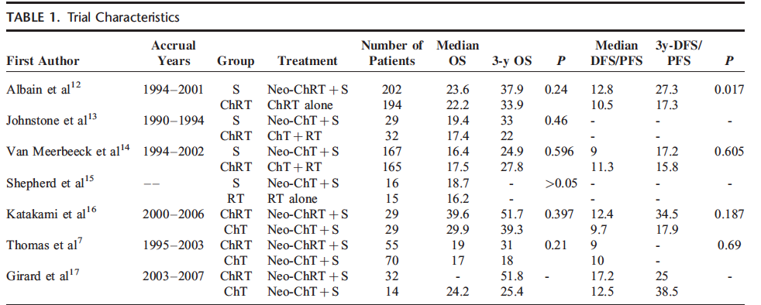
Neoadjuvant chemoradiotherapy does not improve survival compared with neoadjuvant chemotherapy alone
ChT, chemotherapy; ChRT, chemoradiotherapy; DFS, disease-free survival; Neo, neoadjuvant; OS, overall survival; PFS, progression-free survival; S, surgery.
Extracted from Xu Y-P et al. Medicine (Baltimore) 2015;94(23):e879.

Slide 14
New data?
Where do the data come from?
Notes:
What new data do we have?

Slide 15

PAST
PRESENT
5.4% Adjuvant benefit¹
NADIM I-II^{9,10}
CheckMate 816¹¹
KeyNote 671¹², CheckMate 77T¹³
AEGEAN¹⁴, NEOTORCH¹⁵, RATIONALE-315¹⁶
4-8% pCR²
3-year OS: 34%³
RT did not add
any benefit⁴
GECP
EFS: 9.9 m⁵
3-year OS: 36.8%⁵
EFS: 12.4 m⁶
5-year OS: 36.8%⁶
Beva/erlonitib No⁷
30% treated
With Ch-RT⁸
Extracted from 1) Pignon J et al. J Clin Oncol. 2008;26(21):3552-9; 2) Hellmann MD et al. Lancet Oncol. 2014;15(1):e42-50;
3) Martini N et al. Ann Thorac Surg. 1988;45(4):370-9; 4) Xu Y-P et al. Medicine (Baltimore) 2015;94(23):e879;
5) Garrido P et al. J Clin Oncol. 2007;25(30):4736-42; 6) König D et al. ESMO Open. 2022;7(2):100455; 7) Socinski MA et al. J Clin Oncol. 2012;30(32):3953-9; 8) Provencio M et al. Transl Lung Cancer Res. 2023;12(10):2113-2128; 9) Provencio M et al. Lancet Oncol. 2020;21(11):1413-1422; 10) Provencio M et al. N Engl J Med. 2023;389(6):504-513; 11) Forde PM et al. N Engl J Med. 2022;386(21):1973-1985; 12) Wakelee H et al. N Engl J Med. 2023;389(6):491-503; 13) Cascone T et al. N Engl J Med. 2024;390:1756-1769; 14) Heymach JV et al. N Engl J Med 2023;389:1672-1684; 15) Lu S et al. JAMA. 2024;331(3):201-211; 16) Yue D et al. Presented at the ESMO Virtual Plenary with AACR Expert Commentary; February 15&16, 2024 (Accessed 17 July 2024). Available at: Yue_BGB-A317-315_ESMO-VP_Presentation_2024.pdf.
Ch-RT, chemoradiotherapy; EFS, event-free survival; OS, overall survival; pCR, pathologic complete response; RT, radiotherapy.

Slide 16
Neoadjuvant/perioperative chemo-IO treatment
New key aspects
  Pathologic response
  Surgical aspects
  Survival
IO, immuno-oncology.

Slide 17
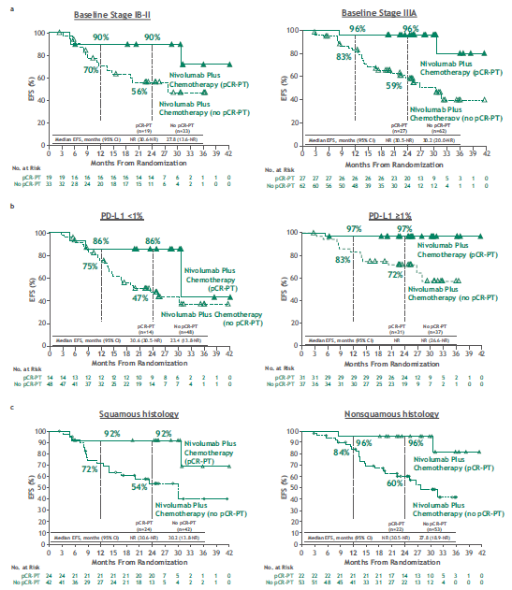
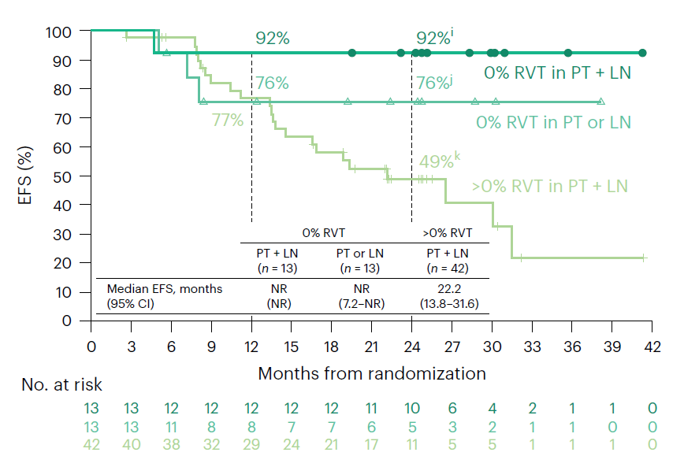
Pathologic response may be a surrogate for survival after neoadjuvant chemoimmunotherapy
CI, confidence interval; EFS, event-free survival; LN, lymph node; NR, not reached; pCR, pathologic complete response; PD-L1, programmed death ligand 1; PT, primary tumor; RVT, residual viable tumor.
Extracted from Deutsch JS et al. Nature Medicine. 2024;30:218–228.

Slide 18
RATIONALE-315: Event-Free Survival (EFS) and Overall Survival (OS) of Neoadjuvant Tislelizumab (TIS) plus Chemotherapy (CT) with Adjuvant TIS in Resectable Non-Small Cell Lung Cancer (NSCLC)
Presented here at ESMO on Friday 13 September (VP1-2024):
Dr Yue
Dongsheng Yue,¹ Wenxiang Wang,² Hongxu Liu,³ Qixun Chen,⁴ Chun Chen,⁵ Lunxu Liu,⁶
Peng Zhang,⁷ Guofang Zhao,⁸ Fan Yang,⁹ Guang Han,¹⁰ Ying Cheng,¹¹ Bentong Yu,¹² Yue Yang,¹³ Haiquan Chen,¹⁴ Jie Jiang,¹⁵ Bin Yao,¹⁶ Shengfei Wang,¹⁷ Ruihua Wang,¹⁷ Wenjuan Zheng,¹⁶
Changli Wang¹ on behalf of the RATIONALE-315 Investigators
¹Tianjin Medical University Cancer Institute and Hospital, Tianjin, China; ²Hunan Cancer Hospital, Hunan, China; ³Liaoning Cancer Hospital and Institute, Shenyang, China; ⁴Zhejiang Cancer Hospital, Hangzhou, China; ⁵Fujian Medical University Union Hospital, Fuzhou, China; ⁶West China Hospital, Sichuan University, Chengdu, China; ⁷Shanghai Pulmonary Hospital, Tongji University School of Medicine, Shanghai, China; ⁸Ningbo No.2 Hospital, Ningbo, China; ⁹Peking University People’s Hospital, Beijing, China; ¹⁰Hubei Cancer Hospital, Wuhan, China; ¹¹Jilin Cancer Hospital, Changchun, China; ¹²The First Affiliated Hospital of Nanchang University, Nanchang, China; ¹³Beijing Cancer Hospital, Beijing, China; ¹⁴Fudan University Shanghai Cancer Center, Shanghai, China; ¹⁵The First Affiliated Hospital of Xiamen University, Xiamen, China; ¹⁶BeiGene (Beijing) Co., Ltd, Beijing, China; ¹⁷BeiGene (Shanghai) Co., Ltd, Shanghai, China
Tislelizumab no está comercializado aún en España.
Extracted from Yue D, Wang W, Liu H, Chen Q, Chen C, Liu L, Zhang P et al. RATIONALE-315: Event-Free Survival (EFS) and Overall Survival (OS) of Neoadjuvant Tislelizumab (TIS) plus Chemotherapy (CT) with Adjuvant TIS in Resectable Non-Small Cell Lung Cancer (NSCLC). Presented at the ESMO Virtual Plenary with AACR Expert Commentary; February 15&16, 2024 (Accessed 17 July 2024). Available at: Yue_BGB-A317-315_ESMO-VP_Presentation_2024.pdf.
18

Slide 19
RATIONALE-315 Study Design
Neoadjuvant phase
(3-4 cycles)
Surgery
Adjuvant phase
(up to 8 cycles^{b})
Key eligibility criteria
Resectable stage II-IIIA NSCLC per AJCC 8th edition (eligible for R0 resection)
ECOG PS 0 or 1
EGFR/ALK WTª
Stratification
Histology (squamous vs
non-squamous)
Disease stage (II vs IIIA)
PD-L1 expression (≥1% vs <1%/not evaluable/indeterminate)
Primary endpoints:
MPR rate by BIPR and EFS by BICR
Key secondary endpoint:
pCR rate by BIPR
Other secondary endpoints:
OS, EFS by investigator, safety (and others not reported here)
TIS Arm
TIS
(200 mg IV Q3W)
+ PtDb CT
Surgery
TIS
(400 mg IV Q6W)
R 1:1
PBO (IV Q3W) + PtDb CT
Surgery
PBO
(IV Q6W)
PBO Arm
PtDb CT
Squamous: cisplatin/carboplatin + paclitaxel
Non-squamous: cisplatin/carboplatin + pemetrexed
Data cut-off: August 21, 2023 (median study follow-up: 22.0 months [range: 0.1, 38.4]).
ClinicalTrials.gov Identifier: NCT04379635.
ª EGFR testing was mandatory for non-squamous NSCLC. ^{b} Adjuvant treatment was only received by patients with an ECOG PS of 0 or 1 and adequate organ function for ≤8 cycles or until disease recurrence/progression, unacceptable adverse events, or death occurs, or if the patient and/or investigator decided to discontinue study treatment.
Abbreviations: ALK, anaplastic large-cell lymphoma kinase; BICR, blinded independent central review; BIPR, blinded independent pathology review; ECOG PS, Eastern Cooperative Oncology Group performance status; EFS, event-free survival; EGFR, epidermal growth factor receptor; IV, intravenously; MPR, major pathological response; NSCLC, non-small cell lung cancer; OS, overall survival; PBO, placebo; pCR, pathological complete response; PD-L1, programmed death-ligand 1; PtDb CT, platinum-based doublet chemotherapy; Q3W, once every 3 weeks; Q6W, once every 6 weeks; R, randomised; R0, pathological complete resection of the primary tumour; TIS, tislelizumab; WT, wild-type.
19
Extracted from Yue D, Wang W, Liu H, Chen Q, Chen C, Liu L, Zhang P et al. RATIONALE-315: Event-Free Survival (EFS) and Overall Survival (OS) of Neoadjuvant Tislelizumab (TIS) plus Chemotherapy (CT) with Adjuvant TIS in Resectable Non-Small Cell Lung Cancer (NSCLC). Presented at the ESMO Virtual Plenary with AACR Expert Commentary; February 15&16, 2024 (Accessed 17 July 2024). Available at: Yue_BGB-A317-315_ESMO-VP_Presentation_2024.pdf

Slide 20
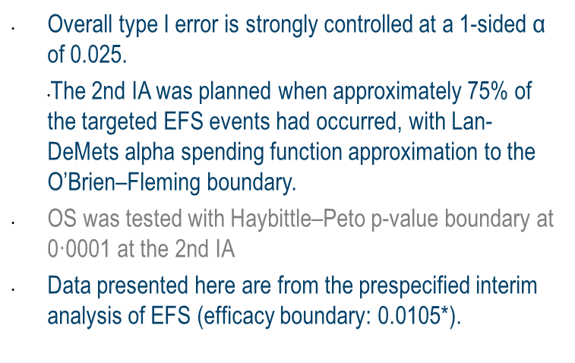
Statistical Considerations
Overall type I error was strongly controlled at a one-sided alpha of 0.025
The interim analysis for EFS was planned for when ~75% of the targeted EFS events (184 EFS events) had occurred, with Lan-DeMets α spending function approximation to the O’Brien–Fleming boundary
The OS interim analysis was to be tested with Haybittle–Peto P-value boundary at 0.0001 at this interim analysis
Type I Error Control Scheme
One-sided α = 0.025
α = 0.005
α = 0.02
MPR of TIS vs PBO
α = 0.005
If pCR is positive, α = 0.005
pCR of TIS vs PBO
EFS of TIS vs PBO
If EFS is positive, α = 0.02
If MPR, pCR, and EFS are positive, α = 0.025
OS of TIS vs PBO
Abbreviations: EFS, event-free survival; MPR, major pathological response; OS, overall survival; PBO, placebo; pCR, pathological complete response; TIS, tislelizumab.
20
Extracted from Yue D, Wang W, Liu H, Chen Q, Chen C, Liu L, Zhang P et al. RATIONALE-315: Event-Free Survival (EFS) and Overall Survival (OS) of Neoadjuvant Tislelizumab (TIS) plus Chemotherapy (CT) with Adjuvant TIS in Resectable Non-Small Cell Lung Cancer (NSCLC). Presented at the ESMO Virtual Plenary with AACR Expert Commentary; February 15&16, 2024 (Accessed 17 July 2024). Available at: Yue_BGB-A317-315_ESMO-VP_Presentation_2024.pdf

Slide 21
Patient Disposition (ITT Analysis Set)
N=453 patients randomised
15 (6.6%) discontinued
neoadjuvant txª
17 (7.5%) discontinued neoadjuvant txª
Adverse event | 7 (3.1%)
Patient withdrawal | 5 (2.2%)
Progressive disease | 2 (0.9%)
Physician decision | 1 (0.4%)
TIS arm N=226
PBO arm N=227
Adverse event | 2 (0.9%)
Patient withdrawal | 9 (4.0%)
Progressive disease | 4 (1.8%)
Physician decision | 2 (0.9%)
226 (100.0%) received neoadjuvant txª
211 (93.4%) completed neoadjuvant txª 130 (57.5%) received 3 cycles of TIS 78 (34.5%) received 4 cycles of TIS
226 (99.6%) received neoadjuvant txª
210 (92.5%) completed neoadjuvant txª 118 (52.2%) received 3 cycles of PBO 91 (40.3%) received 4 cycles of PBO
36 (15.9%) had surgery cancelledª
54 (23.8%) had surgery cancelledª
Patient withdrawal | 20 (8.8%)
Progressive disease | 6 (2.7%)
Adverse event | 6 (2.7%)
Physician decision | 3 (1.3%)
Other^{b} | 1 (0.4%)
Patient withdrawal | 28 (12.3%)
Progressive disease | 17 (7.5%)
Adverse event | 2 (0.9%)
Physician decision | 7 (3.1%)
190 (84.1%) received definitive surgeryª
173 (76.2%) received definitive surgeryª
22 (9.7%) did not receive adjuvant txª
26 (11.5%) did not receive adjuvant txª
Patient withdrawal | 10 (4.4%)
Adverse event | 7 (3.1%)
Physician decision | 4 (1.8%)
Progressive disease | 1 (0.4%)
Patient withdrawal | 13 (5.7%)
Adverse event | 4 (1.8%)
Physician decision | 7 (3.1%)
Progressive disease | 2 (0.9%)
168 (74.3%) received adjuvant TISª
106 (46.9%) completed adjuvant txª 11 (4.9%) adjuvant TIS ongoing
147 (64.8%) received adjuvant PBOª
101 (44.5%) completed adjuvant PBOª 8 (3.5%) adjuvant PBO ongoing
51 (22.6%) discontinued
adjuvant txª
38 (16.7%) discontinued adjuvant txª
Progressive disease | 20 (8.8%)
Adverse event | 15 (6.6%)
Patient withdrawal | 9 (4.0%)
Physician decision | 7 (3.1%)
Data cut-off: August 21, 2023
Median study follow-up: 22.0 months (range: 0.1, 38.4)
Progressive disease | 32 (14.1%)
Adverse event | 4 (1.8%)
Patient withdrawal | 2 (0.9%)
The ITT analysis set included all randomised patients. ª Denominator based on randomised patients. ^{b} Patient was reported to cancel surgery due to lost to follow-up.
Abbreviations: ITT, intention-to-treat; PBO, placebo; TIS, tislelizumab; tx, treatment.
21
Extracted from Yue D, Wang W, Liu H, Chen Q, Chen C, Liu L, Zhang P et al. RATIONALE-315: Event-Free Survival (EFS) and Overall Survival (OS) of Neoadjuvant Tislelizumab (TIS) plus Chemotherapy (CT) with Adjuvant TIS in Resectable Non-Small Cell Lung Cancer (NSCLC). Presented at the ESMO Virtual Plenary with AACR Expert Commentary; February 15&16, 2024 (Accessed 17 July 2024). Available at: Yue_BGB-A317-315_ESMO-VP_Presentation_2024.pdf

Slide 22
Demographics and Baseline Characteristics
ITT Analysis Set
 | TIS arm (N=226) | PBO arm (N=227)
Age, median (IQR), years | 62.0 (57.0, 67.0) | 63.0 (56.0, 68.0)
Male sex, n (%) | 205 (90.7) | 205 (90.3)
Asian race, n (%) | 226 (100.0) | 227 (100.0)
ECOG PS, n (%)ª
0 | 142 (62.8) | 154 (67.8)
1 | 83 (36.7) | 73 (32.2)
Smoking status, n (%)
Current/former | 193 (85.4) | 190 (83.7)
Never | 33 (14.6) | 37 (16.3)
Histology, n (%)^{b}
Squamous | 179 (79.2) | 175 (77.1)
Non-squamous | 45 (19.9) | 50 (22.0)
Disease stage, n (%)
II | 92 (40.7) | 91 (40.1)
IIIA | 132 (58.4) | 133 (58.6)
cN status, n (%)^{c}
N0 | 60 (26.5) | 54 (23.8)
N1 | 84 (37.2) | 93 (41)
N2 | 82 (36.3) | 79 (34.8)
PD-L1 expression, n (%)^{d}
<1% | 89 (39.4) | 84 (37.0)
≥1% | 130 (57.5) | 132 (58.1)
Not evaluable/indeterminate | 7 (3.1) | 11 (4.8)
ª One patient in the TIS arm had a missing ECOG PS. ^{b} Histology by CRF; patients with mixed histology were categorised as ‘Other’ (n=2 [0.9%] in each arm). ^{c} One patient was enrolled (PBO arm) with N3. ^{d} PD-L1 expression from Central Lab.
Abbreviations: CRF, case report form; ECOG PS, Eastern Cooperative Oncology Group performance status; IQR, interquartile range; ITT, intention-to-treat; PBO, placebo; PD-L1, programmed death-ligand 1; TIS, tislelizumab; cN, clinical N.
22
Extracted from Yue D, Wang W, Liu H, Chen Q, Chen C, Liu L, Zhang P et al. RATIONALE-315: Event-Free Survival (EFS) and Overall Survival (OS) of Neoadjuvant Tislelizumab (TIS) plus Chemotherapy (CT) with Adjuvant TIS in Resectable Non-Small Cell Lung Cancer (NSCLC). Presented at the ESMO Virtual Plenary with AACR Expert Commentary; February 15&16, 2024 (Accessed 17 July 2024). Available at: Yue_BGB-A317-315_ESMO-VP_Presentation_2024.pdf

Slide 23
Major Pathological and Pathological Complete Responses
Per BIPR (ITT Analysis Set)
MPRª
Difference=41.1% (95% CI: 33.2, 49.1); P<0.0001
pCR^{b}
Difference=35.0% (95% CI: 27.9, 42.1); P<0.0001
Neoadjuvant TIS + PtDb CT showed a statistically significant and clinically meaningful improvement in MPR and pCR rates vs neoadjuvant PBO + PtDb CT
Final MPR and pCR analysis at the February 20, 2023, cut-off. Patients who did not receive surgical resection were considered non-responders. ª MPR was defined as the proportion of patients with ≤10% residual viable tumour in the resected primary tumour and resected lymph nodes after completion. ^{b} pCR was defined as the proportion of patients absent of residual viable tumour in the resected primary tumour and resected lymph nodes after treatment.
Abbreviations: BIPR, blinded independent pathology review; CI, confidence interval; CT, chemotherapy; ECOG PS, Eastern Cooperative Oncology Group Performance Status; ITT, intention-to-treat; MPR, major pathological response; NSCLC, non-small cell lung cancer; OR, odds ratio; PBO, placebo; PD-L1, programmed-death ligand 1; pCR, pathological complete response; PtDb, platinum-based doublet; TIS, tislelizumab. Yue D, et al. Presented at ESMO, Madrid, Spain; October 23, 2023.
23
Extracted from Yue D, Wang W, Liu H, Chen Q, Chen C, Liu L, Zhang P et al. RATIONALE-315: Event-Free Survival (EFS) and Overall Survival (OS) of Neoadjuvant Tislelizumab (TIS) plus Chemotherapy (CT) with Adjuvant TIS in Resectable Non-Small Cell Lung Cancer (NSCLC). Presented at the ESMO Virtual Plenary with AACR Expert Commentary; February 15&16, 2024 (Accessed 17 July 2024). Available at: Yue_BGB-A317-315_ESMO-VP_Presentation_2024.pdf

Slide 24
Event-Free Survival
 | Events (%) | Median (95% CI), months | HR (95% CI) | P-value
TIS arm | 58 (25.7) | NR (NE, NE) | 0.56 (0.40, 0.79) | 0.0003
PBO arm | 83 (36.6) | NR (16.6, NE)
Per BICR (ITT Analysis Set)
100
80.0%
TIS arm
PBO arm
90
80
68.3%
70
EFS (%)
60
68.1%
50
51.8%
40
30
20
10
0
0
3
6
9
12
15
18
21
24
27
30
33
36
39
Number at risk:
TIS arm
PBO arm
Time from randomisation (months)
226
227
196
187
176
149
160
129
146
113
127
95
105
77
84
57
67
42
37
24
35
23
10
4
3
2
0
0
A statistically significant and clinically meaningful improvement in EFS (HR=0.56 [95% CI: 0.40, 0.79]; one-sided P=0.0003) was observed favouring perioperative TIS
A clinically meaningful improvement in EFS per investigator (HR=0.55 [95% CI: 0.39, 0.77]) was also observed
Analysis occurred at the August 21, 2023, cut-off. EFS was defined as the time from randomisation until any of the following, whichever occurred first: disease progression precluding surgery, local or distant recurrence, or death due to any cause. The significance boundary of the EFS interim analysis was 0.0105 (calculated based on 141 actual EFS events).
Abbreviations: CI, confidence interval; BICR, blinded independent central review; EFS, event-free survival; HR, hazard ratio; ITT, intention-to-treat; NE, not evaluable; NR, not reached; PBO, placebo; TIS, tislelizumab.
24
Extracted from Yue D, Wang W, Liu H, Chen Q, Chen C, Liu L, Zhang P et al. RATIONALE-315: Event-Free Survival (EFS) and Overall Survival (OS) of Neoadjuvant Tislelizumab (TIS) plus Chemotherapy (CT) with Adjuvant TIS in Resectable Non-Small Cell Lung Cancer (NSCLC). Presented at the ESMO Virtual Plenary with AACR Expert Commentary; February 15&16, 2024 (Accessed 17 July 2024). Available at: Yue_BGB-A317-315_ESMO-VP_Presentation_2024.pdf

Slide 25
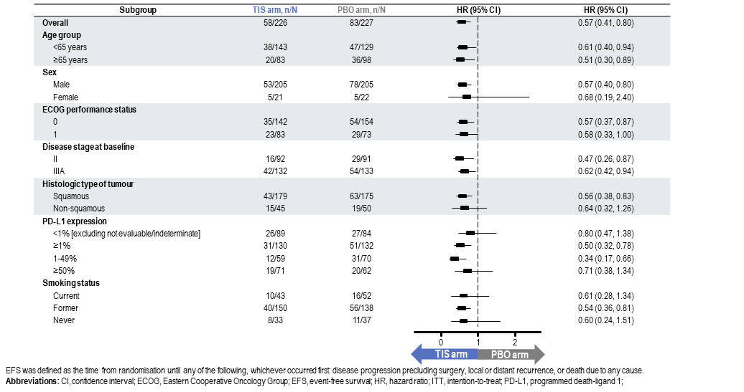
Event-Free Survival By Subgroups
ITT Analysis Set
The EFS benefit with perioperative TIS over PBO was generally consistent across prespecified subgroups
25
Extracted from Yue D, Wang W, Liu H, Chen Q, Chen C, Liu L, Zhang P et al. RATIONALE-315: Event-Free Survival (EFS) and Overall Survival (OS) of Neoadjuvant Tislelizumab (TIS) plus Chemotherapy (CT) with Adjuvant TIS in Resectable Non-Small Cell Lung Cancer (NSCLC). Presented at the ESMO Virtual Plenary with AACR Expert Commentary; February 15&16, 2024 (Accessed 17 July 2024). Available at: Yue_BGB-A317-315_ESMO-VP_Presentation_2024.pdf

Slide 26
Event-Free Survival By Histology
ITT Analysis Set
Squamous
Non-squamous
100
100
90
79.8%
TIS arm
PBO arm
90
80.3%
TIS arm
PBO arm
80
70.2%
80
70
70
60.8%
60
60
EFS (%)
70.5%
EFS (%)
61.4%
50
52.2%
50
52.1%
40
40
30
 | Events (%) | Median (95% CI), months | HR (95% CI)
TIS arm | 43 (24.0) | NR (NE, NE) | 0.56 (0.38, 0.83)
PBO arm | 63 (36.0) | NR (16.6, NE)
30
 | Events (%) | Median (95% CI), months | HR (95% CI)
TIS arm | 15 (33.3) | NR (19.1, NE) | 0.64 (0.32, 1.26)
PBO arm | 19 (38.0) | NR (11.1, NE)
20
20
10
10
0
0
0
3
6
9
12
15
18
21
24
27
30
33
36
39
0
3
6
9
12
15
18
21
24
27
30
33
36
39
Time from randomisation (months)
Time from randomisation (months)
Number at risk:
TIS arm
PBO arm
Number at risk:
TIS arm
PBO arm
179
175
154
143
135
114
122
101
112
92
99
75
80
61
65
45
53
33
29
18
27
17
8
4
3
2
0
0
45
50
40
43
39
35
36
28
32
21
27
20
24
16
18
12
13
9
8
6
8
6
2
0
0
0
0
0
The EFS improvement with perioperative TIS over PBO was consistently observed in patients with squamous and non-squamous NSCLC
26
Extracted from Yue D, Wang W, Liu H, Chen Q, Chen C, Liu L, Zhang P et al. RATIONALE-315: Event-Free Survival (EFS) and Overall Survival (OS) of Neoadjuvant Tislelizumab (TIS) plus Chemotherapy (CT) with Adjuvant TIS in Resectable Non-Small Cell Lung Cancer (NSCLC). Presented at the ESMO Virtual Plenary with AACR Expert Commentary; February 15&16, 2024 (Accessed 17 July 2024). Available at: Yue_BGB-A317-315_ESMO-VP_Presentation_2024.pdf

Slide 27
Event-Free Survival By Disease Stage
ITT Analysis Set
Stage IIª
Stage IIIA
100
100
90
85.2%
TIS arm
PBO arm
90
TIS arm
PBO arm
75.7%
76.5%
80
80
70
70
63.3%
60
74.2%
60
EFS (%)
56.2%
EFS (%)
63.8%
50
50
40
40
48.5%
30
 | Events (%) | Median (95% CI), months | HR (95% CI)
TIS arm | 16 (17.4) | NR (NE, NE) | 0.47 (0.26, 0.87)
PBO arm | 29 (31.9) | NR (16.6, NE)
30
 | Events (%) | Median (95% CI), months | HR (95% CI)
TIS arm | 42 (31.8) | NR (29.6, NE) | 0.62 (0.42, 0.94)
PBO arm | 54 (40.6) | 19.8 (13.1, NE)
20
20
10
10
0
0
0
3
6
9
12
15
18
21
24
27
30
33
36
39
0
3
6
9
12
15
18
21
24
27
30
33
36
39
Time from randomisation (months)
Time from randomisation (months)
Number at risk:
TIS arm
PBO arm
Number at risk:
TIS arm
PBO arm
92
91
77
78
68
61
63
54
58
47
48
39
41
30
30
21
22
13
14
7
13
7
8
2
2
2
0
0
132
133
117
107
106
87
95
74
86
65
77
55
62
47
52
36
43
29
21
17
20
16
1
2
0
0
0
0
The EFS benefit with perioperative TIS over PBO was confirmed in patients with stage II and IIIA NSCLC
27
Extracted from Yue D, Wang W, Liu H, Chen Q, Chen C, Liu L, Zhang P et al. RATIONALE-315: Event-Free Survival (EFS) and Overall Survival (OS) of Neoadjuvant Tislelizumab (TIS) plus Chemotherapy (CT) with Adjuvant TIS in Resectable Non-Small Cell Lung Cancer (NSCLC). Presented at the ESMO Virtual Plenary with AACR Expert Commentary; February 15&16, 2024 (Accessed 17 July 2024). Available at: Yue_BGB-A317-315_ESMO-VP_Presentation_2024.pdf

Slide 28
Overall Survival
ITT Analysis Set
 | Events (%) | Median (95% CI), months | HR (95% CI) | P-value
TIS arm | 31 (13.7) | NR (NE, NE) | 0.62 (0.39, 0.98) | 0.0193
PBO arm | 45 (19.8) | NR (35.0, NE)
94.5%
88.6%
TIS arm
PBO arm
100
90
80
90.9%
79.4%
70
60
OS (%)
50
40
30
20
10
0
0
3
6
9
12
15
18
21
24
27
30
33
36
39
Number at risk:
TIS arm
PBO arm
Time from randomisation (months)
226
227
218
214
211
207
208
199
204
182
184
157
160
136
131
112
103
84
72
55
47
40
35
26
11
7
0
0
An OS benefit trend (HR=0.62 [95% CI: 0.39, 0.98]; one-sided P=0.0193) was observed favouring perioperative TIS
OS was defined as the time from the date of randomisation to the date of death due to any cause.
Abbreviations: CI, confidence interval; HR, hazard ratio; ITT, intention-to-treat; NE, not evaluable; NR, not reached; OS, overall survival; PBO, placebo; TIS, tislelizumab.
28
Extracted from Yue D, Wang W, Liu H, Chen Q, Chen C, Liu L, Zhang P et al. RATIONALE-315: Event-Free Survival (EFS) and Overall Survival (OS) of Neoadjuvant Tislelizumab (TIS) plus Chemotherapy (CT) with Adjuvant TIS in Resectable Non-Small Cell Lung Cancer (NSCLC). Presented at the ESMO Virtual Plenary with AACR Expert Commentary; February 15&16, 2024 (Accessed 17 July 2024). Available at: Yue_BGB-A317-315_ESMO-VP_Presentation_2024.pdf

Slide 29
Safety Summary
Safety Analysis Set
n (%) | TIS arm (N=226) | PBO arm (N=226)
Patients with ≥1 TRAE | 224 (99.1) | 225 (99.6)
Grade ≥3 | 163 (72.1) | 150 (66.4)
Serious | 35 (15.5) | 18 (8.0)
Leading to deathª | 4 (1.8) | 2 (0.9)
Leading to discontinuation | 29 (12.8) | 21 (9.3)
Leading to dose modification^{b} | 88 (38.9) | 73 (32.3)
Leading to surgery delay^{c} | 12 (5.3) | 4 (1.8)
Leading to surgery cancellation | 1 (0.4) | 1 (0.4)
Patients with ≥1 immune-mediated AE | 90 (39.8) | 40 (17.7)
Grade ≥3 | 21 (9.3) | 6 (2.7)
Serious | 23 (10.2) | 5 (2.2)
Leading to death | 2 (0.9) ^{d} | 0
Leading to discontinuation | 15 (6.6) | 0
Leading to dose modification | 30 (13.3) | 6 (2.7)
ª TIS arm (n=1 each): infection, pneumonia, pneumonitis, immune-mediated lung disease. PBO arm: respiratory haemorrhage, cardiac failure. ^{b} Including temporary discontinuation of TIS/PBO in neoadjuvant phase, chemotherapy dose reduction, dose interruption, dose delay, and infusion rate decrease. ^{c} Defined as when date of surgery is beyond 6 weeks after last neoadjuvant treatment dose. ^{d} (n=1 each): pneumonitis, immune-mediated lung disease.
The safety analysis set included all randomised patients who received ≥1 dose of any study drug. AEs were classified based on MedDRA v26.0. AEs were graded for severity using Common Terminology Criteria for AEs v5.0.
Abbreviations: AE, adverse event; PBO, placebo; MedDRA, Medical Dictionary for Regulatory Activities; TIS, tislelizumab; TRAE, treatment-related adverse event.
29
Extracted from Yue D, Wang W, Liu H, Chen Q, Chen C, Liu L, Zhang P et al. RATIONALE-315: Event-Free Survival (EFS) and Overall Survival (OS) of Neoadjuvant Tislelizumab (TIS) plus Chemotherapy (CT) with Adjuvant TIS in Resectable Non-Small Cell Lung Cancer (NSCLC). Presented at the ESMO Virtual Plenary with AACR Expert Commentary; February 15&16, 2024 (Accessed 17 July 2024). Available at: Yue_BGB-A317-315_ESMO-VP_Presentation_2024.pdf

Slide 30
Most Frequently Reported TRAEs
≥20% of Patients; Safety Analysis Set
n (%) | TIS arm (N=226) |  | PBO arm (N=226)
 | Any grade | Grade ≥3 | Any grade | Grade ≥3
Neutrophil count decreased | 177 (78.3) | 138 (61.1) | 176 (77.9) | 134 (59.3)
White blood cell count decreased | 143 (63.3) | 38 (16.8) | 152 (67.3) | 32 (14.2)
Alopecia | 106 (46.9) | 1 (0.4) | 118 (52.2) | 1 (0.4)
Anaemia | 91 (40.3) | 11 (4.9) | 96 (42.5) | 15 (6.6)
ALT increased | 65 (28.8) | 2 (0.9) | 48 (21.2) | 1 (0.4)
Nausea | 60 (26.5) | 1 (0.4) | 59 (26.1) | 0 (0.0)
AST increased | 53 (23.5) | 2 (0.9) | 38 (16.8) | 0 (0.0)
Platelet count decreased | 47 (20.8) | 5 (2.2) | 49 (21.7) | 6 (2.7)
Hypoaesthesia | 44 (19.5) | 0 (0.0) | 47 (20.8) | 0 (0.0)
Decreased appetite | 40 (17.7) | 1 (0.4) | 47 (20.8) | 0 (0.0)
AEs were classified based on MedDRA v26.0 and were graded for severity using Common Terminology Criteria for Adverse Events v5.0.
Abbreviations: AE, adverse event; ALT, alanine transaminase; AST, aspartate transaminase; PBO, placebo; MedDRA, Medical Dictionary for Regulatory Activities; TIS, tislelizumab; TRAE, treatment-related adverse event.
30
Extracted from Yue D, Wang W, Liu H, Chen Q, Chen C, Liu L, Zhang P et al. RATIONALE-315: Event-Free Survival (EFS) and Overall Survival (OS) of Neoadjuvant Tislelizumab (TIS) plus Chemotherapy (CT) with Adjuvant TIS in Resectable Non-Small Cell Lung Cancer (NSCLC). Presented at the ESMO Virtual Plenary with AACR Expert Commentary; February 15&16, 2024 (Accessed 17 July 2024). Available at: Yue_BGB-A317-315_ESMO-VP_Presentation_2024.pdf

Slide 31
Most Frequently Reported Immune-Mediated AEs
≥1% of Patients; Safety Analysis Set
n (%) | TIS arm (N=226) |  | PBO arm (N=226)
 | Any grade | Grade ≥3 | Any grade | Grade ≥3
Immune-mediated skin adverse reaction | 39 (17.3) | 5 (2.2) | 24 (10.6) | 0 (0.0)
Immune-mediated pneumonitis | 18 (8.0) | 7 (3.1) | 4 (1.8) | 0 (0.0)
Immune-mediated hepatitis | 5 (2.2) | 4 (1.8) | 5 (2.2) | 5 (2.2)
Immune-mediated endocrinopathies
Hypothyroidism | 33 (14.6) | 2 (0.9) | 6 (2.7) | 0 (0.0)
Hyperthyroidism | 16 (7.1) | 1 (0.4) | 7 (3.1) | 0 (0.0)
Thyroiditis | 5 (2.2) | 0 (0.0) | 0 (0.0) | 0 (0.0)
Adrenal insufficiency | 3 (1.3) | 1 (0.4) | 0 (0.0) | 0 (0.0)
AEs were classified based on MedDRA v26.0 and were graded for severity using Common Terminology Criteria for Adverse Events v5.0.
Abbreviations: AE, adverse event; MedDRA, Medical Dictionary for Regulatory Activities; PBO, placebo; TIS, tislelizumab.
31
Extracted from Yue D, Wang W, Liu H, Chen Q, Chen C, Liu L, Zhang P et al. RATIONALE-315: Event-Free Survival (EFS) and Overall Survival (OS) of Neoadjuvant Tislelizumab (TIS) plus Chemotherapy (CT) with Adjuvant TIS in Resectable Non-Small Cell Lung Cancer (NSCLC). Presented at the ESMO Virtual Plenary with AACR Expert Commentary; February 15&16, 2024 (Accessed 17 July 2024). Available at: Yue_BGB-A317-315_ESMO-VP_Presentation_2024.pdf

Slide 32
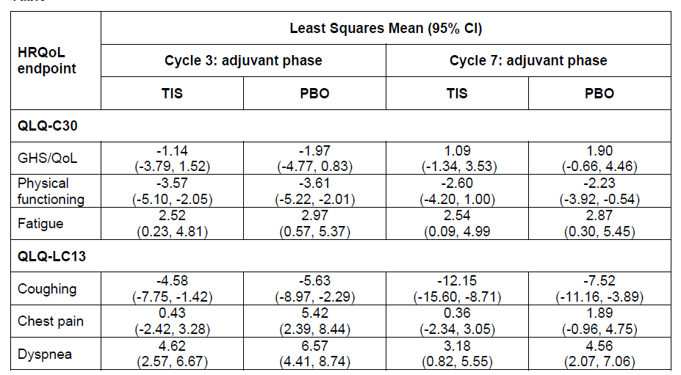
Patient-reported outcomes in the RATIONALE-315 trial
Presented at ESMO 2024 poster #1213P
on Saturday, 14 September:
Cappuzzo et al. 2024
PROs in R-315
Patients in the tislelizumab + CT arm experienced better HRQoL outcomes than those in the placebo + CT arm in this population of patients with resectable NSCLC, with improvements in coughing and lower risk of chest pain
CI, confidence interval; CT, chemotherapy; GHS, global health status; HRQoL, health-related quality of life; NSCLC, non-small cell lung cancer; PBO, placebo; PRO, patient-reported outcomes;
QLQ, quality of life questionnaire; TIS, tislelizumab.
Extracted from Cappuzzo F et al. ESMO 2024; Abstract 1213P.

Slide 33
Conclusions
RATIONALE-315 demonstrated a clinically meaningful and statistically significant benefit in EFS with perioperative TIS plus PtDb CT vs PBO plus neoadjuvant PtDb CT at this interim analysis
  HR=0.56 [95% CI: 0.40, 0.79]; one-sided P=0.0003
  EFS benefit was generally consistent across predefined subgroups
MPR and pCR rate were significantly improved: 56.2% vs 15.0% (P<.0001) and 40.7% vs 5.7% (P<.0001), respectively
An OS benefit trend favouring perioperative TIS (HR=0.62 [95% CI: 0.39, 0.98]; one-sided P=0.0193) was observed at this interim analysis. The trial will continue to assess OS with longer follow-up
The safety profile of perioperative TIS plus PtDb CT was manageable and consistent with the known risks of the individual therapies
Taken together, the statistically and clinically significant EFS, MPR, and pCR benefits, alongside manageable safety, support the use of perioperative TIS plus neoadjuvant PtDb CT for patients with resectable stage II-IIIA NSCLC
Abbreviations: CI, confidence interval; EFS, event-free survival; HR, hazard ratio; MPR, major pathological response; NSCLC, non-small cell lung cancer; OS, overall survival; PBO, placebo; PtDb CT, platinum-based doublet chemotherapy; TIS, tislelizumab.
33
Extracted from Yue D, Wang W, Liu H, Chen Q, Chen C, Liu L, Zhang P et al. RATIONALE-315: Event-Free Survival (EFS) and Overall Survival (OS) of Neoadjuvant Tislelizumab (TIS) plus Chemotherapy (CT) with Adjuvant TIS in Resectable Non-Small Cell Lung Cancer (NSCLC). Presented at the ESMO Virtual Plenary with AACR Expert Commentary; February 15&16, 2024 (Accessed 17 July 2024). Available at: Yue_BGB-A317-315_ESMO-VP_Presentation_2024.pdf

Slide 34
Single agent IO is the only treatment option for NSCLC with high PD-L1 expression
Debate: PRO – CON
34

Slide 35
Single agent IO is the only treatment option for NSCLC with high PD-L1 expression
Debate: PRO
Martin Reck, MD, PhD
Lung Clinic Grosshansdorf,
Grosshansdorf, Germany
0824--MRC-027
Approved: 30 August 2024

Slide 36
Disclosures
COI | Sponsor
Honoraria for lectures and consultancy from: | Amgen, AstraZeneca, BeiGene, Boehringer-Ingelheim, Daiichi-Sankyo, Lilly, Mirati, Merck, MSD, Novartis, Pfizer, Roche, Sanofi, Samsung Bioepis
Compensated Membership in Study Steering Committees: | Amgen, AstraZeneca, BeiGene, Daiichi-Sankyo, Mirati, Merck, MSD, Novartis, Pfizer, Roche, Sanofi
Compensated Membership in Data Safety Monitoring Committees: | Daiichi-Sankyo, Sanofi
COI, conflict of interest.

Slide 37

The major challenge: Not the debate, but the debate “against“ a colleague with a long history of friendship!
And by the way one of the inventors of targeted monotherapies in oncogenic-driven LC!!

Slide 38
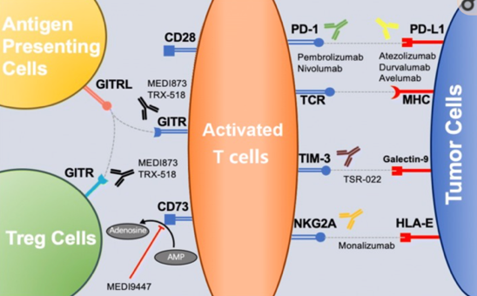
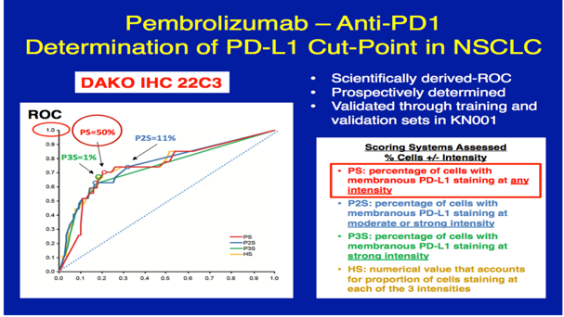
Immunotherapy with anti-PD(L)1 checkpoint inhibitors – the breakthrough in non-oncogenic-driven NSCLC
The concept
The therapeutic cut-off of 50% PD-L1 expression (TPS)
CD28 or 73, cluster of differentiation 28 or 73; GITR, glucocorticoidinduced tumor necrosis factor receptor–related protein; HLA-E, human leukocyte antigen-E; MHC, major histocompatibility complex; NKG2A, natural killer cell receptor group 2 member A; NSCLC, non-small cell lung cancer; PD-1, programmed cell death protein 1; PD-L1, programmed cell death-ligand 1; ROC, receiver operating characteristic; TCR, T cell receptor; TIM-3, cell immunoglobulin and mucin domain-containing protein 3; TPS, tumor proportion score.
Extracted from 1) Qiu Z et al. Exp Hematol Oncol. 2019:8:19; 2) Garon E et al N Engl J Med. 2015;372(21):2018-28 (supplementary appendix).

Slide 39

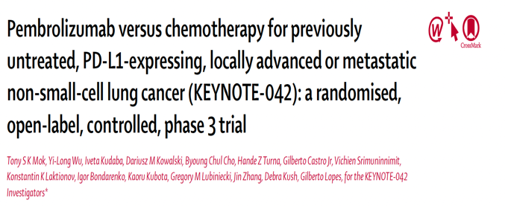
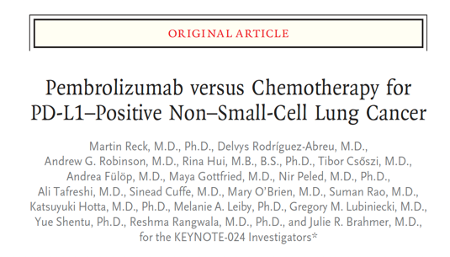
Single agent IO – an attractive concept!
2
1
IO, immuno-oncology; NSCLC, non-small cell lung cancer; PD-L1, programmed cell death-ligand 1.
1) Reck M et al. N Engl J Med. 2016;375(19):1823-1833; 2) Mok TSK et al. Lancet. 2019;393(10183):1819-1830.

Slide 40
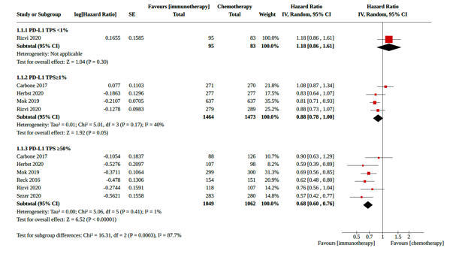
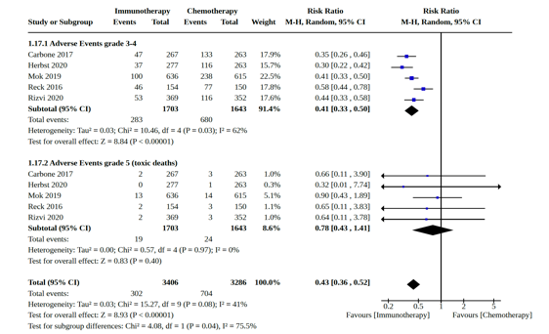
IO monotherapy vs chemotherapy
What do we know?
Better efficacy
Better tolerability
Overall survival
Adverse events
Gr 3/4 AE**
RR 0.41
P<0.00001
PD-L1 ≥ 50%*
HR 0.68
P<0.00001
* Moderate certainty of evidence
** Low certainty of evidence
Single-agent IO vs platinum-based chemotherapy
AE, adverse event; CI, confidence interval; Gr, grade; HR, hazard ratio; IO, immuno-oncology; PD-L1, programmed cell death-ligand 1; RR, risk ratio.
Extracted from Ferrara R et al. Cochrane Database Syst Rev. 2021;4(4):CD013257.

Slide 41
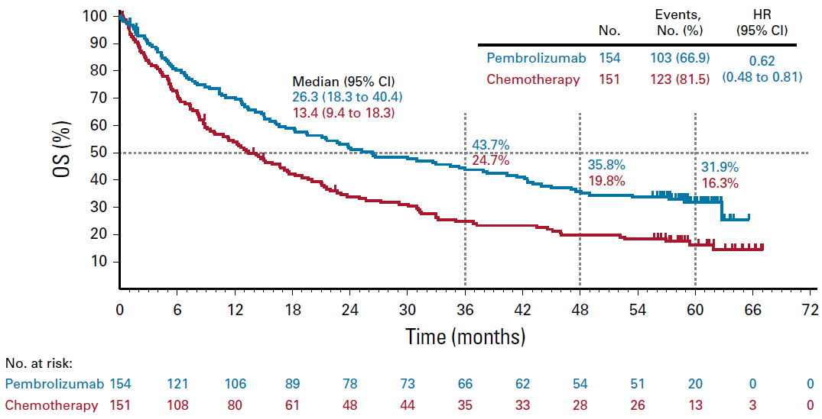
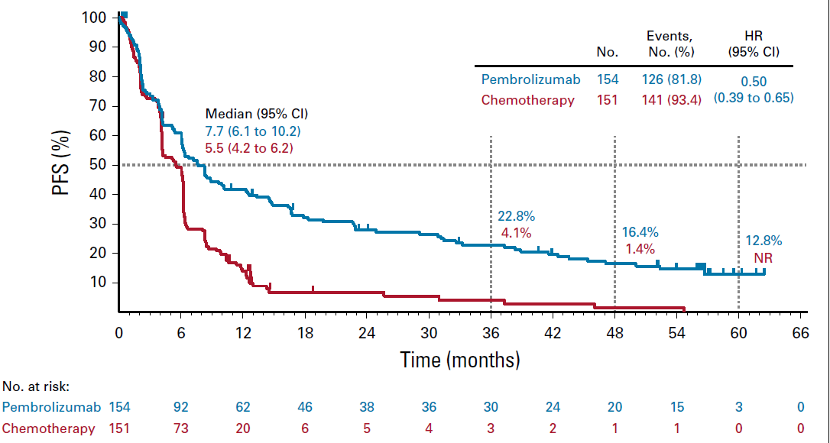
IO monotherapy – the miracle of long-term survival
Example: Keynote-024 trial
OS
PFS
Crossover 66%
DoR: 29.1 vs 6.3 mo.
5-year OS: 31.9% vs 16.3%
Crossover: 66%
CI, confidence interval; DoR, duration of response; HR, hazard ratio; IO, immuno-oncology; mo., months; OS, overall survival; PFS, progression-free survival.
Extracted from Reck M et al. J Clin Oncol. 2021;39(21):2339-2349.

Slide 42
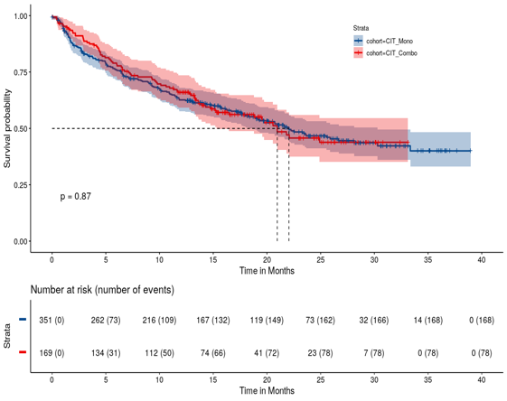
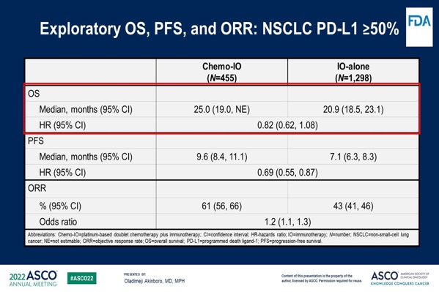
IO vs IO + chemotherapy in PD-L1 ≥ 50%
Any benefit of combination? : No clear data
CIT-mono (n=351)
CIT-combo (n=169)
P=0.87
Time (months)
Benefit for IO/CT vs IO in PFS
No significant difference in OS
IO monotherapy beneficial in elderly patients (≥ 75 years)
Chemo or CT, chemotherapy; CI, confidence interval; CIT, chemoimmunotherapy; HR, hazard ratio; IO, immuno-oncology; NE, not estimable; NSCLC, non-small cell lung cancer; ORR, overall response rate; OS, overall survival; PD-L1, programmed cell death-ligand 1; PFS, progression-free survival.
Extracted from Reck M et al. Presented at the ASCO 2024 Annual Meeting; May 31-June 04, 2024; Chicago, IL (Accessed 31 July 2024). Available at: https://meetings.asco.org/2024-asco-annual-meeting/15686?presentation=228375#228375.

Slide 43
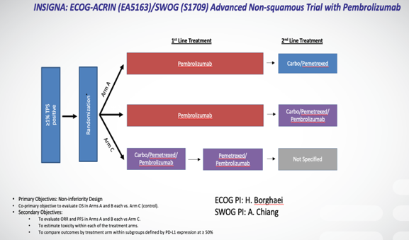
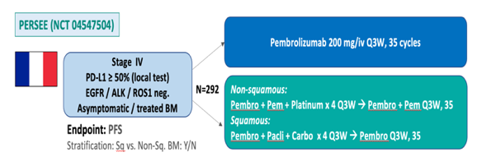
Ongoing prospective trials
Insigna Trial¹
Persee Trial²
GFPC 01-2020
Primary endpoint: PFS
Exploratory endpoints: Early progression rate, QoL, translational analysis of blood and tissue based biomarkers
Integrated Biomarker Objective:
To establish a predictive signature for clinical benefit (OS), to treatment with chemo combined with pembrolizumab versus pembrolizumab alone in patients with PD-L1 expressing tumors (>=1%, 1-49%, >=50%).
To establish a prognostic signature associated with better outcome (OS) to 1st line treatment with pembrolizumab alone in patients with PD-L1 expressing tumors (>=1%, 1-49%, >=50% TPS).
OS, overall survival; PD-L1, programmed cell death-ligand 1; PFS, progression-free survival; QoL, quality of life; Q3W, every 3 weeks; TPS, tumor proportion score.
1) Provided courtesy of Hoss Borghaei and David Carbone; 2) Provided courtesy of R Descourt and C Decroisette.

Slide 44
So, how to proceed in clinical practice?
Let´s ask the patients!

Slide 45
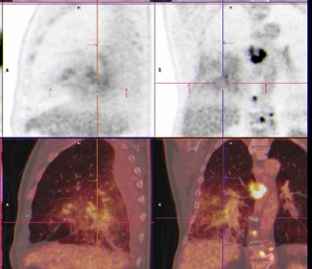
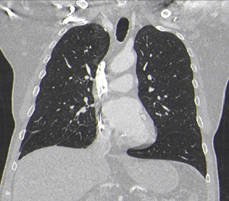
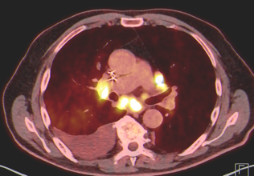
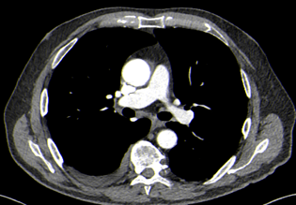
Patient A
IO Monotherapy
08/24
04/23
85-year-old male patient
03/23 Admission for diagnosis of stroke
„By accident“ diagnosis of metastatic adenocarcinoma
No actionable mutation
PD-L1 Expression: 80% TPS
Treatment recommendation?
Improvement of cough
Improvement of dyspnea
Improvement of fatigue
“I am feeling fine“!
PD-L1, programmed cell death-ligand 1; TPS, tumor proportion score.
Provided by the Speaker for educational purposes only.

Slide 46
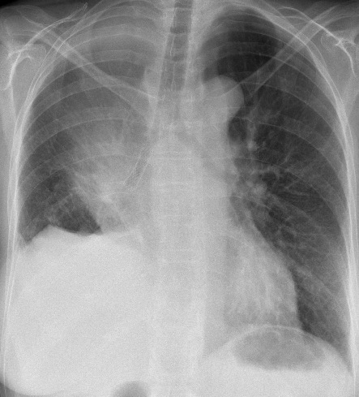
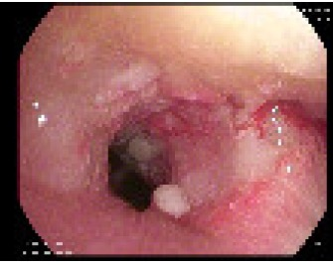
Patient B
55-year-old female patient
Central lung cancer (infiltration of trachea and main bronchi)
High tumor burden (mediastinal lymph nodes, liver and brain metastases)
Histology: Low differentiated adenocarcinoma (TTF-1 negative)
No actionable oncogenic alterations
PD-L1 55%TPS
Treatment recommendation?
PD-L1, programmed cell death-ligand 1; TPS, tumor proportion score; TTF-1, hyroid transcription factor 1.
Provided by the Speaker for educational purposes only.

Slide 47
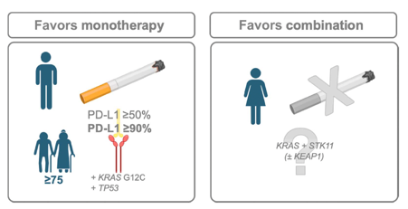
Until we get trial results – some guidance for making decisions…
Favors Monotherapy (IO) | Favors Combination (IO+CT)
Elderly patients (≥ 75 y) | Tumor burden
Smoking | Never smoking
PD-L1 ≥ 90% Improved PFS/OS Different microenvironment | PD-L1 < 50%
Male | Female (Enhanced efficacy of IO-CT combination)
Molecular profile (KRAS G12c + TP53) Immunogenic microenvironment
CT, chemotherapy; IO, immuno-oncology; KRAS, Kirsten rat sarcoma virus; OS, overall survival; PD-L1, programmed cell death-ligand 1; PFS, progression-free survival; TP53, tumor protein p53.
Extracted from Frost N and Reck M. Am Soc Clin Oncol Educ Book. 2024;44(3):e432524.

Slide 48
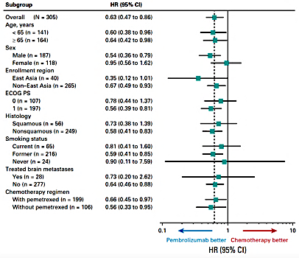
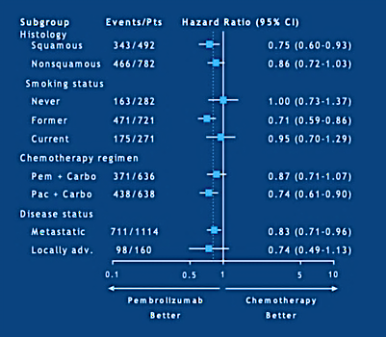
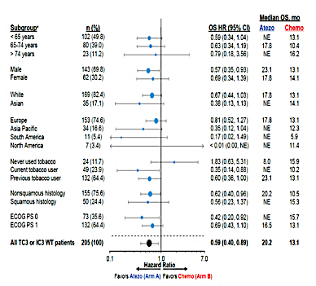
IO monotherapy – no doubt in smokers, but in never-smokers?
Keynote-024 (TPS ≥50%)¹
Keynote-042 (TPS ≥1%)²
IMpower 110 (TC3/IC3)³
HR, 0.9 (95%CI: 0.11–7.59)
HR, 1.00 (95%CI: 0.73–1.37)
HR, 1.83 (95%CI: 0.63–5.31)
Hazard ratios (95% CIs) in never-smokers
CI, confidence interval; HR, hazard ratio; IC, immune cell; IO, immuno-oncology; TC, tumor cell; TPS, tumor proportion score.
Extracted from 1) Reck M et al. J Clin Oncol. 2019;37(7):537-546; 2) Lopes G et al. Presented at ASCO Annual Meeting; June 1-5, 2018. Abstract LBA4 (Accessed 05 August 2024). Available at: https://psmo.org.ph/wp-content/uploads/2019/04/Non-Small-Cell-Lung-Carcinoma-Abstract-Presentation-C.pdf; 3) Herbst R et al N Engl J Med. 2020;383(14):1328-1339 (supplementary appendix).

Slide 49
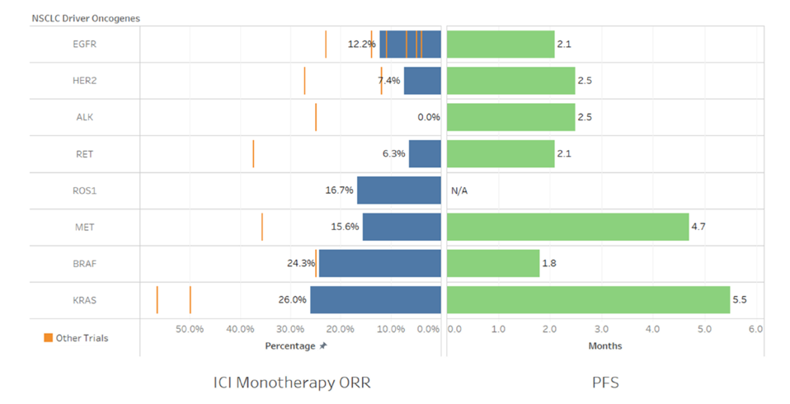
Immunotherapy in oncogene-addicted NSCLC
ORR: 0-24.3%, mPFS: 1.8-4.7 months (IMMUNOTARGET study)
ICI, immune checkpoint inhibitor; mPFS, median progression-free survival; NSCLC, non-small cell lung cancer; ORR, overall response rate.
Extracted from Vokes N et al. Ther Adv Med Oncol. 2023;15:17588359231161409.

Slide 50
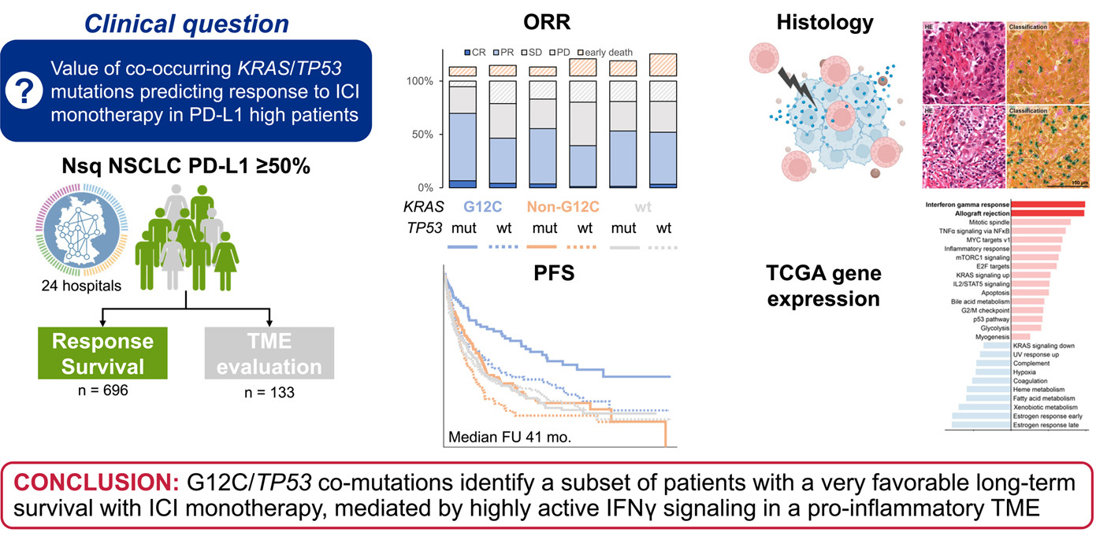
German Network Data on KRAS/TP53 + PD-L1 ≥ 50% and IO monotherapy
ICI, immune checkpoint inhibitor; IFNγ, interferon gamma; IO, immuno-oncology; KRAS, Kirsten rat sarcoma virus; ORR, overall response rate; PD-L1, programmed cell death-ligand 1; PFS, progression-free suvival; TCGA, The Cancer Genome Atlas; TME, tumor microenvironment; TP53, tumor protein p53.
Extracted from Bischoff P et al. J Thorac Oncol. 2024;19(5):803-817.

Slide 51
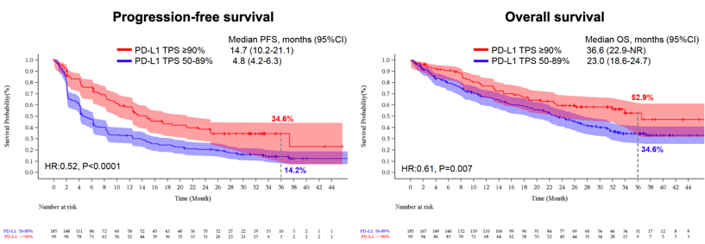
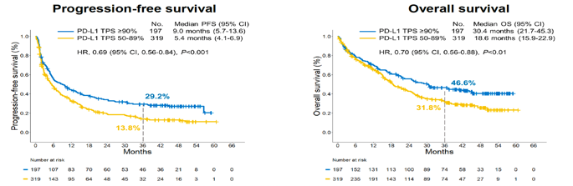
Impact of very high PD-L1 expression (≥ 90%) on IO monotherapy
EMpower-Lung 01
mPFS: 14.7 vs 4.8 m
3-y PFS: 34.6% vs 14.2%
HR 0.51, p<0.001
mOS: 36.6 vs 23.0 m
3-y OS: 52.9% vs 34.6%
HR 0.61, p=0.007
HR, 0.51, P<0.001
HR, 0.61, P=0.007
Academic Cohort
mPFS: 9.0 vs 5.4 m
3-y PFS: 29.2% vs 13.8%
HR 0.69, p<0.001
mOS: 30.4 vs 18.6 m
3-y OS: 46.6% vs 31.8%
HR 0.7, p<0.01
ICI, immune checkpoint inhibitor; IFNγ, interferon gamma; IO, immuno-oncology; KRAS, Kirsten rat sarcoma virus; ORR, overall response rate; PD-L1, programmed cell death-ligand 1; PFS, progression-free suvival; TCGA, The Cancer Genome Atlas; TME, tumor microenvironment; TP53, tumor protein p53.
Extracted from Ricciuti B et al. JTO Clinical and Research Reports. 2024; doi: https://doi.org/10.1016/j.jtocrr.2024.100675 (pre-proof).

Slide 52
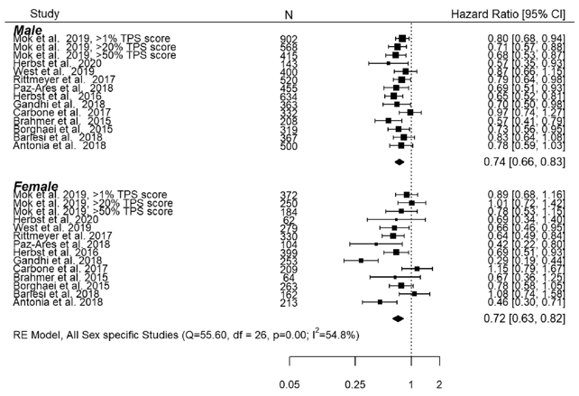
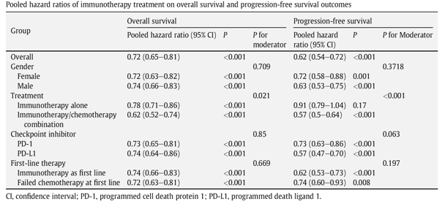
So far no consistent gender-specific survival differences for lung cancer treated with IO: Prospective results required
Overall Survival
HR 0.74 (Male) and 0.72 (Female)
CI, confidence interval; ; HR, hazard ratio; IO, immuno-oncology; PD-1, programmed cell death protein 1; PD-L1, programmed cell death-ligand 1.
Extracted from Madala S et al. Clin Oncol (R Coll Radiol). 2022;34(12):799-809.

Slide 53
Single agent IO is the favorable treatment option for NSCLC with high PD-L1 expression (Speaker’s own)
In principle yes, based on:
  Efficacy
  Impact on long-term overall survival (= chronification)
  Tolerability
  Symptom control and quality of life
Clinical treatment decision should be based on individual patient factors
The additional value of chemotherapy in patients with high PD-L1 expression needs to be shown prospectively
The potential value of chemotherapy needs to be weighed against the harm to patients by toxicity
IO, immuno-oncology; NSCLC, non-small cell lung cancer; PD-L1, programmed cell death-ligand 1.

Slide 54

Single agent IO is the only treatment option for NSCLC with high PD-L1 expression
Debate: CON
Professor Tony Mok
Li Shu Fan Medical Foundation
Professor of Clinical Oncology
The Chinese University of Hong Kong
0924-BGB-A317-MRC-002
Approved: 05 September 2024

Slide 55
Disclosures
COI | Sponsor
Grant/Research Support | AstraZeneca, Boehringer Ingelheim, Pfizer, Novartis, SFJ Pharmaceuticals, Roche, Merck Sharp & Dohme, Bristol-Myers Squibb, Eisai, Taiho
Speaker’s Fees | BeiGene, AstraZeneca, Roche/Genentech, Pfizer, Eli Lilly, Boehringer Ingelheim, Merck Sharp & Dohme, Novartis, Bristol-Myers Squibb, Taiho
Major Stock Shareholder | Prenetics Ltd
Advisory Board | AstraZeneca, Roche/Genentech, Pfizer, Eli Lilly, Boehringer Ingelheim, Merck Serono, Merck Sharp & Dohme, Novartis, SFJ Pharmaceuticals, ACEA Biosciences, Vertex Pharmaceuticals, Bristol-Myers Squibb, geneDecode, OncoGenex, Celgene, Cirina
Board of Directors | AstraZeneca Ltd, HutchMed Ltd, Insighta Ltd.
COI, conflict of interest.

Slide 56
ONLY is a serious word
Adjective:
Being the single one or the relatively few of the kind
Single in superiority or distinction; unique; the best

Slide 57
Is single agent IO the ONLY option?
NCCN Guidelines for Metastatic NSCLC 2024
ESMO Guideline for Metastatic NSCLC 2023
ESMO, European Society for Medical Oncology; IO, immuno-oncology; NCCN, National Comprehensive Cancer Network; NSCLC, non-small cell lung cancer.

Slide 58
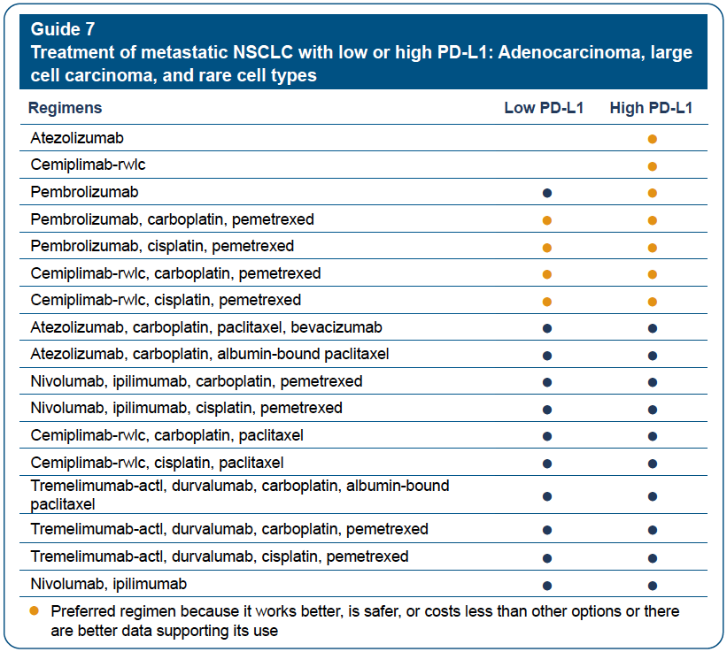
NCCN Guidelines for Patients Metastatic NSCLC, 2024
NCCN, National Comprehensive Cancer Network; NSCLC, non-small cell lung cancer; PD-L1, programmed cell death-ligand 1.
Extracted from NCCN Guidelines for Patients®, Metastatic NSCLC, 2024.

Slide 59
ESMO Guidelines Metastatic NSCLC, 2023
ESMO, European Society for Medical Oncology; BSC, best supportive care; ChT, chemotherapy; CPG, Clinical Practice Guideline; ECOG, Eastern Cooperative Oncology Group; EMA, European Medicines Agency; FDA, Food and Drug Administration; IC, immune cell; ICI, immune checkpoint inhibitor; LRT, local radical therapy; MCBS, ESMO-Magnitude of Clinical Benefit Scale; mNSCLC, metastatic non-small-cell lung cancer; NSCLC, non-small-cell lung cancer; PD-L1, programmed death-ligand 1; PS, performance status; SqCC, squamous-cell carcinoma.
Extracted from Hendriks LE et al. Ann Oncol. 2023 Apr;34(4):358-376.

Slide 60
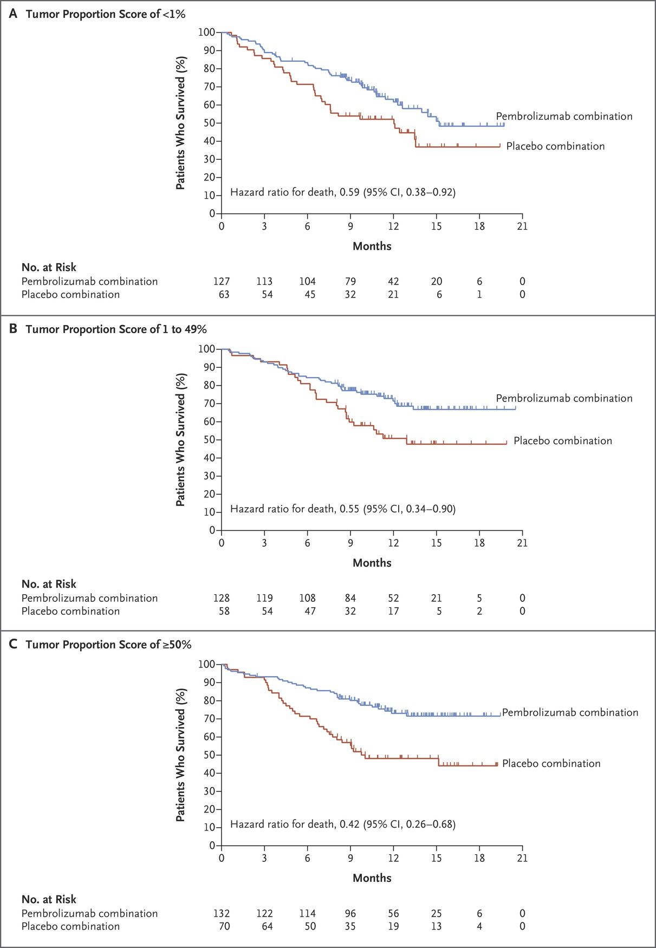
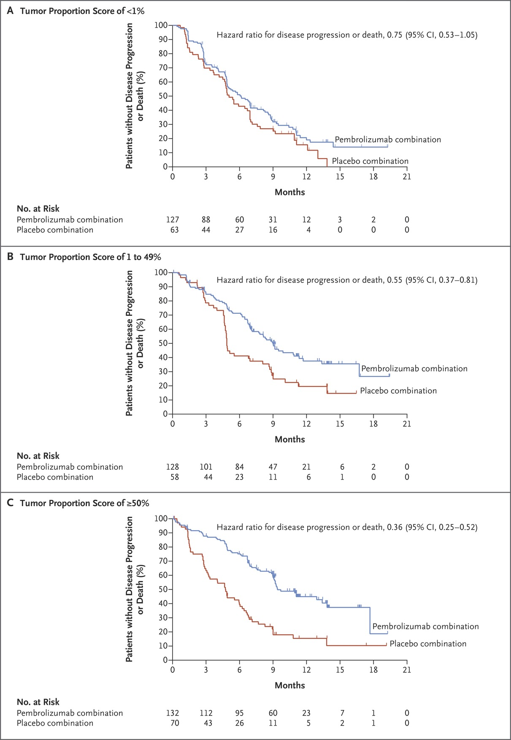
KEYNOTE189
TPS <1%
Pembro + CT vs CT
TPS 1-49%
TPS ≥ 50%
CT, chemotherapy; Pembro, pembrolizumab; TPS, tumor proportion score.
Extracted from Gandhi L et al. N Engl J Med. 2018;378(22):2078-2092.

Slide 61
IMpower150: High expression
Atezolizumab (A) + CP
vs
Bevacizumab (B) + CP
vs
ABCP
ABCP
BCP
ABCP, atezolizumab + bevacizumab + carboplatin + paclitaxel; BCP, bevacizumab + carboplatin + paclitaxel; CI, confidence interval; HR, hazard ratio; mo, months; PFS, progression-free survival;
Teff, effector T-cell; WT, wild type.
Extracted from Socinski MA et al. N Engl J Med. 2018;378(24):2288-2301 (supplemental appendix).

Slide 62
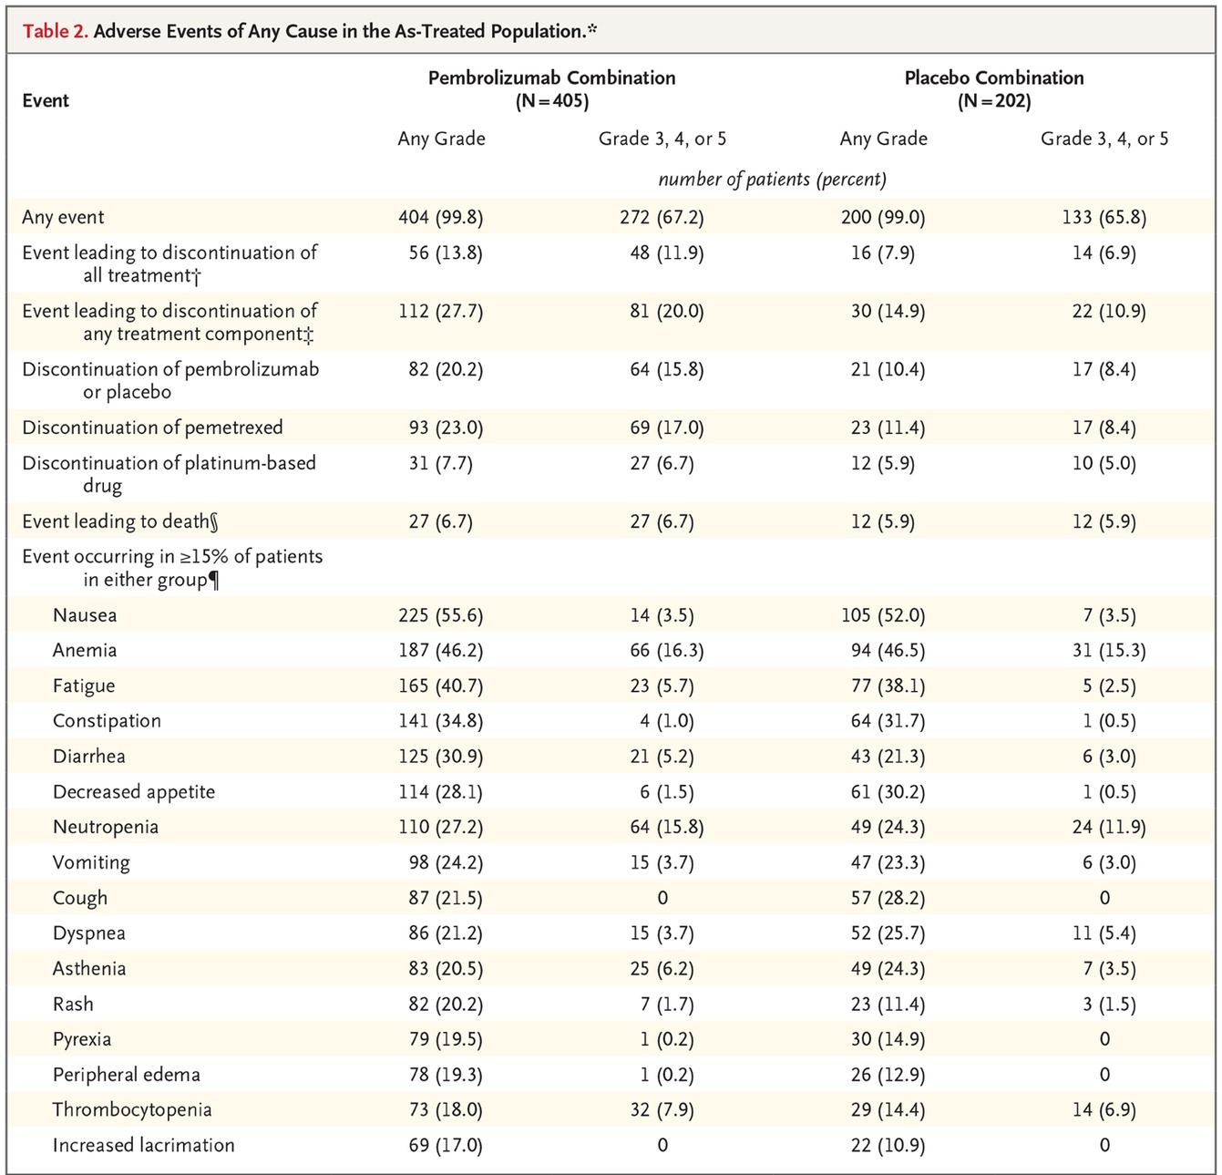
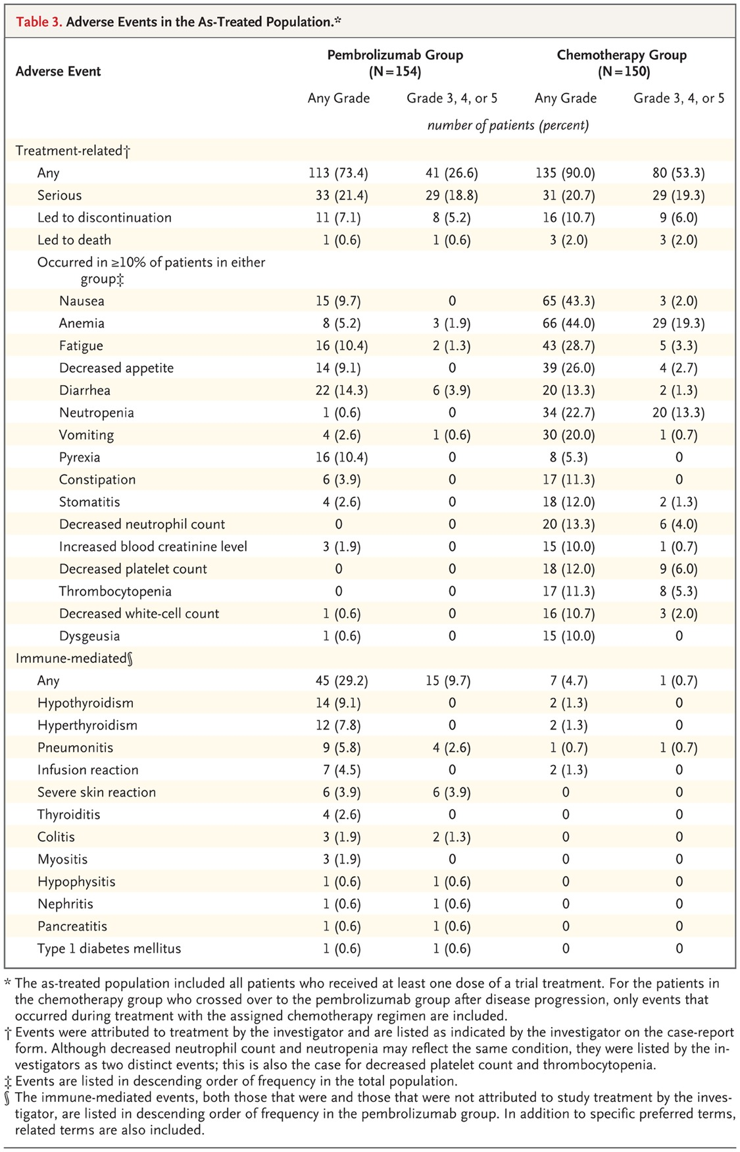
Difference in toxicity profile
KEYNOTE-189 (Pembro + CT, any PD-L1)¹
KEYNOTE-024 (Pembro vs CT, PD-L1 ≥50%)²
CT, chemotherapy; Pembro, pembrolizumab; PD-L1, programmed cell death-ligand 1; TPS, tumor proportion score.
Extracted from 1) Gandhi L et al. N Engl J Med. 2018;378(22):2078-20; 2) Reck M et al. N Engl J Med. 2016;375(19):1823-1833.

Slide 63
PREFERRED ≠ ONLY
Single agent IO is preferred but certainly NOT the ONLY treatment for PD-L1 >50%
IO, immuno-oncology; PD-L1, programmed cell death-ligand 1.

Slide 64
High PD-L1 is not a single entity?
PD-L1, programmed cell death-ligand 1.

Slide 65
PD-L1 protein expression is a semi-quantitative biomarker that varies with different antibodies
We need standardization of antibody
and a validated cut-off
PD-L1, programmed cell death-ligand 1.
Extracted from Hirsch FR et al. J Thorac Oncol. 2017;12(2):208-222.

Slide 66
Standardized test: Blueprint PD0L1 IHC assay comparison project
Multiple companies
Multiple platforms
  Ventana vs Dako
Multiple antibodies
  22C3
  28-8
  SP142
Multiple cut-off
  >1%, >25%, >50%
PD-L1, programmed cell death-ligand 1.
Extracted from Hirsch FR et al. J Thorac Oncol. 2017;12(2):208-222.

Slide 67
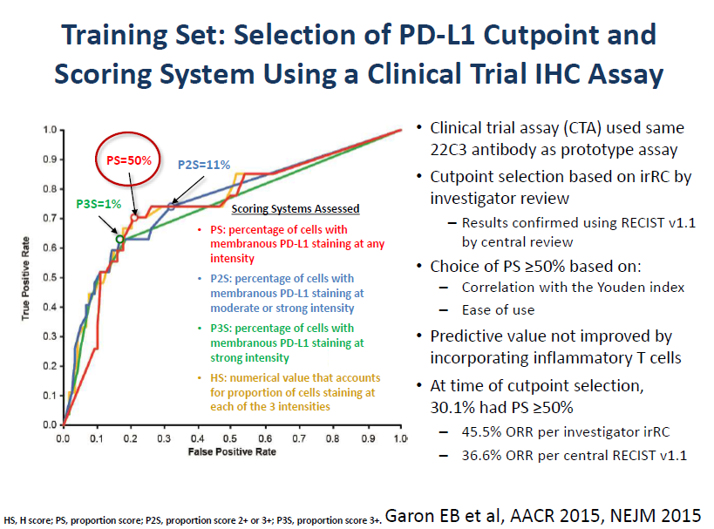
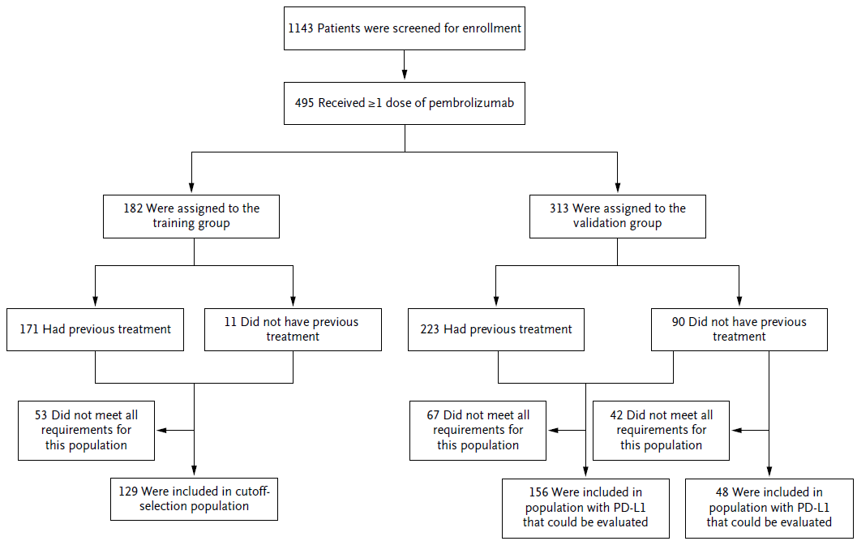
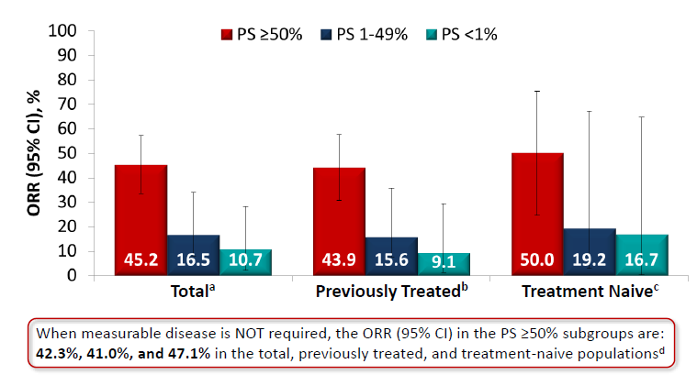
KEYNOTE-001: First study that validated PD-L1 expression cut-off at 50%
CI, confidence interval; IHC, immunohistochemistry; ORR, overall response rate; PD-L1, programmed cell death-ligand 1; PS, performance status.
Extracted from Garon EB et al. N Engl J Med. 2015;372(21):2018-28.

Slide 68

KEYNOTE-024
Key Eligibility Criteria
Untreated stage IV NSCLC
PD-L1 TPS ≥50%
ECOG PS 0-1
No activating EGFR mutation or ALK translocation
No untreated brain metastases
No active autoimmune disease requiring systemic therapy
Pembrolizumab
200 mg IV Q3W
(2 years)
R (1:1)
N = 305
Platinum-Doublet Chemotherapy
(4-6 cycles)
Key End Points
Primary: PFS (RECIST v1.1 per blinded, independent central review)
Secondary: OS, ORR, safety
Exploratory: DOR
Martin Reck
ALK, anaplastic lymphoma kinase; DOR, duration of response; ECOG PS, Eastern Cooperative Oncology Group performance status; EGFR, estimated glomerular filtration rate; IV, intravenous; NSCLC, non-small cell lung cancer;
ORR, overall response rate; OS, overall survival; PD-L1, programmed cell death-ligand 1; PFS, progression-free survival; Q3W, every 3 weeks; R, randomized; TPS, tumor proportion score.
Extracted from Reck M et al. N Engl J Med. 2016;375(19):1823-1833.

Slide 69


KEYNOTE-042
Pembrolizumab
200 mg Q3W
for up to 35 cycles
Key Eligibility Criteria
Untreated locally advanced or metastatic NSCLC of any histology
PD-L1 TPS ≥1%ª
No sensitizing EGFR or ALK alterations
ECOG PS 0 or 1
No untreated or unstable CNS metastases
No history of pneumonitis that required systemic corticosteroids
R (1:1)
N=1274
Carboplatin AUC 5 or 6 Q3W + Paclitaxel 200 mg/m² Q3W^{b}
OR
Carboplatin AUC 5 or 6 Q3W + Pemetrexed 500 mg/m² Q3W^{b}
for up to 6 cycles
Stratification Factors
Region (east Asia vs rest of the world)
ECOG PS (0 vs 1)
Histology (squamous vs nonsquamous)
PD-L1 TPS (≥50% vs 1-49%)
Tony Mok
Key End Points
Primary: OS
Secondary: PFS, ORR, safety
Exploratory: DOR
ALK, anaplastic lymphoma kinase; AUC, area under the curve; CNS, central nervous system; DOR, duration of response; ECOG PS, Eastern Cooperative Oncology Group performance status; EGFR, estimated glomerular filtration rate; NSCLC, non-small cell lung cancer; ORR, overall response rate; OS, overall survival; PD-L1, programmed cell death-ligand 1; PFS, progression-free survival; Q3W, every 3 weeks; R, randomized; TPS, tumor proportion score.
Extracted from Mok TSK et al. Lancet. 2019;393(10183):1819-1830.
69

Slide 70
PFS outcomes of KEYNOTE-024 and -042 are different despite the similar high PD-L1 expression
PD-L1>50%
PD-L1>20%
PD-L1 ≥50%
PD-L1>1%
PD-L1 1-49%
KN-024 PFS HR 0.50¹
CI, confidence interval; HR, hazard ratio; PD-L1, programmed cell death-ligand 1; PFS, progression-free survival.
Extracted from 1) Reck M et al. N Engl J Med. 2016;375(19):1823-1833; 2) Mok TSK et al. Lancet. 2019;393(10183):1819-1830.

Slide 71
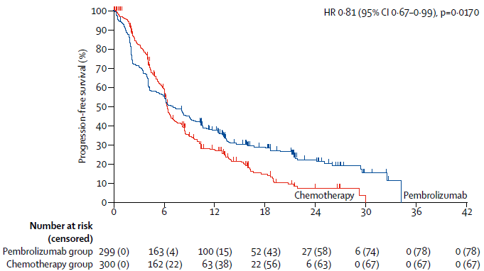
PFS outcomes of KEYNOTE-024 and -042 are different despite the similar high PD-L1 expression
PD-L1>50%
PD-L1 ≥50%
subgroup
PD-L1>20%
PD-L1>1%
PD-L1 1-49%
KN-042 PFS HR 0.81²
CI, confidence interval; HR, hazard ratio; PD-L1, programmed cell death-ligand 1; PFS, progression-free survival.
Extracted from 1) Reck M et al. N Engl J Med. 2016;375(19):1823-1833; 2) Mok TSK et al. Lancet. 2019;393(10183):1819-1830.

Slide 72


EMPOWER-Lung 3: Chemo/cemiplimab combination is highly effective in PDL1>50% population
HR 0.65
Cemi + CT
HR 0.56
CT
CI, confidence interrval; HR, hazard ratio; PD-L1, programmed cell death-ligand 1; PFS, progression-free survival.
Extracted from Makharadze T et al. Cemiplimab plus chemotherapy versus chemotherapy alone in advanced non small cell lung cancer: 2 year follow up results from the Phase 3 EMPOWER Lung 3 Part 2 trial. Presented at ELCC; October 20-24, 2023; Madrid, Spain. Available at: https://oncologypro.esmo.org/meeting-resources/european-lung-cancer-congress-2023/cemiplimab-plus-chemotherapy-versus-chemotherapy-alone-in-non-small-cell-lung-cancer-longer-follow-up-results-from-the-phase-iii-empower-lung-3-trial.

Slide 73


RATIONALE-304: Chemo/tislelizumab is highly effective in the PD-L1 >50% population
Overall survival
²
¹
HR 0.39
Tisle + CT
CT
HR 0.68
(two-stage model)
CI, confidence interval; chemo or CT, chemotherapy; HR, hazard ratio; ITT, intent-to-treat; NE, not estimable; NSCLC, non-small cell lung cancer; OS, overall survival; PD-L1, programmed cell death-ligand 1; Tisle, tislelizumab.
1) Extracted from Lu S et al. Randomized Phase 3 Study of Tislelizumab Plus Chemotherapy Versus Chemotherapy Alone as First-Line Treatment for Advanced Nonsquamous Non-Small Cell Lung Cancer: RATIONALE-304 Updated Analysis. Poster 138P. Presented at ESMO IO; December 2022; Geneva, Switzerland. Available at: Lu_BGB-A317-304_ESMO_IO_Poster_2022.pdf; 2) Tevimbra SmPC, July 2024.

Slide 74
PD-L1 >50% is a heterogenous population!
PD-L1, programmed cell death-ligand 1.

Slide 75
PD-1 inhibitors monotherapy for PD-L1 50-89% vs PD-L1 ≥90%
CI, confidence interval; HR, hazard ratio; PD-1, programmed cell death protein 1; PD-L1, programmed cell death-ligand 1; PFS, progression-free survival; TPS, tumor proportion score.
Extracted from Ricciuti B et al. JTO Clinical and Research Reports. 2024; doi: https://doi.org/10.1016/j.jtocrr.2024.100675 (pre-proof).

Slide 76


Some patients don’t do well with single-agent IO despite high PD-L1 expression
````
Atezolizumab (IMpower110)¹
Cemiplimab (EMPOWER-Lung1)
*Dako 22C3; past history of smoking
Atezo, atezolizumab; chemo, chemotherapy; CI, confidence interval; HR, hazard ratio; IO, immuno-oncology; ITT, intent-to-treat; mo, months; PD-L1, programmed cell death-ligand 1; PFS, progression-free survival; TC, tumor cell, PD-LI expression on ≥50% of tumor cells; WT, wild type.
Extracted from 1) Herbst RS et al. N Engl J Med. 2020;383(14):1328-1339 (supplementary appendix); 2) Brahmer JR et al. LBA51 - KEYNOTE-024 5-year OS update: First-line (1L) pembrolizumab (pembro) vs platinum-based chemotherapy (chemo) in patients (pts) with metastatic NSCLC and PD-L1 tumour proportion score (TPS) ≥50%. Presented at ESMO Virtual Congress; September 19-21, 2020. Available at: https://oncologypro.esmo.org/meeting-resources/esmo-virtual-congress-2020/keynote-024-5-year-os-update-first-line-1l-pembrolizumab-pembro-vs-platinum-based-chemotherapy-chemo-in-patients-pts-with-metastatic-nsclc; 3) Sezer A et al. LBA52 - EMPOWER-Lung 1: Phase III first-line (1L) cemiplimab monotherapy vs platinum-doublet chemotherapy (chemo) in advanced non-small cell lung cancer (NSCLC) with programmed cell death-ligand 1 (PD-L1) ≥50%. Presented at ESMO Virtual Congress; September 19-21, 2020. Available at: https://oncologypro.esmo.org/meeting-resources/esmo-virtual-congress-2020/empower-lung-1-phase-iii-first-line-1l-cemiplimab-monotherapy-vs-platinum-doublet-chemotherapy-chemo-in-advanced-non-small-cell-lung-cancer-n.
Pembrolizumab (KN-024)²
PD-L1 ≥50%

Slide 77

Never-smokers may not do well with single-agent IO
Keynote-024 (TPS ≥50%)¹
Never-smoker: HR, 0.9 (95%CI: 0.11–7.59)
CI, confidence interval; ECOG PS, Eastern Cooperative Oncology Group performance status; HR, hazard ratio; IC, immune cell; IO, immuno-oncology; TPS, tumor proportion score.
Extracted from 1) Reck M et al. J Clin Oncol. 2019;37(7):537-546; 2) Herbst RS et al. N Engl J Med. 2020;383(14):1328-1339 (supplementary appendix).

Slide 78

Never-smokers may not do well with single-agent IO
IMpower 110 (TC3/IC3)²
Never-smoker: HR, 1.83 (95%CI: 0.63–5.31)
CI, confidence interval; ECOG PS, Eastern Cooperative Oncology Group performance status; HR, hazard ratio; IC, immune cell; IO, immuno-oncology; TPS, tumor proportion score.
Extracted from 1) Reck M et al. J Clin Oncol. 2019;37(7):537-546; 2) Herbst RS et al. N Engl J Med. 2020;383(14):1328-1339 (supplementary appendix).

Slide 79
Subgroup of patients with high PD-L1 don’t respond as well to single agent IO, thus certainly NOT the ONLY treatment
IO, immuno-oncology; PD-L1, programmed cell death-ligand 1.

Slide 80
Why do we give immunotherapy to patients?

Slide 81

To help patient living a full and colorful life
Image provided courtesy of Tony Mok.

Slide 82


Single-agent IO has improved the 5-year OS rate of patients with advanced NSCLC
Platinum-based doublets in advanced NSCLC¹
Single agent IO for PD-L1 ≥50% advanced NSCLC²
We should not be satisfied with this success when 70% of patients may die!!
5 yr OS rate <5%
CI, confidence interval; HR, hazard ratio; IO, immuno-oncology; NSCLC, non-small cell lung cancer; OS, overall survival; PD-L1, programmed cell death-ligand 1.
Extracted from 1) Schiller JH et al. N Engl J Med. 2002 Jan 10;346(2):92-8; 2) Reck M et al. J Clin Oncol. 2021;39(21):2339-2349.

Slide 83

PD-L1 is only one piece of a complex puzzle
APC, antigen-presenting cell; CTLA4, cytotoxic T-lymphocyte-associated protein 4; IFNγ, interferon gamma; IL-2, interleukin-2; MHC, major histocompatibility complex; PD-1, programmed cell death protein 1; PD-L1, programmed cell death-ligand 1; TCR, T cell receptor; TNF, tumor necrosis factor.
Extracted from Katopodi T et al. Pharmaceutics. 2024;16(4):455.

Slide 84

Multiple potential partners
APC, antigen-presenting cell; CAR-T, chimeric antigen receptor T cells; CD, cluster of differentiation; CTLA4, cytotoxic T-lymphocyte-associated protein 4; IFN, interferon; IL, interleukin; LAG-3, lymphocyte-activation gene 3 protein; PD-1, programmed cell death protein 1; PD-L1, programmed cell death-ligand 1; TCR, T cell receptor; TIGIT, T cell immunoreceptor with Ig and ITIM domains; TLR, toll-like receptor; TNF, tumor necrosis factor; VEGF, vascular endothelial growth factor.
Extracted from Mellman I et al. Immunity. 2023;56(10):2188-2205.

Slide 85
CTLA-4 inhibitor as partner: POSEIDON
T+D+CT vs CT
Stage IV NSCLC
N=1013 (randomised)
EGFR/ALKwt
ECOG PS 0 or 1
Treatment-naïve for metastatic disease
Tumour biopsy* and baseline plasma sample (for ctDNA)
Stratification factors
PD-L1 expression
(TC ≥50% vs <50%)
Disease stage (IVA vs IVB)
Histology (NSQ vs SQ)
 | T+D+CT | CT
Events/patients, n/N (%) | 279/338 (82.5) | 304/337 (90.2)
mOS, months (95% CI) | 14.0 (11.7–16.1) | 11.6 (10.5–13.1)
HR* (95% CI) | 0.76 (0.64–0.89) | –
    T+D+CT†
    q3w 4 cycles
T (week 16 only)
+ D q4w until PD
1.0
0.8
    D+CT†
    q3w 4 cycles
D q4w until PD
0.6
54.8%
R
1:1:1
Probability of OS
49.0%
0.4
32.8%
24.9%
20.9%
    Platinum-based CT†
    q3w up to 6 cycles
0.2
21.8%
15.7%
13.3%
8.5%
0.0
6.8%
0
6
12
18
24
30
36
42
48
54
60
66
72
Time from randomisation (months)
No. at risk
T+D+CT |  | 338 | 256 | 183 | 136 | 108 | 88 | 81 | 71 | 66 | 56 | 47 | 21 | 3
CT |  | 337 | 235 | 159 | 110 | 70 | 50 | 42 | 31 | 25 | 21 | 20 | 10 | 2
ALK, anaplastic lymphoma kinase; CI, confidence interval; CT, chemotherapy; ctDNA, circulating tumor DNA; CTLA4, cytotoxic T-lymphocyte-associated protein 4; D, durvalumab; ECOG PS, Eastern Cooperative Oncology Group performance status; EGFR, estimated glomerular filtration rate; HR, hazard ratio; mOS, median overall survival; NSQ, non-squamous; PD, progressive disease; PD-L1, programmed cell death ligand 1; q3w, every 3 weeks; q4w, every 4 weeks; SQ, squamous; T, tremelimumab; TC, tumor cell; WT, wild type.
Extracted from Peters S et al. LBA3 - Durvalumab (D) ± tremelimumab (T) + chemotherapy (CT) in first-line metastatic (m) NSCLC: 5-year overall survival (OS) update from the POSEIDON study. Presented at ESMO Immuno-Oncology Congress; December 06-08, 2023; Geneva, Switzerland. Available at: https://oncologypro.esmo.org/meeting-resources/esmo-immuno-oncology-congress-2023/durvalumab-d-tremelimumab-t-chemotherapy-ct-in-first-line-metastatic-m-nsclc-5-year-overall-survival-os-update-from-the-poseidon-study.

Slide 86
More impressive HR in patients with high PD-L1
 |  | Events/ patients, n/N | T+D+CT vs CT | HR | Events/ patients, n/N | D+CT vs CT | HR
All patients |  | 583/675 |  | 0.76 | 594/675 |  | 0.84
Sex | Male Female | 455/517 128/158 |  | 0.68 0.92 | 450/501 144/174 |  | 0.79 0.90
Age | <65 years ≥65 years | 308/367 275/308 |  | 0.76 0.72 | 299/345 295/330 |  | 0.86 0.79
PD-L1 expression | TC ≥50% TC <50% TC ≥1% TC <1% | 161/198 422/477 350/420 233/255 |  | 0.62 0.81 0.71 0.81 | 162/191 432/483 371/431 223/243 |  | 0.65 0.91 0.78 0.98
Histology | SQ NSQ | 229/246 353/428 |  | 0.85 0.69 | 234/250 358/423 |  | 0.82 0.81
Planned CT | Nab-paclitaxel doublet Pemetrexed doublet Gemcitabine doublet | 36/42 338/411 209/222 |  | 0.61 0.71 0.85 | 43/49 343/407 208/219 |  | 0.75 0.80 0.89
Smoking history | Current Former Never | 125/150 331/386 126/138 |  | 0.53 0.73 1.17 | 115/130 335/381 143/163 |  | 0.73 0.81 0.92
Race | Asian Non-Asian | 189/227 394/448 |  | 0.94 0.62 | 211/251 383/424 |  | 0.93 0.75
ECOG PS | 0 1 | 187/229 396/446 |  | 0.74 0.72 | 193/228 401/447 |  | 0.73 0.86
Brain metastases | Yes No | 64/78 519/597 |  | 0.79 0.73 | 62/73 532/602 |  | 0.83 0.81
AJCC disease stage | IVA IVB | 290/337 292/335 |  | 0.71 0.81 | 288/336 304/337 |  | 0.70 0.99
0.25
0.5
1
2
0.25
0.5
1
2
Favours T+D+CT
Favours CT
Favours D+CT
Favours CT
AJCC, American Joint Committee on Cancer
HR <1 favours D(±T)+CT vs CT (all patients analysis stratified, subgroup analysis unstratified); size of circle is proportional to the number of events across both treatment groups; DCO, 24 Aug 2023.
CT, chemotherapy; D, durvalumab; ECOG PS, Eastern Cooperative Oncology Group performance status; HR, hazard ratio; NSQ, non-squamous; PD-L1, programmed cell death ligand 1; SQ, squamous; T, tremelimumab; TC, tumor cell.
Extracted from Peters S et al. LBA3 - Durvalumab (D) ± tremelimumab (T) + chemotherapy (CT) in first-line metastatic (m) NSCLC: 5-year overall survival (OS) update from the POSEIDON study. Presented at ESMO Immuno-Oncology Congress; December 06-08, 2023; Geneva, Switzerland. Available at: https://oncologypro.esmo.org/meeting-resources/esmo-immuno-oncology-congress-2023/durvalumab-d-tremelimumab-t-chemotherapy-ct-in-first-line-metastatic-m-nsclc-5-year-overall-survival-os-update-from-the-poseidon-study
86

Slide 87

TIGIT
T cell immunoreceptor with immunoglobulin and ITIM domain
APCs, antigen-presenting cells; IL, interleukin; ITIM, immunoreceptor tyrosine-based inhibitory motif; TIGIT, T cell immunoreceptor with immunoglobulin and ITIM domain; Tregs, regulatory T cells.
Extracted from Chauvin J-M and Zarour HM. J Immunother Cancer. 2020 Sep;8(2):e000957.
Notes:
TIGIT potently inhibits innate and adaptive immunity through multiple mechanisms

Slide 88




CITYSCAPE: TIGIT-PD-L1 in NSCLC
PD-L1 TPS ≥ 50%
PD-L1 TPS 1-49%
Atezo, atezolizumab; CI, confidence interval; DOR, duration of response; HR, hazard ratio; IHC, immunohistochemistry; ITT, intent-to-treat; NSCLC, non-small cell lung cancer; ORR, confirmed overall response rate; OS, overall survival; PD, progressive disease; PD-L1, programmed cell death-ligand 1; PFS, progression free survival; q3w, every 3 weeks; R, randomized; TIGIT, T cell immunoreceptor with immunoglobulin and ITIM domain; Tira, tiragolumab; TPS, tumor proportion score.
Extracted from Rodriguez-Abreu D et al. CITYSCAPE: Primary Analysis of a Randomized, Double-Blind, Phase II Study of the Anti-TIGIT Antibody Tiragolumab plus Atezolizumab versus Placebo plus Atezolizumab as 1L Treatment in Patients with PD-L1-Selected NSCLC. Presented at the ASCO Annual Meeting; May 29-June 02, 2020; Chicago, IL. Available at: https://medically.roche.com/content/dam/pdmahub/non-restricted/oncology/asco-2020/ASCO-2020-presentation-rodriguez-abreu-primary-analysis-of-a-randomized-double-blind-phase-II-study-of-the-anti-TIGIT-antibody-tiragolumab-tira-plus-atezolizumab-atezo.pdf.

Slide 89
SKYSCRAPER-01 (GO41717): tiragolumab + atezolizumab in PD-L1-high 1L NSCLC
Phase III, double-blind study in 1L PD-L1-high patients with metastatic NSCLC
1L Stage IV NSCLC
EGFR/ALK WT
PD-L1 TPS ≥50% (PD-L1 IHC 22C3 pharmDx assay) OR TC3 or IC3 (VENTANA PD-L1 SP142 assay) OR TC ≥50% (VENTANA
PD-L1 SP263 assay)
N=500
Tiragolumab 600 mg IV Q3W +
atezolizumab 1200 mg IV Q3W
May 11 2022
SKYSCRAPER-1 Trial does not meet primary endpoint of PFS with tiragolumab plus atezolizumab in PDL1 high population
Treat until PD or loss of clinical benefit
R
1:1
No crossover
Placebo 600 mg IV Q3W +
atezolizumab 1200 mg IV Q3W
Stratification factors:
Co-primary endpoints:
Secondary endpoints:
ECOG (0 vs 1)
Histology (NSQ vs SQ)
Geographic region (Asian vs non-Asian)
OS in ITT
PFS in ITT
ORR
DOR
PFS & OS landmarks
PK/ADA
PRO
Safety
1L, first-line; ALK, anaplastic lymphoma kinase; DOR, duration of response; ECOG, Eastern Cooperative Oncology Group; EGFR, epidermal growth factor receptor; IHC, immunohistochemistry; ITT, intention-to-treat; IV, intravenously; NSQ, nonsquamous; OS, overall survival; PD, progressive disease; PFS, progression-free survival; PK/ADA, pharmacokinetic/anti-drug antibodies; PRO, patient-reported outcome; Q3W, every 3 weeks; SQ, squamous; TC, tumour cell; TPS, tumour proportion score; WT, wild-type.
https://clinicaltrials.gov/study/NCT04294810.
89

Slide 90
“Data leak” in August 2023
The interim results for the primary endpoint of overall survival were not mature at the time of the second interim analysis, with median overall survival estimates of 22.9 months [95% CI: 17.5, NE] in the tiragolumab plus Tecentriq arm, and 16.7 months [95% CI: 14.6, 20.2] in the Tecentriq monotherapy arm, yielding a hazard ratio of 0.81 [95% CI: 0.63, 1.03].
July 24, 2024
Roche announced on Thursday that it will discontinue the Phase II/III SKYSCRAPER-06 study due to disappointing results from its investigational anti-TIGIT antibody, tiragolumab. The drug failed to significantly improve survival rates in patients with non-small cell lung cancer (NSCLC).
CI, confidence interval; NE, not estimable; TIGIT, T cell immunoreceptor with immunoglobulin and ITIM domain.
90

Slide 91
With more approaches to come…
CTLA4, cytotoxic T-lymphocyte-associated protein 4; GITR, glucocorticoid-induced tumor necrosis factor receptor family-related receptor; LAG-3, lymphocyte-activation gene 3 protein; mAB, monoclonal antibody; PD-L1, programmed cell death-ligand 1; TIGIT, T cell immunoreceptor with immunoglobulin and ITIM domain; IM-3, T cell immunoglobulin domain and mucin domain-3.
https://clinicaltrials.gov/.

Slide 92
Ivonescimab
May 31 2024
First-line treatment with ivonescimab (AK112; SMT112) monotherapy led to a statistically significant and clinically meaningful improvement in progression-free survival (PFS) compared with pembrolizumab (Keytruda) monotherapy in patients with locally advanced or metastatic, PD-L1–positive non–small cell lung cancer (NSCLC), meeting the primary end point of the phase 3 HARMONi-2 trial (NCT05499390).¹
PD-L1, programmed cell death ligand 1; VEGF, vascular endothelial growth factor.
Extracted from Zhong T et al. Mechanism of Action of Ivonescimab (AK112/SMT112): A First-in-Class Tetravalent Bispecific Antibody with Dual Blockade of PD-1 and VEGF that Promotes Cooperative Biological Effects. Abstract 35333. Presented at AACR-NCI-EORTC; October 11-15, 2023; Boston, MA. Available at: https://www.smmttx.com/publications/.
92

Slide 93
Single agent is NOT the ONLY treatment
Single agent IO may be preferred for patient with high PD-L1 expression but is NOT the ONLY treatment option¹
PD-L1 >50% represents a heterogenous population and some patients don’t respond well to single-agent IO, thus certainly NOT the ONLY treatment²⁻⁷
Objective of immunotherapy is to help patients to live a long and normal life, but current 5-year OS rate is only 30%, thus we must declare single-agent IO NOT the ONLY treatment^{8,9}
IO, immuno-oncology; OS, overall survival; PD-L1, programmed cell death ligand 1.
1) Speaker’s own; 2) Ricciuti B et al. JTO Clinical and Research Reports. 2024; doi: https://doi.org/10.1016/j.jtocrr.2024.100675 (pre-proof); 3) Herbst RS et al. N Engl J Med. 2020;383(14):1328-1339 (supplementary appendix); 4) Brahmer JR et al. LBA51 - KEYNOTE-024 5-year OS update: First-line (1L) pembrolizumab (pembro) vs platinum-based chemotherapy (chemo) in patients (pts) with metastatic NSCLC and PD-L1 tumour proportion score (TPS) ≥50%. Presented at ESMO Virtual Congress; September 19-21, 2020. Available at: https://oncologypro.esmo.org/meeting-resources/esmo-virtual-congress-2020/keynote-024-5-year-os-update-first-line-1l-pembrolizumab-pembro-vs-platinum-based-chemotherapy-chemo-in-patients-pts-with-metastatic-nsclc; 5) Sezer A et al. LBA52 - EMPOWER-Lung 1: Phase III first-line (1L) cemiplimab monotherapy vs platinum-doublet chemotherapy (chemo) in advanced non-small cell lung cancer (NSCLC) with programmed cell death-ligand 1 (PD-L1) ≥50%. Presented at ESMO Virtual Congress; September 19-21, 2020. Available at: https://oncologypro.esmo.org/meeting-resources/esmo-virtual-congress-2020/empower-lung-1-phase-iii-first-line-1l-cemiplimab-monotherapy-vs-platinum-doublet-chemotherapy-chemo-in-advanced-non-small-cell-lung-cancer-n; 6) Reck M et al. J Clin Oncol. 2019;37(7):537-546; 7) Herbst RS et al. N Engl J Med. 2020;383(14):1328-1339; 8) Schiller JH et al. N Engl J Med. 2002 Jan 10;346(2):92-8; 9) Reck M et al. J Clin Oncol. 2021;39(21):2339-2349.

Slide 94


Single tapa is good but combination may be better

Slide 95





What to do in NSCLC with
low PD-L1 expression?
Luis Paz-Ares, MD, PhD
Hospital Universitario “12 de Octubre”
Universidad Complutense de Madrid
Lung Cancer Unit at National Oncology Research Center
0924-BGB-A317-MRC-001
Approved: 05 September 2024

Slide 96
Disclosures
COI | Sponsor
Leadership | Altum Sequencing (founding partner and member of the board), Stab therapeutics (founding partner and member of the board), Genomica (external member of the board),
Travel, accommodation, expenses | AstraZeneca, AstraZeneca Spain, Bristol-Myers Squibb, Lilly, MSD, Pfizer, Roche
Honoraria (Scientific advice, speaker) | Amgen, Astellas, AstraZeneca, Bayer, BeiGene, BioNTech, BMS, Boehringer, Esteve, GSK, Hutchmed, iTM, Lilly, Merck, MSD, Novartis, Pierre-Fabre, Pfizer, Pharmamar, Regeneron, Roche, Sanofi, Servier, Takeda
Research grants to Institution | MSD, BMS, AstraZeneca, Pfizer, Pharmamar
COI, conflict of interest.

Slide 97

Abstract LBA9015: 5-year long-term overall survival for patients with advanced NSCLC treated with pembrolizumab
KEYNOTE-001
Phase 1b
Pembro
PD-L1 ≥1%
5-year OS
PD-1/PD-L1 inhibitors benefit a relevant subset of patients
TPS ≥50%
TPS 1-49%
TPS ≥50%
TPS 1-49%
CI, confidence interval; mo, months; OS, overall survival; PD-1, programmed cell death protein 1; PD-L1, programmed cell death-ligand 1; Pembro, pembrolizumab; TPS, tumor proportion score.
Extracted from Garon EB et al. J Clin Oncol. 2019;37(28):2518-2527.
97

Slide 98



IO strategy in first-line setting NSCLC
100
% PD-L1 expression¹
50
0
Newly approved in Europe²:
Tiselizumab
RATIONALE-303
Tiselizumab
ChT
+
RATIONALE-304
PD-L1 ≥ 50%
Tiselizumab
+
ChT
RATIONALE-307
BVZ, bevacizumab; ChT, chemotherapy; IO, immuno-oncology; NSCLC, non-small cell lung cancer; PD-L1, programmed cell death-ligand 1.
1) Extracted from Reck M et al. J Clin Oncol. 2022;40(6):586-597; 2) Available from: press release.
98

Slide 99
Advanced NSCLC: IO Selection
Tumor
PD-L1
Aggressiveness
Tumor burden
Genomics/TMB
IO Monotherapy
Chemo plus IO
IO plus IO combos
Patient
Performance status
Smoking
Gender
Comorbidities
Convenience
Expectations
Chemo, chemotherapy; IO, immuno-oncology; NSCLC, non-small cell lung cancer; PD-L1, programmed cell death-ligand 1; TMB, tumor mutational burden.
99

Slide 100
Agenda
IO Monotherapy
Chemo plus IO
IO plus IO combos
100
Chemo, chemotherapy; IO, immuno-oncology; TMB, tumor mutational burden.

Slide 101
Agenda
IO Monotherapy
Chemo plus IO
IO plus IO combos
101
Chemo, chemotherapy; IO, immuno-oncology; TMB, tumor mutational burden.

Slide 102


KEYNOTE-024
Phase 3
Pembro vs CT
PD-L1 ≥50%
5-year OS
KEYNOTE-024 (PD-L1 ≥50%) – 5 year update
Median follow up: 59.9 months (range: 55.5–68.4)
By RECIST v1.1 per Investigator Review^{c}
ªITT population.
^{b}Effective crossover rate from chemotherapy to anti–PD-L1 therapy, 66.0% (99 patients in total crossed over to anti-PD-L1 therapy: 83 patients crossed over to pembrolizumab during the study, and 16 patients received subsequent anti–PD-[L]1 therapy outside of crossover; patients may have received >1 subsequent anti–PD-[L]1 therapy).
^{c}Secondary end point; primary endpoint was PFS assessed per blinded, independent, central radiology review.
CI, confidence interval; CT, chemotherapy; HR, hazard ratio; mo, months; OS, overall survival; PD-L1, programmed cell death-ligand 1; Pembro, pembrolizumab.
Extracted from Brahmer JR et al. LBA51 KEYNOTE-024 5-year OS update: First-line (1L) pembrolizumab (pembro) vs platinum-based chemotherapy (chemo) in patients (pts) with metastatic NSCLC and PD-L1 tumour proportion score (TPS)≥ 50%. Presented at: European Society of Medical Oncology; September 19-21, 2020; virtual. Abstract LBA51. Available at: https://doi.org/10.1016/j.annonc.2020.08.2284.
102

Slide 103

Benefit from IO monotherapy is limited in PD-L1 low or intermediate expressors
KEYNOTE-042:
PD-L1 1-49%¹
Impower110:
PD-L1 TC2/3 or IC2/3²
IMpower110:
PD-L1 TC1/2 or IC1/2³
 | Median OS (95% CI), mo
Pembrolizumab (n=338) | 13.4 (10.7-16.9)
Chemotherapy (n= 337) | 12.1 (11.0-14.0)
(PD-L1 ≥5%)
(PD-L1 1-49%)
 | Median OS (95% CI), mo
Atezolizumab (n=166) | 19.9 (17.2–25.3)
Chemotherapy (n=162) | 16.1 (12.6–18.0)
 | Median OS, mo
Atezolizumab (n=170) | 12.9
Chemotherapy (n=179) | 14.9
100
100
100
90
HR (95% CI):
0.90 (0.77–1.06)
90
HR (95% CI)ª:
0.87 (0.66–1.14)
90
HR (95% CI)ª:
1.04 (0.76–1.44)
80
80
80
70
70
63.4%
70
60
Median follow-up time = 46.9 mo.
58.7%
Median follow-up time = 31.3 mo.
60
60
OS (%)
OS (%)
50
50
OS (%)
50
40
40
40
30
20%
30
30
Median follow-up time = 15.7 mo.
20
15%
20
20
10
10
10
0
0
0
0
6
12
18
24
30
36
42
48
54
60
66
0
6
12
18
24
30
36
42
48
54
0
6
12
18
Months
Months
Months
Slide intended for educational purposes only. Cross-study comparisons are not intended.
ª stratified.
CI, confidence interval; HR, hazard ratio; IO, immuno-oncology; mo, months; OS, overall survival; PD-L1, programmed cell death-ligand 1.
TC1/2 denotes PD-L1 expression on ≥1% and <50% of tumor cells or ≥1% and <10% tumor-infiltrating cells, respectively. TC2/3 or IC2/3 denotes PD-L1 expression on ≥5% of tumor or tumor-infiltrating cells respectively.
Extracted from 1) Cho BC et al. KEYNOTE-042 3-Year Survival Update: 1L Pembrolizumab vs Platinum-Based Chemotherapy for PD-L1+ Locally Advanced/Metastatic NSCLC. Presented at 2020 WCLC; Singapore; January 28-31, 2021. Abstract FP13.04. Available at: https://wclc2020.iaslc.org/; 2) Herbst RS et al. IMpower110: updated OS analysis of atezolizumab vs platinum-based hemotherapy as first-line treatment in PD-L1–selected NSCLC. Presented at: 2020 World Conference on Lung Cancer Singapore. January 28-31, 2021. Abstract FP13.03. Available at: https://wclc2021.iaslc.org/; 3) Herbst RS et al. Clinical efficacy of atezolizumab (atezo) in biomarker subgroups by SP142, SP263 and 22C3 PD-L1 immunohistochemistry (IHC) assays and by blood tumour mutational burden (bTMB): Results from the IMpower110 study. Abstract LBA1. Presented at the ESMO IO Congress; December 11-14, 2019; Geneva, Switzerland. Available at: https://medically.gene.com/content/dam/pdmahub/restricted/oncology/esmo-io-2019/ESMO-IO-2019-presentation-herbst-clinical-efficacy-of-atezolizumab-in-biomarker-subgroups.pdf.
103

Slide 104

Cochrane-Analysis
Overall survival IO vs CT by PD-L1 expression
 | PD-L1 =/> 50%* HR 0.68 P<0.00001
PD-L1 < 1%
HR 1.18
P 0.3
PD-L1 =/> 1%
HR 0.88
P 0.05
* Moderate certainty of evidence
104
Chemo, chemotherapy; CI, confidence interval; HR, hazard ratio; IO, immuno-oncology; PD-L1, programmed cell death-ligand 1; TPS, tumor proportion score.
Extracted from Ferrara R et al. Cochrane Database Syst Rev. 2020;12(12):CD013257.

Slide 105



IPSOS
Phase 3
Atezo vs CT
PD-L1 all %
mFU 41 mo.
IPSOS trial: Atezo 1L in PS 2-3 patients/elderly PS 1
OS
Atezo
Chemo
n
n
HR (95% CI)
Author’s conclusion:
1L treatment with atezolizumab improved OS in this poor-prognosis NSCLC population with no EGFR and ALK alterations regardless of histology, PD-L1 status and ECOG PS with no new safety signals identified, while maintaining QoL
1L, first line; ALK, anaplastic lymphoma kinase; Atezo, atezolizumab; Chemo, chemotherapy; CI, confidence interval; EGFR, estimated glomerular filtration rate; HR, hazard ratio; mFU, median follow-up; mo, months;
NSCLC, non-small cell lung cancer; OS, overall survival; PD-L1, programmed cell death-ligand 1; PFS, progression-free survival; PS, performance status; QoL, quality of life.
Extracted from Lee SM et al. IPSOS: Results from a Phase 3 study of first-line (1L) atezolizumab (atezo) vs single-agent chemotherapy (chemo) in patients (pts) with NSCLC not eligible for a platinum-containing regimen. Presented at the ESMO Congress; September, 09-13; 2022; Paris France. Abstract LBA11. Available at: http://medically.roche.com/global/.
105
Notes:
105
105

Slide 106
Agenda
IO Monotherapy
Chemo plus IO
IO plus IO combos
106
Chemo, chemotherapy; IO, immuno-oncology; TMB, tumor mutational burden.

Slide 107
KEYNOTE-189
Phase 3
Non-squamous
Pembro + CT vs CT
PD-L1 all %
5-year OS
PD-1/PD-L1 + CT combos may enlarge the benefit
KEYNOTE-407 Phase 3
Squamous
Pembro + CT vs CT
PD-L1 all %
5-year OS
Non SCC KeyNote 189 Trial
SCC KeyNote 407 Trial
KEYNOTE-189 (Non-Squamous)¹
KEYNOTE-407 (Squamous)²
OS
(ITT)
OS
(ITT)
CI, confidence interval; CT, chemotherapy; HR, hazard ratio; ITT, intent-to-treat; OS, overall survival; PD-1, programmed cell death protein 1; PD-L1, programmed cell death-ligand 1; Pembro, pembrolizumab; TPS, tumor proportion score.
Extracted from Garassino MC et al. 973MO - KEYNOTE-189 5-year update: First-line pembrolizumab (pembro) + pemetrexed (pem) and platinum vs placebo (pbo) + pem and platinum for metastatic nonsquamous NSCLC. Presented at ESMO Congress; September, 09-13; 2022; Paris France. Abstract 973MO. Available at: https://oncologypro.esmo.org/973MO; 2) Novello S et al. 5-Year Update From KEYNOTE 407: Pembrolizumab Plus Chemotherapy in Squamous Non‒Small Cell Lung Cancer. Presented at ESMO Congress; September, 09-13; 2022; Paris, France. Abstract 974MO. Available at: https://oncologypro.esmo.org/974MO.
107

Slide 108

Phase III trials with PD-1/PD-L1 inhibitors in advanced NSCLC
ChemoIO, chemoimmunotherapy; CI, confidence interval; HR, hazard ratio; mo, months; NSCLC, non-small cell lung cancer; OS, overall survival; PD-1, programmed cell death protein 1; PD-L1, programmed cell death-ligand 1; PFS, progression-free survival.
Slide provided courtesy of Dr Paz-Ares.
108

Slide 109


IMpower131 – CnP + atezolizumab
Final OS in the ITT population (Arm B vs Arm C)
IMpower131
Phase 3
Squamous
Atezo + CT vs CT
PD-L1 % all
Final OS
 | Arm B: Atezo + CnP | Arm C: CnP
Median OS (95% CI), mo | 14.2 (12.3, 16.8) | 13.5 (12.2, 15.1)
HRª (95% CI) P value | 0.88 (0.73, 1.05) 0.1581
Median FU, mo | 26.8 | 24.8
Although PFS was improved, OS was similar between arms
OS improvement seen in PD-L1 ≥50% though not formally tested
109
A or Atezo, atezolizumab; CnP, carboplatin + nab-paclitaxel; CI, confidence interval; CT, chemotherapy; FU, follow-up; HR, hazard ratio; ITT, intent-to-treat; mo, months; OS, overall survival; PD-L1, programmed cell death-ligand 1;
PFS, progression-free survival.
Extracted from Jotte R et al. J Thorac Oncol. 2020 Aug;15(8):1351-1360.
109

Slide 110

Chemo + tislelizumab trials in 1L NSCLC
Presented here at ESMO 2024 Abstract #2876
(Wang et al. 2024):
4-year OS data
RATIONALE-307
Phase 3
Squamous, 1L
Tisle + CT vs CT
PD-L1 % all
mFU 50.3 mo.
RATIONALE-307 – Squamous
Long-term OS outcomes (mFU 50.3 mo.), ITT population
OS (secondary endpoint)
1L, first line; Chemo, chemotherapy; CI, confidence interval; ITT, intent-to-treat; mFU, median follow-up; mo, months; NSCLC, non-small cell lung cancer; OS, overall survival; PD-L1, programmed cell death-ligand 1; Tisle, tislelizumab.
Extracted from Wang Z et al. RATIONALE-307 Long-term Outcomes : First-line Tislelizumab (TIS) Plus Chemotherapy (chemo) vs Chemo Alone for Advanced Squamous (sq) NSCLC. Abstract 2876. ESMO 2024; September 13-17, 2024; Barcelona, Spain.
110

Slide 111


Chemo + tislelizumab trials in 1L NSCLC (2/2)
RATIONALE-304
Phase 3
Non-squamous, 1L
Tisle + CT vs CT
PD-L1 % all
mFU 16.1 mo.
RATIONALE-304 – Non-Squamous
Updated analysis (mFU 16.1 mo.)
¹
²
PFS
(primary endpoint)
OS
(secondary endpoint)
HR 0.63 (0.47-0.86)
Data cutoff: October 26, 2020
1L, first line; CI, confidence interval; Chemo or CT, chemotherapy; HR, hazard ratio; ITT, intent-to-treat; mFU, median follow-up; mo, months; NSCLC, non-small cell lung cancer; OS, overall survival;
PD-L1, programmed cell death-ligand 1; PFS, progression-free survival; Tisle, tislelizumab.
1) Extracted from Lu S et al. Randomized Phase 3 Study of Tislelizumab Plus Chemotherapy Versus Chemotherapy Alone as First-Line Treatment for Advanced Nonsquamous Non-Small Cell Lung Cancer: RATIONALE-304 Updated Analysis. Poster 138P. Presented at ESMO IO; December 2022; Geneva, Switzerland. Available at: Lu_BGB-A317-304_ESMO_IO_Poster_2022.pdf; 2) Tevimbra SmPC, July 2024.
111

Slide 112

Outcomes for IO alone vs. chemo vs Chemo-IO in 1-49%
IO alone v Chemo-IO in tumors with PD-L1 1-49%
Chemo, chemotherapy; CI, confidence interval; HR, hazard ratio; IO, immuno-oncology; IPI, ipilimumab; Nivo, nivolumab; NSCLC, non-small cell lung cancer; OS, overall survival; PD-L1, programmed cell death-ligand 1.
Extracted from Redman M. Optimizing effective and safe deployment of immune checkpoint inhibitors for patients with NSCLC. Presented at the ASCO Annual Meeting (virtual); June 04-08, 2021. Available at: https://meetings.asco.org/abstracts-presentations/200362/slides.
112

Slide 113



KN-189 update (4 y): PD-L1 expression does not predict overall OS benefit but long-term outcome
KEYNOTE-189
Phase 3
Non-squamous
Pembro + CT vs CT
PD-L1 all %
4-year OS
Chemo or CT, chemotherapy; CI, confidence interval; HR, hazard ratio; OS, overall survival; PD-L1, programmed cell death-ligand 1; Pembro, pembrolizumab; TPS, tumor proportion score.
Extracted from Gray JE et al. Pembrolizumab + pemetrexed-platinum for metastatic NSCLC: 4-year follow-up from KEYNOTE-189. Presented at: 2020 WCLC Singapore. January 27-31, 2021. Abstract FP13.02. Available at: https://wclc2020.iaslc.org/
113

Slide 114





KEYNOTE-189
Phase 3
Non-squamous
Pembro + CT vs CT
PD-L1 all %
5-year PFS/OS
Pembro + CT in PD-L1 negative NSCLC
Update of KN-189/KN-407 trials
KEYNOTE-407 Phase 3
Squamous
Pembro + CT vs CT
PD-L1 all %
5-year PFS/OS
114
CT, chemotherapy; CI, confidence interval; HR, hazard ratio; NSCLC, non-small cell lung cancer; OS, overall survival; PD-L1, programmed cell death-ligand 1; Pembro, pembrolizumab; PFS, progression-free survival; TPS, tumor proportion score.
Extracted from Gadgeel S et al. OA14. 05 5-year survival of pembrolizumab plus chemotherapy for metastatic NSCLC with PD-L1 tumor proportion score< 1%. Presented at: WCLC; September 9-12, 2023; Singapore. Available at: https://wclc2023.iaslc.org/.

Slide 115



Impower151 Phase 3
Non-squamous, 1L
Atezo + Beva + CT vs Beva + CT
PD-L1 % all
mFU 14.0 mo.
IMpower151 – primary endpoint missed
IMpower151 did not meet its primary endpoint though numerical PFS improvements seen
53% of patients were EGFR/ALK+ and no incremental PFS benefit was seen in this subgroup
No PD-L1–dependent PFS differences observed
No clinically meaningful OS improvement
ABCPem/Pac was generally well-tolerated, no new safety signals identified
These results are inconsistent with the PFS and OS improvements seen with ABCPac in IMpower1501
ABCPem, atezolizumab+bevacizumab+carboplatin+pemetrexed; ALK, anaplastic lymphoma kinase; Atezo, atezolizumab;
Beva, bevacizumab; CT, chemotherapy; CI, confidence interval; EGFR, estimated glomerular filtration rate; HR, hazard ratio; ITT, intent-to-treat; OS, overall survival; Pac, paclitaxel; PD-L1, programmed cell death-ligand 1; PFS, progression-free survival.
Extracted from Zhou C et al. IMpower151: Phase III study of atezolizumab + bevacizumab + chemotherapy in first-line metastatic nonsquamous NSCLC. Presented at the WCLC; September 09-12 2023; Singapore. Available at: https://medically.roche.com/global/en/oncology/wclc-2023/medical-material/WCLC-2023-presentation-zhou-IMpower151-phase-study-of-atezolizumab-pdf.html.
115

Slide 116



HARMONi-A Phase 3 ivonescimab + CT vs CT in EGFR-mutant NSQ NSCLC
PFS
Met primary endpoint of PFS per IRRC
HR 0.46 (0.34-0.62)
mFU 7.89 mo.
Bispecific Ab
OS
OS at 52% of data maturity
HR 0.80 (0.59-1.08)
Ab, antibody; CT, chemotherapy; CI, confidence interval;
HR, hazard ratio; IRRC, independent radiology review committee; OS, overall survival; PD-L1, programmed cell death-ligand 1; VEGF, vascular endothelial growth factor.
Extracted from Zhang L et al. Ivonescimab combined with chemotherapy in patients with EGFR-mutant non-squamous non-small cell lung cancer who progressed on EGFR-TKIs treatment: a randomized, double-blind, multi-center, phase 3 trial (HARMONi-A study). Presented at the ASCO Annual Meeting; May 31-June 04, 2024 ; Chicago, IL. Available at: https://www.akesobio.com/media/2203/ak112-301_2024-asco_oral-final-0530.pdf.
116

Slide 117
Agenda
IO Monotherapy
Chemo plus IO
IO plus IO combos
117
Chemo, chemotherapy; IO, immuno-oncology; TMB, tumor mutational burden.

Slide 118




CheckMate 227 – 6-year update
CheckMate 227 Part 1 study design
CheckMate 227
Phase 3
Nivo + Ipi vs CT
PD-L1 % all
6-year OS
PD-L1 ≥ 1%
PD-L1 < 1%
Chemo, chemotherapy; CI, confidence interval; DOR, duration of response; Ipi, ipilimumab; mo, months; Nivo, nivolumab; ORR, overall response rate; OS, overall survival; PD-L1, programmed cell death-ligand 1;
PFS, progression-free survival.
Ramalingam SS et al. Six-year survival and HRQoL outcomes with 1L Nivolumab+ Ipilimumab in patients with metastatic NSCLC from CheckMate227. Presented at: WCLC; September 9-12, 2023; Singapore. OA14.03 (Accessed 23 August 2024). Available at: https://wclc2023.iaslc.org/.
118

Slide 119


CheckMate 9LA trial 5-year OS (all randomized patients)
CheckMate 9LA
Phase 3
Nivo + Ipi + CT vs CT
PD-L1 % all
5-year OS update
PD-L1 < 1%
PD-L1 ≥ 1%
CT or chemo, chemotherapy; CI, confidence interval; HR, hazard ratio; Ipi, ipilimumab; Nivo, nivolumab; OS, overall survival; PD-L1, programmed cell death-ligand 1.
Extracted from Reck M et al. Five-year outcomes with first-line nivolumab plus ipilimumab with chemotherapy vs chemotherapy in patients with metastatic NSCLC in CheckMate 9LA. Poster 8560. Presented at the ASCO Annual Meeting; May 31-June 04, 2024; Chicago, IL.
119

Slide 120


POSEIDON
Phase 3
Durva + Trem + CT vs CT
PD-L1 % all
mFU 46.5 mo.
POSEIDON – 4-year OS update
Median follow-up: 46.5 months
CT, chemotherapy; CI, confidence interval; D or Durva, durvalumab; HR, hazard ratio; mFU, median follow-up; OS, overall survival; PD-L1, programmed cell death-ligand 1; T or Trem, tremelimumab
Extracted from Johnson ML et al. Durvalumab ± Tremelimumab + Chemotherapy in 1L Metastatic NSCLC: Overall Survival Update from POSEIDON After Median Follow-Up of Approximately 4 Years. Abstract LBA59. Presented at the ESMO Congress; September, 09-13; 2022; Paris, France. Available at: https://oncologypro.esmo.org/meeting-resources/esmo-congress-2022/durvalumab-d-tremelimumab-t-chemotherapy-ct-in-1l-metastatic-m-nsclc-overall-survival-os-update-from-poseidon-after-median-follow-up.
120

Slide 121

Patients with LKB1 and/or KEAP1 mutations may particularly benefit from IO-IO combos
CI, confidence interval; CT, chemotherapy; D, durvalumab; HR, hazard ratio; IO, immuno-oncology; mOS, median overall survival; T, tremelimumab.
Extracted from Peters S et al. Association Between KRAS STK11 KEAP1 Mutations and Outcomes in POSEIDON: Durvalumab Tremelimumab + Chemotherapy in mNSCLC. Abstract OA15.05.
Presented at the WCLC; August 06-09, 2022; Vienna, Austria. Available at: https://wclc2022.iaslc.org/.
121

Slide 122
Take-home messages (Speaker’s own)
Novel immunotherapy strategies have improved the natural history of advanced NSCLC
PD-1/PD-L1 monotherapy mainly benefits patients with PD-L1 ≥50%
However, patients with low/negative PD-L1 expression still have good options, e.g.:
  Chemo-IO combos
  IO/IO combos
Different treatment alternatives and combos should be considered according to tumor characteristics and patient health and expectations
Multiparametric predictive biomarkers are required for personalized IO approaches
122
Chemo, chemotherapy; IO, immuno-oncology; NSCLC, non-small cell lung cancer; PD-1, programmed cell death protein 1; PD-L1, programmed cell death-ligand 1.

Slide 123
Gracias
lpazaresr@seom.org
123
Notes:
123
123

Slide 124
First-line small cell lung cancer
Silvia Novello, MD, PhD
San Luigi Hospital (part of University of Turin), Orbassano, Italy

Slide 125



Small Cell Lung Cancer: Epidemiology
¹
Incidence of SCLC has decreased in recent decades²
¹
Despite some improvements, 5-year OS <10%²
¹
More patients being diagnosed with extensive-stage disease¹
OS, overall survival; SCLC, small-cell lung cancer.
Extracted from 1) Cittolin-Santos GF et al. Cancer. 2024; 130(14): 2453-2461; 2) Dingemans A et al. Ann Oncol. 2021;32:839–853.

Slide 126




Small Cell Lung Cancer: Some Characteristics
SCLC is a very aggressive, poorly differentiated, and high-grade neuroendocrine carcinoma and accounts for ~15% of all lung cancers^{1–6}
Most patients with SCLC have extensive-stage disease^{1,5}
In many instances this is a disease of the elderly
44% SCLC occurs in the 70+ years ago group⁶; 10% SCLC occurs in the 80+⁷
Decreasing survival from SCLC is observed with increasing age⁵
The 5-year survival rate for extensive-stage SCLC is ~3%⁸
Median OS is approximately 6–12 months^{4–6}
Lack of significant drug therapy progress over the last 40 years
Current SoC 1L treatment for extensive-stage SCLC is systemic chemotherapy and immunotherapy (with or without consolidation RT)⁶
Targeting the PD-1/PD-L1 pathway has been shown to improve patient outcomes, in combination with chemotherapy, in the first line setting^{6,9}
NSCLC, non-small cell lung cancer; OS, overall survival; PD-1, programmed cell death protein 1; PD-L1, programmed death ligand 1; SCLC, small cell lung cancer; SoC, standard of care.
Extracted from 1) Meijer J-J et al. Semin Cancer Biol. 2022;86(Pt 2):376-385; 2) NCCN SCLC V3.2023; 3) Raso MG et al. Cancers (Basel). 2021;13(4):820; 4) Herzog BH et al. J Thorac Oncol. 2021;16(12):2002-2015; 5) National Cancer Institute. Small-cell lung cancer treatment PDQ. Available at: https://www.cancer.gov/types/lung/hp/small-cell-lung-treatment-pdq#_6_toc (Accessed 30 Aug 2023; 6) Dingemans A et al. Ann Oncol. 2021;32:839–853; 7) Pallis AG et al. Cancer. 2010;116(5):1192-200; 8) American Cancer Society Small-cell lung cancer. Available at: https://www.cancer.org/cancer/types/lung-cancer/detection-diagnosis-staging/survival-rates.html (Accessed 16 Jun 2024); 9) Horn L et al. N Engl J Med. 2018;379(23):2220-2229.
Notes:
the foundation of treatment is with chemotherapy,
with a combination of platinum agent (cisplatin
or carboplatin) with etoposide.4 This regimen was used since
the 1980s until recently, with studies demonstrating the
benefit for ICI to traditional chemotherapy

Slide 127




The other face(s) of SCLC…..
Despite a wealth of data on SCLC, treatment options are still limited
¹
²
CP/ET, carboplatin and etoposide; EMT, epithelial–mesenchymal transition; IFN-γ, interferon-gamma; LTS, long-term survivors; non-LTS, non–long-term survivors; SCLC, small-cell lung cancer; SCLC-A, ASCL1 driven; SCLC-I, SCLC inflamed; SCLC-N, NEUROD1 driven; SCLC-P, POU2F3 driven.
Extracted from 1) Gay CM et al. Cancer Cell. 2021;39(3):346-360.e7; 2) Liu SV et al. Lung Cancer. 2023:186:107418.
127
Notes:
Although some preliminary analyses have
demonstrated the predictive value of these subtypes,9,10 as
well as of tumor methylation profiles,11 these molecular
profiles have largely yet to be incorporated into clinical
decision making.

Slide 128


Network Listening
(Jan 2017- Dec 2018)²
….and faces of SCLC patients
ASCO Educational Book
(2024)¹
Only 6% of messages come from pts who describe their experience: a sign of a highly trying condition that leaves no room for the desire to share
«…..I have people in my support group who say, ‘Don’t even ask about prognosis, because it’s just the average’ I don’t agree with that. You have SCLC-that’s a huge thing introduced in your life, the probability of dying just went way up. You have the opportunity to do what’s necessary to prepare yourself and your loved ones. But sometimes people are so in denial that they just assume things are going to be fine»
«……………In hindsight, I feel like my medical oncologist was perhaps overly pessimistic about my case and my radiation oncologist was overly optimistic. I needed to get my affairs in order, to be prepared to die, but I’m glad I didn’t give away all of my money»
-70% of messages express emotional needs and when they talk about chemo or radiotherapy users refer to them as palliatives
-Loneliness and anger emerge as the most prevalent feelings that caregivers talk about
1) Extracted from Wang X and Chiang AC. Am Soc Clin Oncol Educ Book. 2024 ;44(3):e432520;
2) Provided courtesy of Prof. Novello.
128
Pts, patients; SCLC, small-cell lung cancer
Notes:
What is SCLC from pt and caregiver point of view
-Ed Book ASCO 2024
-Results of a program conducted by WALCE (European Advocacy, I’m the president of this) and Doxapharma checking the social media about SCLC in the period of time between jan 2017 and Dec 2018

Slide 129
Tislelizumab and ES-SCLC: Trial Design^{1,2}
RATIONALE-312
Phase 3
Study Identifier: RATIONALE-312, BGB-A317-312, NCT04005716
Primary Endpoint: OS
Key Secondary Endpoints: PFS, ORR, DoR, DCR (INV-assessed); Safety and tolerability; HRQoL.
Key eligibility criteria
Stratification factors
Treatment
Follow-up
Induction phase
(Up to 4 cycles)
Maintenance phase†
Patients aged ≥18
years with histologically or cytologically confirmed Stage IV/T3-T4 ES-SCLC
No prior systemic treatment for ES-SCLC
ECOG PS 0 or 1
ECOG PS (0 vs. 1)
INV-chosen chemotherapy
(cisplatin vs. carboplatin)
Brain metastasis
(yes vs. no)
Tislelizumab 200 mg IV Q3W
+ carboplatin or cisplatin + etoposide
(n=182)
Tislelizumab 200 mg IV Q3W
Treatment until
disease progression, loss of clinical benefit, unacceptable toxicity, or withdrawal of informed consent
Safety and Survival
R 1:1
Placebo
+ carboplatin or cisplatin + etoposide
(n=182)
Placebo Q3W
Statistical methods
Planned to enroll 455 pts; 80% power to detect HR 0.74 with 353 OS events
Hierarchical testing on PFS: only when OS demonstrates significance*
129

Slide 130
Tislelizumab and ES-SCLC: Baseline Characteristics
RATIONALE-312
 |  | Tislelizumab + chemo (n=227) | Placebo + chemo (n =230)
Age (years), median (IQR) |  | 63 (56-66) | 62 (56-67)
≥65 years, n (%) |  | 89 (39) | 81 (35)
Male, n (%) |  | 186 (82) | 186 (81)
ECOG PS, n (%) | 0 1 | 35 (15) 192 (85) | 34 (15) 196 (85)
Smoking status, n (%) | Never Current Former | 53 (23) 151 (67) 23 (10) | 59 (26) 135 (59) 36 (16)
AJCC stage at study entry (date of randomization), n (%) | IIIA IIIB IV | 4 (2) 16 (7) 207 (91) | 2 (1) 27 (12) 201 (87)
≥3 metastatic sites, n (%) |  | 183 (81) | 164 (71)
Distant metastatic site, n (%) | Liver Brain | 64 (28) 1 (<1) | 59 (26) 4 (2)
Baseline LDH | ≤ULN >ULN | 114 (50) 113 (50) | 109 (47) 121 (53)
Choice of platinum | Carboplatin Cisplatin | 180 (79) 47 (21) | 181 (79) 49 (21)
130

Slide 131

Tislelizumab and ES-SCLC: Overall Survival
RATIONALE-312
131

Slide 132

Tislelizumab and ES-SCLC: Overall Survival Subgroup Analyses
RATIONALE-312
132

Slide 133

Tislelizumab and ES-SCLC: Progression-Free Survival
RATIONALE-312
133

Slide 134

Tislelizumab and ES-SCLC: Progression-Free Survival Subgroup Analyses
RATIONALE-312
ª
134

Slide 135
Tislelizumab and ES-SCLC: Tumor Response Outcomes
RATIONALE-312
 | Tislelizumab + chemo (n=227) | Placebo + chemo (n =230)
ORR [95% CI] | 155 (68%) [62–74] | 142 (62%) [55–68]
Best overall response, n (%)
CR | 1 (<1) | 0 (0)
PR | 154 (68) | 142 (62)
Stable disease | 46 (20) | 60 (26)
Non-CR/Non-PD | 0 (0) | 1 (<1)
PD | 11 (5) | 15 (7)
NEª/NA^{b} | 15 (7) | 12 (5)
DCR, n (%) [95% CI] | 201 (89) [84–92] | 203 (88) [83–92]
Median DoR, months [95% CI] | 4.3 [4.1–5.6] | 3.7 [3.0–4.1]
135

Slide 136
Tislelizumab and ES-SCLC: Safety Summary (Safety Analysis Set)^{1,2}
RATIONALE-312
 | Tislelizumab + chemo (n=227) | Placebo + chemo (n=229)
Duration of exposure, weeks
Mean (SD) | 39.0 (43.2) | 23.6 (19.0)
Median (IQR) | 19.4 (15.4–41.1) | 19.1 (17.3–25.7)
Tislelizumab/placebo cycles
Mean (SD) | 11.8 (13.0) | 7.3 (5.7)
Median (IQR) | 6.0 (5–13) | 6.0 (5–8)
>16 cycles, n (%) | 44 (19) | 10 (4)
Chemotherapy cycles, median, n (IQR) | 4.0 (4–4) | 4.0 (4–4)
Any TEAE, n (%) | 226 (>99%) | 228 (>99%)
Treatment-related | 226 (>99%) | 228 (>99%)
Grade ≥3 | 201 (89%) | 206 (90%)
Serious | 94 (41%) | 69 (30%)
Leading to discontinuation | 30 (13%) | 7 (3%)
Leading to death | 14 (6%) | 4 (2%)
Immune-mediated AEs, n (%) | 87 (38%) | 41 (18%)
Leading to death | 1 (0.4) | 0 (0.0)
The most common immune-mediated AEs in the tislelizumab plus chemo arm were hypothyroidism (14%), rash (13%), and hyperthyroidism (6%)
136

Slide 137
Author Conclusions
RATIONALE-312
RATIONALE-312 met its primary endpoint, demonstrating a statistically significant and clinically meaningful improvement in OS with tislelizumab plus chemotherapy compared with placebo plus chemotherapy in 1L ES-SCLC
  Median OS 15.5 vs 13.5 months (HR 0.75 [95% CI: 0.61, 0.93]; P=0.0040)
  Survival benefit was consistently observed across all the pre-defined subgroups, accompanied by significant improvement in PFS, increase in ORR, and more durable responses compared with placebo plus chemotherapy
Tislelizumab plus chemotherapy showed a manageable safety profile
The results from this study confirm that the PD-1 inhibitor tislelizumab, in combination with chemotherapy, can improve OS in ES-SCLC, adding supporting evidence for the use of PD-1 inhibitors in 1L treatment of ES-SCLC
137

Slide 138
Randomized studies of PE + immune-checkpoints inhibitors (ICPIs) in first-line treatment of ED-SCLC: RATIONALE-312 in context
No. of pts
ICPI
Platinum*
No. tx cycles
PCI/TRT
Asian%
RR%
mPFS(months)
mOS(months)
IMPOWER-133¹
403 (2 arms)
Atezolizumab (anti-PDL1)
Carboplatin
4 vs 4
Yes/No
16
64.4 vs 60.2
4.3 vs 5.2 (P=0.02)
10.3 vs 12.3 (P=0.007)#
CASPIAN²
805 (3 arms)
Durvalumab (anti-PDL1)
Carboplatin or Cisplatin
4-6 (ctr) vs 4
Yes (ctr arm)/No
15
58 vs 68§
5.4 vs 5.1§ (P not tested)
10.3 vs 13 (P=0.004)#
KEYNOTE-604³
453 (2 arms)
Pembrolizumab (anti-PD1)
Carboplatin or Cisplatin
4 vs 4
Yes/No
19
61.8 vs 70.6
4.3 vs 4.5 (P=0.002)
9.7 vs 10.8 (P=0.016)
EA 5161⁴
160 (2 arms)
Nivolumab (anti-PD1)
Carboplatin or Cisplatin
4 vs 4
Yes/No
nr
47.51 vs 52.29
4.7 vs 5.5 (P=0.047)
9.3 vs 11.3 (P=0.14)
ASTRUM⁵
585 (2 arms)
Serplulimab (anti-PD1)
Carboplatin
4 vs 4
No/No
68
70.4 vs 80.2
4.3 vs 5.7 (P not tested)
10.9 vs 15.4 (P=0.001)#
CAPSTONE⁶
462 (2 arms)
Adebrelimab (anti-PDL1)
Carboplatin
4-6 vs 4-6
Yes/No
100
65.0 vs 70.4
5.6 vs 5.8 (P=0.0001)
12.8 vs 15.3 (P=0.0017)#
RATIONALE⁷
456 (2 arms)
Tislelizumab (anti-PD1)
Carboplatin or Cisplatin
4 vs 4
-
100
62 vs 68
4.3 vs 4.7 (P<0.0001)
13.5 vs 15.5 (P=0.0040)#
*second Chemotherapy drug in each trial: etoposide; § : PE vs PE+Durva; #: stat. significant
ED-SCLC, extensive disease small cell lung cancer; ICPI, immune checkpoint inhibitor; mPFS, median progression-free survival; mOS, median overall survival; nr, not recorded; Pbo, placebo; PCI, prophylactic cranial irradiation; PD1, programmed death cell protein 1; PE, platinum and etoposide; RR, response rate; TRT, thoracic radiation therapy; tx, treatment.
Extracted from 1) Horn L et al. N Engl J Med. 2018;379(23):2220-2229; 2) Paz Ares L et al. Lancet. 2019;394(10212):1929-1939; 3) Rudin CM et al. J Clin Oncol. 2020;38(21):2369-2379; 4) Leal TA et al. J Clin Oncol. 2020;38(15 suppl):9000; 5) Cheng Y et al. JAMA. 2022;328(12):1223–1232; 6) Wang J et al. Lancet Oncol. 2022 Jun;23(6):739-747; 7) Cheng Y et al. J Thorac Oncol. 2024;19(7):1073-1085.

Slide 139
Randomized studies of PE + ICPIs in first-line treatment of ED-SCLC: Safety
Study | Safety conclusion
IMPOWER-133¹ | The safety profile of atezolizumab plus carboplatin and etoposide was consistent with the previously reported safety profile of the individual agents, with no new findings observed
CASPIAN² | Safety findings were consistent with the known safety profiles of all drugs received
KEYNOTE-604³ | No unexpected toxicities were seen with pembrolizumab plus PE
EA 5161⁴ | No new safety signals were observed
ASTRUM⁵ | The incidence and severity of treatment-emergent adverse events were similar between the 2 groups. Adverse events attributed to serplulimab reflect the toxic effects frequently observed with immunotherapy in patients with SCLC
CAPSTONE⁶ | Adding adebrelimab to chemotherapy showed an acceptable safety profile in patients with ES-SCLC
RATIONALE-312⁷ | Tislelizumab plus chemotherapy showed a manageable safety profile
ES-SCLC, extensive stage-small cell lung cancer; ICPI, immune checkpoint inhibitor; PE, platinum and etoposide.
Extracted from 1) Horn L et al. N Engl J Med. 2018;379(23):2220-2229; 2) Paz Ares L et al. Lancet. 2019;394(10212):1929-1939; 3) Rudin CM et al. J Clin Oncol. 2020;38(21):2369-2379; 4) Leal TA et al. J Clin Oncol. 2020;38(15 suppl):9000; 5) Cheng Y et al. JAMA. 2022;328(12):1223–1232; 6) Wang J et al. Lancet Oncol. 2022 Jun;23(6):739-747; 7) Cheng Y et al. J Thorac Oncol. 2024;19(7):1073-1085.

Slide 140


Is there room for consolidative thoracic radiotherapy for ES-SCLC in the era of immunotherapy?
Chemo, chemotherapy; ICI, immune checkpoint inhibitor; cTRT, consolidative thoracic radiation therapy; ES-SCLC, extensive stage-small cell lung cancer; PD-L1, programmed cell death ligand 1.
Extracted from Feng B et al. Radiother Oncol. 2024:190:110014.
140
Notes:
A total of 4677 studies were initially screened and 15 studies encompassing a total of 1033 patients were included. Chemoimmunotherapy combined with cTRT significantly improved survival (HR = 0.52, 95 % CI: 0.39, 0.68) with favorable 6-month (0.89, 95 % CI: 0.77, 1.00) and 1-year (0.77, 95 % CI: 0.72, 0.82) OS, without affecting ≥3 grade TRAEs (RR = 1.29, 95 % CI: 0.85, 1.98). Pooled 6-month and 1-year PFS were 0.67 (95 % CI: 0.47, 0.86) and 0.38 (95 % CI: 0.22, 0.55), respectively. Incidence of ≥3 grade TRAEs was 0.24 (95 % CI: 0.08, 0.39) and radiation pneumonitis was 0.03 (95 % CI: 0.01, 0.06). Chemoimmunotherapy combined with cTRT improves survival and shows favorable outcomes in ES-SCLC patients, with manageable adverse events. Further research with larger samples is needed to confirm these findings.

Slide 141
ES-SCLC: second-line options
ASCO Educational Book
(2024)¹
ESMO Guidelines²
«The philosophy that suits me is Stoicism - my cancer will come back or it won’t come back and, other than my healthy lifestyle, there is not a whole lot I can do about that. Other people are scared about scans - for me, before the scan, I imagine what it would be like if it showed progression , and what I would do. I have to have that Plan B. But this way, I’m still able to live my life and be at peace with it....»
ES-SCLC, extensive stage-small cell lung cancer.
Extracted from 1) Wang X and Chiang AC. Am Soc Clin Oncol Educ Book. 2024 ;44(3):e432520; 2) Dingemans A et al. Ann Oncol. 2021;32:839–853.
141

Slide 142




ES-SCLC: second line options
«that plan B» some examples
Tarlatamab: DeLLphi-301 phase II trial²
¹
DLL3 as a target
BI 764532 a DLL3-targeting T cell engager³
CI, confidence interval; DLL3, delta-like ligand 3; ES-SCLC, extensive stage-small cell lung cancer; LCNEC, large cell neuroendocrine lung carcinoma; NE, not estimable; OS, overall survival.
Extracted from 1 ) Tanizaki J et al. Presented at ELCC 2024; March 20-23 March 2024; Prague, Czech Republic; 2) Paz-Ares L at al. Presented at ESMO 2023; October 20-24 October 2023; Madrid, Spain;
3) Wermke M et al. Presented at the WCLC 2023; September 9-12, 2023; Singapore.
142

Slide 143
Conclusions (Speaker’s own)
Chemo-immunotherapy is SOC for 1st line treatment of ED-SCLC
Second-line treatments are still a huge unmet need: nothing really tailored, but (more or less) novel agents are being tested!
Not managing SCLC as a unique entity may lead to better results in the next future BUT we still need reliable and reproducible ways to define them
Behind the disease there are patients and caregivers demanding and aware of an unfavorable situation

Slide 144
Panel discussion and Audience Q&A
Prof. Silvia Novello (Co-chair)
San Luigi Hospital (part of University of Turin), Orbassano, Italy
Prof. Tony Mok (Co-chair)
Li Shu Fan Medical Foundation
Professor of Clinical Oncology
The Chinese University of Hong Kong
Dr. Mariano Provencio
Hospital Universitario Puerta de Hierro Majadahonda,
Autonomous University Madrid, Spain
Dr. Luis Paz-Ares
Hospital Universitario “12 de Octubre”
Universidad Complutense de Madrid
Lung Cancer Unit at National Oncology Research Center
Prof. Martin Reck
Lung Clinic Grosshansdorf,
Grosshansdorf, Germany

Slide 145
Take-home messages
Professor Tony Mok
Li Shu Fan Medical Foundation
Professor of Clinical Oncology
The Chinese University of Hong Kong

Slide 146


ENGAGE NOW!
This symposium
Provide your feedback and help BeiGene to better meet your educational needs in the future.
Explore BeiMedPlus!
BeiGene’s new medical education platform provides:
Information on BeiGene’s investigational compounds and clinical development program..
Slide kits and recordings from recent
congresses and BeiGene’s symposia.
BeiGeneius Academy – an expert-led
initiative with educational content in
multiple formats.

Slide 147
Bibliography listed for your reference
Andre F, Grunenwald D, Pignon JP, Dujon A, Pujol JL, Brichon PY, et al. Survival of patients with resected N2 non-small-cell lung cancer: evidence for a subclassification and implications. J Clin Oncol. 2000;18(16):2981-9.
Bischoff P, Reck M, Overbeck T, Christopoulos P, Rittmeyer A, Lüders H, et al. Outcome of First-Line Treatment With Pembrolizumab According to KRAS/TP53 Mutational Status for Nonsquamous Programmed Death-Ligand 1-High (≥50%) NSCLC in the German National Network Genomic Medicine Lung Cancer. J Thorac Oncol. 2024;19(5):803-17.
Brahmer JR, Rodriguez-Abreu D, Robinson AG, Hui R, Csőszi T, Fülöp A, Gottfried M et al. LBA51 - KEYNOTE-024 5-year OS update: First-line (1L) pembrolizumab (pembro) vs platinum-based chemotherapy (chemo) in patients (pts) with metastatic NSCLC and PD-L1 tumour proportion score (TPS) ≥50%. Presented at ESMO Virtual Congress; September 19-21, 2020. Available at: https://oncologypro.esmo.org/meeting-resources/esmo-virtual-congress-2020/keynote-024-5-year-os-update-first-line-1l-pembrolizumab-pembro-vs-platinum-based-chemotherapy-chemo-in-patients-pts-with-metastatic-nsclc.
Cappuzzo F, Wang C, Wang W, Liu H, Chen Q, Yue D, Wang S et al. Neoadjuvant Tislelizumab (TIS) Plus Chemotherapy (CT) with Adjuvant TIS vs. Neoadjuvant Placebo (PBO) Plus CT with Adjuvant PBO in Resectable Non-Small Cell Lung Cancer (NSCLC): Patient-Reported Outcomes (PRO) in the RATIONALE-315 Trial (Abstract 1213P). ESMO; September 13-17, 2024; Barcelona Spain.
Cascone T, Awad MM, Spicer JD, He J, Lu S, Sepesi B, et al. Perioperative Nivolumab in Resectable Lung Cancer. New England Journal of Medicine. 2024;390(19):1756-69.
Chauvin J-M, Zarour HM. TIGIT in cancer immunotherapy. Journal for ImmunoTherapy of Cancer. 2020;8(2):e000957.
Cheng, Y., Y. Fan, Y. Zhao, D. Huang, X. Li, P. Zhang, M. Kang, N. Yang, D. Zhong, Z. Wang, Y. Yu, Y. Zhang, J. Zhao, T. Qin, C. Chen, S. Leaw, W. Zheng and Y. Song (2024). "Tislelizumab Plus Platinum and Etoposide Versus Placebo Plus Platinum and Etoposide as First-Line Treatment for Extensive-Stage SCLC (RATIONALE-312): A Multicenter, Double-Blind, Placebo-Controlled, Randomized, Phase 3 Clinical Trial." Journal of Thoracic Oncology 19(7): 1073-1085.
Cheng, Y., L. Han, L. Wu, J. Chen, H. Sun, G. Wen, Y. Ji, M. Dvorkin, J. Shi, Z. Pan, J. Shi, X. Wang, Y. Bai, T. Melkadze, Y. Pan, X. Min, M. Viguro, X. Li, Y. Zhao, J. Yang, T. Makharadze, E. Arkania, W. Kang, Q. Wang, J. Zhu and A.-S. Group (2022). "Effect of First-Line Serplulimab vs Placebo Added to Chemotherapy on Survival in Patients With Extensive-Stage Small Cell Lung Cancer: The ASTRUM-005 Randomized Clinical Trial." JAMA 328(12): 1223-1232.
Cho BC, Wu YL, Lopes G, Kudaba I, Kowalski DM, Turna HZ, de Castro, Jr G, Caglevic C et al. KEYNOTE-042 3-Year Survival Update: 1L Pembrolizumab vs Platinum-Based Chemotherapy for PD-L1+ Locally Advanced/Metastatic NSCLC. Presented virtually at the 2020 WCLC; January 28-31, 2021; Singapore. Abstract FP13.04. Available at: https://wclc2020.iaslc.org/.
Cittolin-Santos, G. F., B. Knapp, B. Ganesh, F. Gao, S. Waqar, T. E. Stinchcombe, R. Govindan and D. Morgensztern (2024). "The changing landscape of small cell lung cancer." Cancer 130(14): 2453-2461.
Deutsch JS, Cimino-Mathews A, Thompson E, Provencio M, Forde PM, Spicer J, et al. Association between pathologic response and survival after neoadjuvant therapy in lung cancer. Nature Medicine. 2024;30(1):218-28.
Dingemans, A. C., M. Früh, A. Ardizzoni, B. Besse, C. Faivre-Finn, L. E. Hendriks, S. Lantuejoul, S. Peters, N. Reguart, C. M. Rudin, D. De Ruysscher, P. E. Van Schil, J. Vansteenkiste and M. Reck (2021). "Small-cell lung cancer: ESMO Clinical Practice Guidelines for diagnosis, treatment and follow-up(☆)." Ann Oncol 32(7): 839-853.
Donington JS, Pass HI. Surgical resection of non-small cell lung cancer with N2 disease. Thorac Surg Clin. 2014;24(4):449-56.

Slide 148
Bibliography listed for your reference
Feng, B., Y. Zheng, J. Zhang, M. Tang and F. Na (2024). "Chemoimmunotherapy combined with consolidative thoracic radiotherapy for extensive-stage small cell lung cancer: A systematic review and meta-analysis." Radiother Oncol 190: 110014.
Ferrara R, Imbimbo M, Malouf R, Paget-Bailly S, Calais F, Marchal C, Westeel V. Single or combined immune checkpoint inhibitors compared to first-line platinum-based chemotherapy with or without bevacizumab for people with advanced non-small cell lung cancer. Cochrane Database Syst Rev. 2021;4(4):Cd013257.
Ferrara R, Imbimbo M, Malouf R, Paget-Bailly S, Calais F, Marchal C, Westeel V. Single or combined immune checkpoint inhibitors compared to first-line platinum-based chemotherapy with or without bevacizumab for people with advanced non-small cell lung cancer. Cochrane Database Syst Rev. 2020;12(12):Cd013257.
Forde PM, Spicer J, Lu S, Provencio M, Mitsudomi T, Awad MM, et al. Neoadjuvant Nivolumab plus Chemotherapy in Resectable Lung Cancer. N Engl J Med. 2022;386(21):1973-85.
Frost N, Reck M. Non-Small Cell Lung Cancer Metastatic Without Oncogenic Alterations. Am Soc Clin Oncol Educ Book. 2024;44(3):e432524.
Gadgeel S, Rodríguez-Abreu D, Halmos B, Garassino MC, Kurata T, Cheng Y, Jensen E et al. OA14. 05 5-year survival of pembrolizumab plus chemotherapy for metastatic NSCLC with PD-L1 tumor proportion score< 1%. Presented at: WCLC; September 9-12, 2023; Singapore. Available at: https://wclc2023.iaslc.org/.
Gandhi L, Rodríguez-Abreu D, Gadgeel S, Esteban E, Felip E, De Angelis F, et al. Pembrolizumab plus Chemotherapy in Metastatic Non-Small-Cell Lung Cancer. N Engl J Med. 2018;378(22):2078-92.
Garassino MC, Gadgeel S, Speranza G, Felip E, Esteban E, Domine M, Hochmair MJ et al. 973MO - KEYNOTE-189 5-year update: First-line pembrolizumab (pembro) + pemetrexed (pem) and platinum vs placebo (pbo) + pem and platinum for metastatic nonsquamous NSCLC. Presented at ESMO Congress; September, 09-13; 2022; Paris France. Abstract 973MO. Available at: https://oncologypro.esmo.org/meeting-resources/esmo-congress-2022/keynote-189-5-year-update-first-line-pembrolizumab-pembro-pemetrexed-pem-and-platinum-vs-placebo-pbo-pem-and-platinum-for-metastatic-non.
Garrido P, González-Larriba JL, Insa A, Provencio M, Torres A, Isla D, et al. Long-term survival associated with complete resection after induction chemotherapy in stage IIIA (N2) and IIIB (T4N0-1) non small-cell lung cancer patients: the Spanish Lung Cancer Group Trial 9901. J Clin Oncol. 2007;25(30):4736-42.
Garon EB, Hellmann MD, Rizvi NA, Carcereny E, Leighl NB, Ahn MJ, et al. Five-Year Overall Survival for Patients With Advanced Non‒Small-Cell Lung Cancer Treated With Pembrolizumab: Results From the Phase I KEYNOTE-001 Study. J Clin Oncol. 2019;37(28):2518-27.
Garon EB, Rizvi NA, Hui R, Leighl N, Balmanoukian AS, Eder JP, et al. Pembrolizumab for the treatment of non-small-cell lung cancer. N Engl J Med. 2015;372(21):2018-28.
Gay, C. M., C. A. Stewart, E. M. Park, L. Diao, S. M. Groves, S. Heeke, B. Y. Nabet, J. Fujimoto, L. M. Solis, W. Lu, Y. Xi, R. J. Cardnell, Q. Wang, G. Fabbri, K. R. Cargill, N. I. Vokes, K. Ramkumar, B. Zhang, C. M. Della Corte, P. Robson, S. G. Swisher, J. A. Roth, B. S. Glisson, D. S. Shames, Wistuba, II, J. Wang, V. Quaranta, J. Minna, J. V. Heymach and L. A. Byers (2021). "Patterns of transcription factor programs and immune pathway activation define four major subtypes of SCLC with distinct therapeutic vulnerabilities." Cancer Cell 39(3): 346-360.e347.
Goldstraw P, Chansky K, Crowley J, Rami-Porta R, Asamura H, Eberhardt WE, et al. The IASLC Lung Cancer Staging Project: Proposals for Revision of the TNM Stage Groupings in the Forthcoming (Eighth) Edition of the TNM Classification for Lung Cancer. J Thorac Oncol. 2016;11(1):39-51.
Gourcerol D, Scherpereel A, Debeugny S, Porte H, Cortot AB, Lafitte JJ. Relevance of an extensive follow-up after surgery for nonsmall cell lung cancer. Eur Respir J. 2013;42(5):1357-64.

Slide 149
Bibliography listed for your reference
Gray J, Rodríguez-Abreu D, Powell SF, Hochmair MJ, Gadgeel S, Esteban E et al. Pembrolizumab + pemetrexed-platinum for metastatic NSCLC: 4-year follow-up from KEYNOTE-189. Presented at: 2020 WCLC Singapore. January 27-31, 2021. Abstract FP13.02. Available at: https://wclc2020.iaslc.org/.
Hellmann MD, Chaft JE, William WN, Jr., Rusch V, Pisters KM, Kalhor N, et al. Pathological response after neoadjuvant chemotherapy in resectable non-small-cell lung cancers: proposal for the use of major pathological response as a surrogate endpoint. Lancet Oncol. 2014;15(1):e42-50.
Hendriks LE, Kerr KM, Menis J, Mok TS, Nestle U, Passaro A, et al. Non-oncogene-addicted metastatic non-small-cell lung cancer: ESMO Clinical Practice Guideline for diagnosis, treatment and follow-up. Ann Oncol. 2023;34(4):358-76
Herbst RS, Giaccone G, de Marinis F, Reinmuth N, Vergnenegre A, Barrios CH, et al. Atezolizumab for First-Line Treatment of PD-L1-Selected Patients with NSCLC. N Engl J Med. 2020;383(14):1328-39.
Herbst RS, de Marinis F, Giaccone G, Vergnenegre A, Barrios CH, Morise M, Felip E et al. IMpower110: updated OS analysis of atezolizumab vs platinum-based hemotherapy as first-line treatment in PD-L1–selected NSCLC. Presented at: 2020 World Conference on Lung Cancer Singapore. January 28-31, 2021. Abstract FP13.03. Available at: https://wclc2021.iaslc.org/.
Herbst RS, de Marinis F, Giaccone G, Reinmuth N, Vergnenegre A, Barrios CH, Morise M et al. Clinical efficacy of atezolizumab (atezo) in biomarker subgroups by SP142, SP263 and 22C3 PD-L1 immunohistochemistry (IHC) assays and by blood tumour mutational burden (bTMB): Results from the IMpower110 study. Abstract LBA1. Presented at the ESMO IO Congress; December 11-14, 2019; Geneva, Switzerland. Available at: https://medically.gene.com/content/dam/pdmahub/restricted/oncology/esmo-io-2019/ESMO-IO-2019-presentation-herbst-clinical-efficacy-of-atezolizumab-in-biomarker-subgroups.pdf.
Herzog, B. H., S. Devarakonda and R. Govindan (2021). "Overcoming Chemotherapy Resistance in SCLC." J Thorac Oncol 16(12): 2002-2015.
Heymach JV, Harpole D, Mitsudomi T, Taube JM, Galffy G, Hochmair M, et al. Perioperative Durvalumab for Resectable Non-Small-Cell Lung Cancer. N Engl J Med. 2023;389(18):1672-84.
Hirsch FR, McElhinny A, Stanforth D, Ranger-Moore J, Jansson M, Kulangara K, et al. PD-L1 Immunohistochemistry Assays for Lung Cancer: Results from Phase 1 of the Blueprint PD-L1 IHC Assay Comparison Project. J Thorac Oncol. 2017;12(2):208-22.
Horn, L., A. S. Mansfield, A. Szczęsna, L. Havel, M. Krzakowski, M. J. Hochmair, F. Huemer, G. Losonczy, M. L. Johnson, M. Nishio, M. Reck, T. Mok, S. Lam, D. S. Shames, J. Liu, B. Ding, A. Lopez-Chavez, F. Kabbinavar, W. Lin, A. Sandler and S. V. Liu (2018). "First-Line Atezolizumab plus Chemotherapy in Extensive-Stage Small-Cell Lung Cancer." N Engl J Med 379(23): 2220-2229.
Johnson ML, Cho BC, Luft A, Alatorre-Alexander J, Geater SL, Laktionov K, Kim S-W et al. Durvalumab ± Tremelimumab + Chemotherapy in 1L Metastatic NSCLC: Overall Survival Update from POSEIDON After Median Follow-Up of Approximately 4 Years. Abstract LBA59. Presented at the ESMO Congress; September, 09-13; 2022; Paris, France. Available at: https://oncologypro.esmo.org/meeting-resources/esmo-congress-2022/durvalumab-d-tremelimumab-t-chemotherapy-ct-in-1l-metastatic-m-nsclc-overall-survival-os-update-from-poseidon-after-median-follow-up.
Jotte R, Cappuzzo F, Vynnychenko I, Stroyakovskiy D, Rodríguez-Abreu D, Hussein M, et al. Atezolizumab in Combination With Carboplatin and Nab-Paclitaxel in Advanced Squamous NSCLC (IMpower131): Results From a Randomized Phase III Trial. J Thorac Oncol. 2020;15(8):1351-60.
Katopodi T, Petanidis S, Grigoriadou E, Anestakis D, Charalampidis C, Chatziprodromidou I, et al. Immune Specific and Tumor-Dependent mRNA Vaccines for Cancer Immunotherapy: Reprogramming Clinical Translation into Tumor Editing Therapy. Pharmaceutics. 2024;16(4).

Slide 150
Bibliography listed for your reference
Kelsey CR, Marks LB, Hollis D, Hubbs JL, Ready NE, D'Amico TA, Boyd JA. Local recurrence after surgery for early stage lung cancer: an 11-year experience with 975 patients. Cancer. 2009;115(22):5218-27.
König D, Schär S, Vuong D, Guckenberger M, Furrer K, Opitz I, et al. Long-term outcomes of operable stage III NSCLC in the pre-immunotherapy era: results from a pooled analysis of the SAKK 16/96, SAKK 16/00, SAKK 16/01, and SAKK 16/08 trials. ESMO Open. 2022;7(2).
Leal, T., Y. Wang, A. Dowlati, D. A. Lewis, Y. Chen, A. R. Mohindra, M. Razaq, H. G. Ahuja, J. Liu, D. M. King, C. J. Sumey and S. S. Ramalingam (2020). "Randomized phase II clinical trial of cisplatin/carboplatin and etoposide (CE) alone or in combination with nivolumab as frontline therapy for extensive-stage small cell lung cancer (ES-SCLC): ECOG-ACRIN EA5161." Journal of Clinical Oncology 38(15_suppl): 9000-9000.
Lee SM, Schulz C, Prabhash K, Han B, Szczesna A, Cortinovis D, Rittmeyer A et al. IPSOS: Results from a Phase 3 study of first-line (1L) atezolizumab (atezo) vs single-agent chemotherapy (chemo) in patients (pts) with NSCLC not eligible for a platinum-containing regimen. Presented at the ESMO Congress; September, 09-13; 2022; Paris France. Abstract LBA11. Available at: https://medically.gene.com/content/dam/pdmahub/restricted/oncology/esmo-2022/ESMO-2022-presentation-lee-IPSOS-results-from-a-phase-3-study-of-first-line-1L-atezolizumab-atezo.pdf.
Liu, S. V., T. S. K. Mok, B. Y. Nabet, A. S. Mansfield, R. De Boer, G. Losonczy, S. Sugawara, R. Dziadziuszko, M. Krzakowski, A. Smolin, M. J. Hochmair, M. C. Garassino, C. M. Gay, J. V. Heymach, L. A. Byers, S. Lam, A. Cardona, S. Morris, L. Adler, D. S. Shames and M. Reck (2023). "Clinical and molecular characterization of long-term survivors with extensive-stage small cell lung cancer treated with first-line atezolizumab plus carboplatin and etoposide." Lung Cancer 186: 107418.
Lopes G et al. Presented at ASCO Annual Meeting; June 1-5, 2018. Abstract LBA4 (Accessed 05 August 2024). Available at: https://psmo.org.ph/wp-content/uploads/2019/04/Non-Small-Cell-Lung-Carcinoma-Abstract-Presentation-C.pdf.
Lu S, Zhang W, Wu L, Wang W, Zhang P, Investigators N. Perioperative Toripalimab Plus Chemotherapy for Patients With Resectable Non–Small Cell Lung Cancer: The Neotorch Randomized Clinical Trial. JAMA. 2024;331(3):201-11.
Lu S, Wang J, Yu Y, Yu X, Hu Y, Ma Z, Li X et al. Randomized Phase 3 Study of Tislelizumab Plus Chemotherapy Versus Chemotherapy Alone as First-Line Treatment for Advanced Nonsquamous Non-Small Cell Lung Cancer: RATIONALE-304 Updated Analysis. Presented at ESMO IO; December 2022; Geneva, Switzerland. Available at: Lu_BGB-A317-304_ESMO_IO_Poster_2022.pdf.
Madala S, Rasul R, Singla K, Sison CP, Seetharamu N, Castellanos MR. Gender Differences and Their Effects on Survival Outcomes in Lung Cancer Patients Treated With PD-1/PD-L1 Checkpoint Inhibitors: A Systematic Review and Meta-Analysis. Clinical Oncology. 2022;34(12):799-809.
Makharadze T, Gogishvili M, Melkadze T, Baramidze A, Giorgadze D, Penkov K, Laktionov K et al. Cemiplimab plus chemotherapy versus chemotherapy alone in advanced non small cell lung cancer: 2 year follow up results from the Phase 3 EMPOWER Lung 3 Part 2 trial. Presented at ELCC; October 20-24, 2023; Madrid, Spain. Available at: https://oncologypro.esmo.org/meeting-resources/european-lung-cancer-congress-2023/cemiplimab-plus-chemotherapy-versus-chemotherapy-alone-in-non-small-cell-lung-cancer-longer-follow-up-results-from-the-phase-iii-empower-lung-3-trial.
Martini N, Kris MG, Gralla RJ, Bains MS, McCormack PM, Kaiser LR, et al. The effects of preoperative chemotherapy on the resectability of non-small cell lung carcinoma with mediastinal lymph node metastases (N2 M0). Ann Thorac Surg. 1988;45(4):370-9.

Slide 151
Bibliography listed for your reference
Meijer, J. J., A. Leonetti, G. Airò, M. Tiseo, C. Rolfo, E. Giovannetti and M. Vahabi (2022). "Small cell lung cancer: Novel treatments beyond immunotherapy." Semin Cancer Biol 86(Pt 2): 376-385.
Mellman I, Chen DS, Powles T, Turley SJ. The cancer-immunity cycle: Indication, genotype, and immunotype. Immunity. 2023;56(10):2188-205.
Mok TSK, Wu YL, Kudaba I, Kowalski DM, Cho BC, Turna HZ, et al. Pembrolizumab versus chemotherapy for previously untreated, PD-L1-expressing, locally advanced or metastatic non-small-cell lung cancer (KEYNOTE-042): a randomised, open-label, controlled, phase 3 trial. Lancet. 2019;393(10183):1819-30.
NCCN Clinical Practice Guidelines in Oncology (NCCN Guidelines®) Non-Small Cell Lung Cancer: Version 5 2023.nscl.pdf (nccn.org).
Novello S, Kowalski DM, Luft A, Gümüş M, Vicente D, Mazières J, Rodríguez-Cid J et al. 5-Year Update From KEYNOTE 407: Pembrolizumab Plus Chemotherapy in Squamous Non‒Small Cell Lung Cancer. Presented at ESMO Congress; September, 09-13; 2022; Paris, France. Abstract 974MO. Available at: https://oncologypro.esmo.org/meeting-resources/esmo-congress-2022/5-year-update-from-keynote-407-pembrolizumab-plus-chemotherapy-in-squamous-non-small-cell-lung-cancer-nsclc.
Qiu Z, Chen Z, Zhang C, Zhong W. Achievements and futures of immune checkpoint inhibitors in non-small cell lung cancer. Experimental Hematology & Oncology. 2019;8(1):19.
Pallis, A. G., F. A. Shepherd, D. Lacombe and C. Gridelli (2010). "Treatment of small-cell lung cancer in elderly patients." Cancer 116(5): 1192-1200.
Paz-Ares LG, Ciuleanu T-E, Cobo M, Bennouna J, Schenker M, Cheng Y, et al. First-Line Nivolumab Plus Ipilimumab With Chemotherapy Versus Chemotherapy Alone for Metastatic NSCLC in CheckMate 9LA: 3-Year Clinical Update and Outcomes in Patients With Brain Metastases or Select Somatic Mutations. Journal of Thoracic Oncology. 2023;18(2):204-22.
Paz-Ares, L., M. Dvorkin, Y. Chen, N. Reinmuth, K. Hotta, D. Trukhin, G. Statsenko, M. J. Hochmair, M. Özgüroğlu, J. H. Ji, O. Voitko, A. Poltoratskiy, S. Ponce, F. Verderame, L. Havel, I. Bondarenko, A. Kazarnowicz, G. Losonczy, N. V. Conev, J. Armstrong, N. Byrne, N. Shire, H. Jiang and J. W. Goldman (2019). "Durvalumab plus platinum-etoposide versus platinum-etoposide in first-line treatment of extensive-stage small-cell lung cancer (CASPIAN): a randomised, controlled, open-label, phase 3 trial." Lancet 394(10212): 1929-1939.
Peters S, Cho BC, Luft A, Alatorre-Alexander J, Geater SL, Laktionov K, Trukhin D et al. LBA3 - Durvalumab (D) ± tremelimumab (T) + chemotherapy (CT) in first-line metastatic (m) NSCLC: 5-year overall survival (OS) update from the POSEIDON study. Presented at ESMO Immuno-Oncology Congress; December 06-08, 2023; Geneva, Switzerland. Available at: https://oncologypro.esmo.org/meeting-resources/esmo-immuno-oncology-congress-2023/durvalumab-d-tremelimumab-t-chemotherapy-ct-in-first-line-metastatic-m-nsclc-5-year-overall-survival-os-update-from-the-poseidon-study.
Peters S, Cho BC, Luft A, Alatorre-Alexander J, Geater SL, Kim S-W, Ursol G et al. Association Between KRAS STK11 KEAP1 Mutations and Outcomes in POSEIDON: Durvalumab Tremelimumab + Chemotherapy in mNSCLC. Abstract OA15.05. Presented at the WCLC; August 06-09, 2022; Vienna, Austria. Available at: https://wclc2022.iaslc.org/.
Pignon JP, Tribodet H, Scagliotti GV, Douillard JY, Shepherd FA, Stephens RJ, et al. Lung adjuvant cisplatin evaluation: a pooled analysis by the LACE Collaborative Group. J Clin Oncol. 2008;26(21):3552-9.
Pless M, Stupp R, Ris HB, Stahel RA, Weder W, Thierstein S, et al. Induction chemoradiation in stage IIIA/N2 non-small-cell lung cancer: a phase 3 randomised trial. Lancet. 2015;386(9998):1049-56.
Provencio M, Carcereny E, López Castro R, Calvo V, Rodríguez Abreu D, Cobo M, et al. Real-world treatment patterns and survival outcomes for patients with stage III non-small cell lung cancer in Spain: a nationwide cohort study. Transl Lung Cancer Res. 2023;12(10):2113-28.

Slide 152
Bibliography listed for your reference
Provencio M, Nadal E, González-Larriba JL, Martínez-Martí A, Bernabé R, Bosch-Barrera J, et al. Perioperative Nivolumab and Chemotherapy in Stage III Non-Small-Cell Lung Cancer. N Engl J Med. 2023;389(6):504-13.
Provencio M, Nadal E, Insa A, García-Campelo MR, Casal-Rubio J, Dómine M, et al. Neoadjuvant chemotherapy and nivolumab in resectable non-small-cell lung cancer (NADIM): an open-label, multicentre, single-arm, phase 2 trial. The Lancet Oncology. 2020;21(11):1413-22.
Ramalingam SS, Ciuleanu T-E, Caro RB, Nishio M, Mizutani H, Lee J-S, Audigier-Valette C et al. Six-year survival and HRQoL outcomes with 1L Nivolumab+ Ipilimumab in patients with metastatic NSCLC from CheckMate227. Presented at the WCLC; September 9-12, 2023; Singapore. OA14.03 (Accessed 23 August 2024). Available at: https://wclc2023.iaslc.org/.
Ramalingam SS, Balli D, Ciuleanu TE, Pluzanski A, Lee JS, Schenker M, Bernabe Caro R et al. Nivolumab (NIVO) + ipilimumab (IPI) versus chemotherapy (chemo) as first-line (1L) treatment for advanced NSCLC (aNSCLC) in CheckMate 227 part 1: Efficacy by KRAS, STK11, and KEAP1 mutation status. Annals of Oncology. 2021;32:S1375-S6.
Raso, M. G., N. Bota-Rabassedas and Wistuba, II (2021). "Pathology and Classification of SCLC." Cancers (Basel) 13(4).
Reck M, Ciuleanu T-E, Schenker M, Bordenave S, Cobo M, Juan-Vidal O, Reinmuth N et al. Five-year outcomes with first-line nivolumab plus ipilimumab with chemotherapy vs chemotherapy in patients with metastatic NSCLC in CheckMate 9LA. Poster 8560. Presented at the ASCO Annual Meeting; May 31-June 04, 2024; Chicago, IL.
Reck M. Metastatic Non-Small-Cell Lung Cancer. Presented at the ASCO 2024 Annual Meeting; May 31-June 04, 2024; Chicago, IL (Accessed 31 July 2024). Available at: https://meetings.asco.org/2024-asco-annual-meeting/15686?presentation=228375#228375.
Reck M, Remon J, Hellmann MD. First-Line Immunotherapy for Non-Small-Cell Lung Cancer. J Clin Oncol. 2022;40(6):586-97.
Reck M, Rodríguez-Abreu D, Robinson AG, Hui R, Csőszi T, Fülöp A, et al. Five-Year Outcomes With Pembrolizumab Versus Chemotherapy for Metastatic Non-Small-Cell Lung Cancer With PD-L1 Tumor Proportion Score ≥ 50. J Clin Oncol. 2021;39(21):2339-49.
Reck M, Rodríguez-Abreu D, Robinson AG, Hui R, Csőszi T, Fülöp A, et al. Updated Analysis of KEYNOTE-024: Pembrolizumab Versus Platinum-Based Chemotherapy for Advanced Non-Small-Cell Lung Cancer With PD-L1 Tumor Proportion Score of 50% or Greater. J Clin Oncol. 2019;37(7):537-46.
Reck M, Rodríguez-Abreu D, Robinson AG, Hui R, Csőszi T, Fülöp A, et al. Pembrolizumab versus Chemotherapy for PD-L1–Positive Non–Small-Cell Lung Cancer. New England Journal of Medicine. 2016;375(19):1823-33.
Redman M. Optimizing effective and safe deployment of immune checkpoint inhibitors for patients with NSCLC. Presented at the ASCO Annual Meeting (virtual); June 04-08, 2021. Available at: https://meetings.asco.org/abstracts-presentations/200362/slides.
Ricciuti B, Elkrief A, Lin J, Zhang J, Alessi JV, Lamberti G, et al. Three-year overall survival outcomes and correlative analyses in patients with non-small-cell lung cancer and high (50-89%) versus very high (≥90%) PD-L1 expression treated with first-line pembrolizumab or cemiplimab. JTO Clinical and Research Reports.

Slide 153
Bibliography listed for your reference
Rodriguez-Abreu D, Johnson ML, Hussein M, Cobo M, Patel AJ, Secen N, Lee KH et al. CITYSCAPE: Primary Analysis of a Randomized, Double-Blind, Phase II Study of the Anti-TIGIT Antibody Tiragolumab plus Atezolizumab versus Placebo plus Atezolizumab as 1L Treatment in Patients with PD-L1-Selected NSCLC. Presented at the ASCO Annual Meeting; May 29-June 02, 2020; Chicago, IL. Available at: https://medically.roche.com/content/dam/pdmahub/non-restricted/oncology/asco-2020/ASCO-2020-presentation-rodriguez-abreu-primary-analysis-of-a-randomized-double-blind-phase-II-study-of-the-anti-TIGIT-antibody-tiragolumab-tira-plus-atezolizumab-atezo.pdf.
Rudin, C. M., M. M. Awad, A. Navarro, M. Gottfried, S. Peters, T. Csőszi, P. K. Cheema, D. Rodriguez-Abreu, M. Wollner, J. C. Yang, J. Mazieres, F. J. Orlandi, A. Luft, M. Gümüş, T. Kato, G. P. Kalemkerian, Y. Luo, V. Ebiana, M. C. Pietanza and H. R. Kim (2020). "Pembrolizumab or Placebo Plus Etoposide and Platinum as First-Line Therapy for Extensive-Stage Small-Cell Lung Cancer: Randomized, Double-Blind, Phase III KEYNOTE-604 Study." J Clin Oncol 38(21): 2369-2379.
Schiller JH, Harrington D, Belani CP, Langer C, Sandler A, Krook J, et al. Comparison of four chemotherapy regimens for advanced non-small-cell lung cancer. N Engl J Med. 2002;346(2):92-8.
Sezer A, Kilickap S, Gümüş M, Bondarenko I, Özgüroğlu M, Gogishvili M, Turk HM et al. LBA52 - EMPOWER-Lung 1: Phase III first-line (1L) cemiplimab monotherapy vs platinum-doublet chemotherapy (chemo) in advanced non-small cell lung cancer (NSCLC) with programmed cell death-ligand 1 (PD-L1) ≥50%. Presented at ESMO Virtual Congress; September 19-21, 2020. Available at: https://oncologypro.esmo.org/meeting-resources/esmo-virtual-congress-2020/empower-lung-1-phase-iii-first-line-1l-cemiplimab-monotherapy-vs-platinum-doublet-chemotherapy-chemo-in-advanced-non-small-cell-lung-cancer-n.
Socinski MA, Jotte RM, Cappuzzo F, Orlandi F, Stroyakovskiy D, Nogami N, et al. Atezolizumab for First-Line Treatment of Metastatic Nonsquamous NSCLC. N Engl J Med. 2018;378(24):2288-301.
Socinski MA, Stinchcombe TE, Moore DT, Gettinger SN, Decker RH, Petty WJ, et al. Incorporating bevacizumab and erlotinib in the combined-modality treatment of stage III non-small-cell lung cancer: results of a phase I/II trial. J Clin Oncol. 2012;30(32):3953-9.
Uramoto H, Tanaka F. Recurrence after surgery in patients with NSCLC. Transl Lung Cancer Res. 2014;3(4):242-9.
Vokes NI, Pan K, Le X. Efficacy of immunotherapy in oncogene-driven non-small-cell lung cancer. Ther Adv Med Oncol. 2023;15:17588359231161409.
Wakelee H, Liberman M, Kato T, Tsuboi M, Lee SH, Gao S, et al. Perioperative Pembrolizumab for Early-Stage Non-Small-Cell Lung Cancer. N Engl J Med. 2023;389(6):491-503.
Wang, J., C. Zhou, W. Yao, Q. Wang, X. Min, G. Chen, X. Xu, X. Li, F. Xu, Y. Fang, R. Yang, G. Yu, Y. Gong, J. Zhao, Y. Fan, Q. Liu, L. Cao, Y. Yao, Y. Liu, X. Li, J. Wu, Z. He, K. Lu, L. Jiang, C. Hu, W. Zhao, B. Zhang, W. Shi, X. Zhang and Y. Cheng (2022). "Adebrelimab or placebo plus carboplatin and etoposide as first-line treatment for extensive-stage small-cell lung cancer (CAPSTONE-1): a multicentre, randomised, double-blind, placebo-controlled, phase 3 trial." Lancet Oncol 23(6): 739-747.
Wang, X. and A. C. Chiang (2024). "Big Decisions on Small Cell Lung Cancer: A Focus on Clinical Care Updates and Patient Perspectives." Am Soc Clin Oncol Educ Book 44(3): e432520.
Wang Z, Yu X, Zhao J, Yu Y, Wu J, Ma R, Cui J et al. RATIONALE-307 Long-term Outcomes : First-line Tislelizumab (TIS) Plus Chemotherapy (chemo) vs Chemo Alone for Advanced Squamous (sq) NSCLC. Abstract 2876. ESMO 2024; September 13-17, 2024; Barcelona, Spain.

Slide 154
Bibliography listed for your reference
West H, Hu X, Zhang S, Song Y, Chirovsky D, Gao C, et al. Treatment Patterns and Outcomes in Resected Early-stage Non-small Cell Lung Cancer: An Analysis of the SEER-Medicare Data. Clin Lung Cancer. 2023;24(3):260-8.
Xu YP, Li B, Xu XL, Mao WM. Is There a Survival Benefit in Patients With Stage IIIA (N2) Non-small Cell Lung Cancer Receiving Neoadjuvant Chemotherapy and/or Radiotherapy Prior to Surgical Resection: A Systematic Review and Meta-analysis. Medicine (Baltimore). 2015;94(23):e879.
Yue D, Wang W, Liu H, Chen Q, Chen C, Liu L, Zhang P et al. Presented at the ESMO Virtual Plenary with AACR Expert Commentary; February 15&16, 2024 (Accessed 17 July 2024). Available at: Yue_BGB-A317-315_ESMO-VP_Presentation_2024.pdf.
Zhang L, Fang W, Zhao Y, Luo Y, Yang R, Huang Y, He Z et al. Ivonescimab combined with chemotherapy in patients with EGFR-mutant non-squamous non-small cell lung cancer who progressed on EGFR-TKIs treatment: a randomized, double-blind, multi-center, phase 3 trial (HARMONi-A study). Presented at the ASCO Annual Meeting; May 31-June 04, 2024; Chicago, IL. Available at: https://www.akesobio.com/media/2203/ak112-301_2024-asco_oral-final-0530.pdf.
Zhong T, Huang Z, Pang X, Jin C, He X, Piewngam P, Huda N et al. Mechanism of Action of Ivonescimab (AK112/SMT112): A First-in-Class Tetravalent Bispecific Antibody with Dual Blockade of PD-1 and VEGF that Promotes Cooperative Biological Effects. Abstract 35333. Presented at AACR-NCI-EORTC; October 11-15, 2023; Boston, MA. Available at: https://www.smmttx.com/publications/.
Zhou C, Dong X, Chen G, Wang Z, Wu X, Yao Y, Zhang Y et al. IMpower151: Phase III study of atezolizumab + bevacizumab + chemotherapy in first-line metastatic nonsquamous NSCLC. Presented at the WCLC; September 09-12 2023; Singapore. Available at: https://medically.roche.com/global/en/oncology/wclc-2023/medical-material/WCLC-2023-presentation-zhou-IMpower151-phase-study-of-atezolizumab-pdf.html.

